Slide 1
A Joint Super-Resolution and Deformable
Registration Network for 3D Brain Images
Sheng Lan
Co-authors:
Bo Yuan, Zhenhua Guo
Tsinghua University

Slide 2
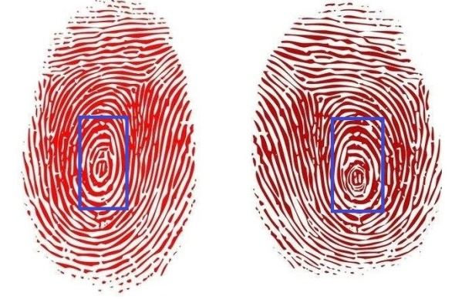
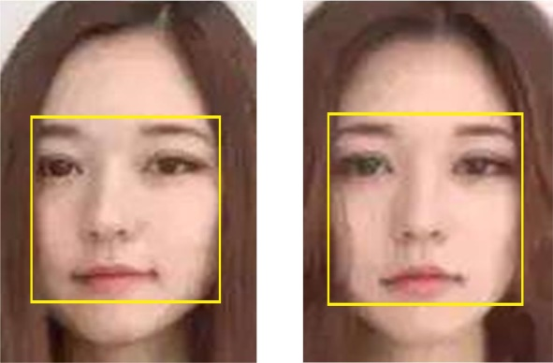
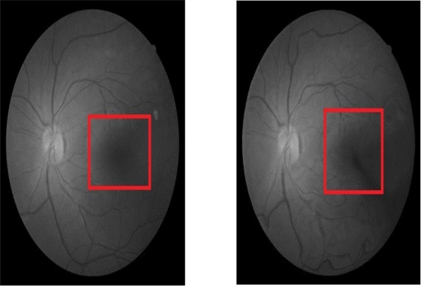
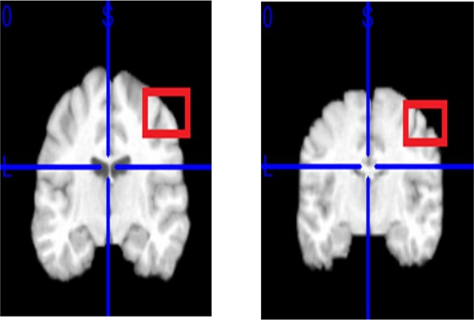
Deformation in Images is Common
Due to the influence of various environmental factors, such as force, direction, skin surface condition and acquisition instrument, the acquired images are often deformed.
Fingerprint Identification
Face Recognition
During the process of fingerprint acquisition, because of different pressing force and angle, even fingerprints of the same person and the same finger can be deformed.
In face recognition system, with the change of facial expression or angle, the collected face images often has obvious deformations.
Biometric System
Medical Diagnosis
Other biological features, such as retina, sweat glands and palmprints, can also deform in different acquisition environment and time.
In the process of medical diagnosis, images collected from organs and tissues before and after the occurrence of lesions often have obvious deformations.

Slide 3
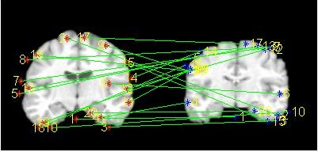
Challenges for Deformable Image Registration
Many various methods have been proposed in this field, which include traditional methods, supervised learning-based methods and unsupervised learning-based methods.
Learning-based Methods
It has strong feature extraction ability and can be applied to many types of images. The supervised learning-based based methods usually need the ground truth labels, which are usually difficult to obtain.
Traditional Methods
Usually rely on hand-engineered features, they may achieve good results for some specific types of images, but can not be general enough to be suitable for all types of images.

Slide 4
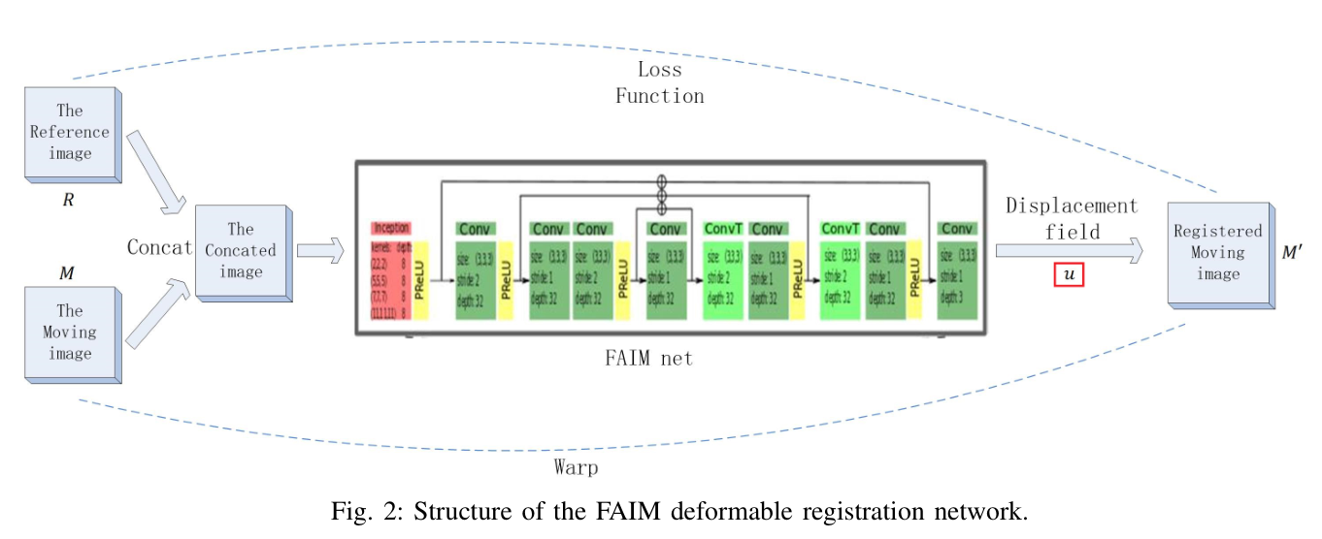
Challenges for Deformable Image Registration
Many various methods have been proposed in this field, which include traditional methods, supervised learning-based methods and unsupervised learning-based methods.
Unsupervised learning-based methods:
A similarity metric is used as the loss function for optimization, and ground truth labels are not needed
Calculate deformation field based on the extracted features by convolution layers.

Slide 5
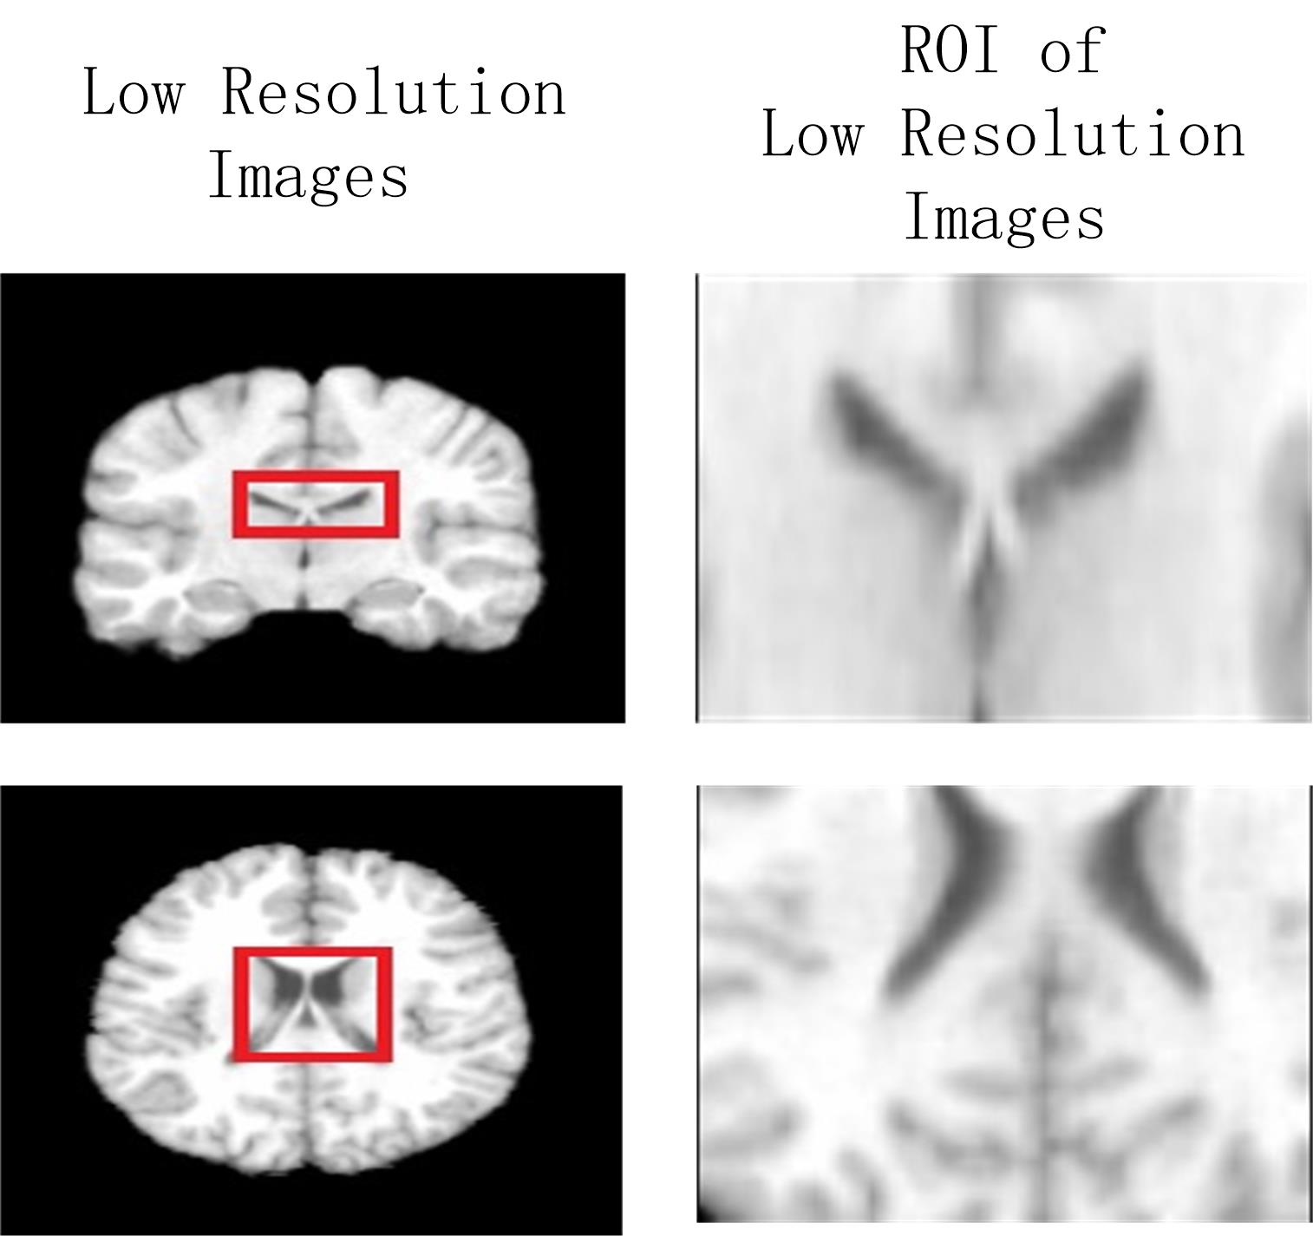
Challenges for Deformable Image Registration
Most of deformable registration methods are under the assumption that the image resolution is high enough.
Challenges of deformable registration methods :
Due to the limited level of acquisition instruments, the resolution of images is often low, especially for medical image applications
It is difficult to register low resolution images due to lack of sufficient features

Slide 6
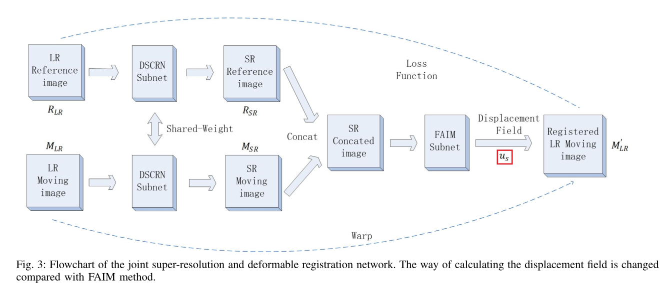
Motivations
A new joint super-resolution and deformable registration network is proposed.
Contributions:
1.Comparison of traditional and deep learning based deformable registration methods.
2. A new joint super-resolution and deformable registration network to aid the registration of low resolution
images.

Slide 7
Super-Resolution
Super-resolution (SR) typically describes the process of reconstructing high-quality images from images of lower resolutions. It permits acquisition of low resolution (LR) images in order to produce high resolution (HR) images..
The Relation between LR images Y and ground truth HR images X：
Reconstruction error of the SR process:
r: the reconstruction error

Slide 8
Super-Resolution
Super-resolution (SR) typically describes the process of reconstructing high-quality images from images of lower resolutions. It permits acquisition of low resolution (LR) images in order to produce high resolution (HR) images..
MSE between the SR output image and the ground truth HR image is used as loss function：
h, w, d: height, width and depth of the images respectively

Slide 9
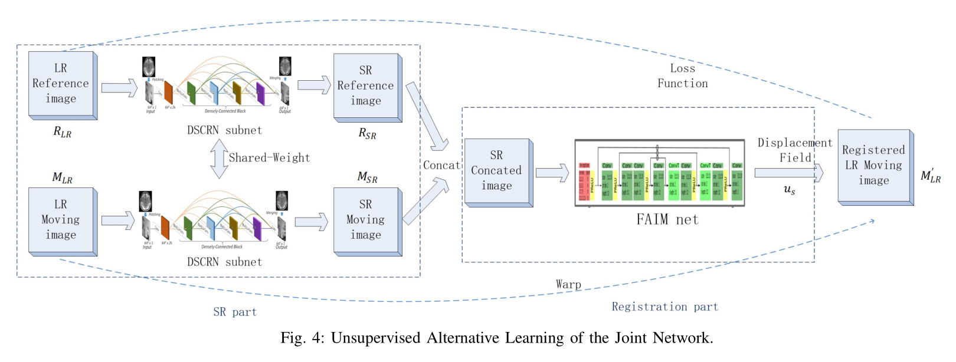
Flowchart of the Proposed Method
First, the low resolution image $M_{LR}$ and $R_{LR}$ are separately fed into the SR subnetworks. After the process of super-resolution, we get the corresponding super-resolution image $M_{SR}$ and $R_{SR}$. Then, the output super-resolution images are stacked together as input of the FAIM subnetwork. In this way, we calculate the displacement field $u_{s}$ based on super-resolution images ($M_{SR}$ and $R_{SR}$) instead of original low resolution images ($M_{LR}$ and $R_{LR}$). Finally, according to the displacement field $u_{s}$, the original low resolution moving image $M_{LR}$ is warped to get the registered image $M_{LR}^{′}$.
loss function:
CC: Cross correlation

Slide 10
Displacement Field
The proposed method changes the way of calculating the displacement field u.
Displacement field $u_{s}$ in the proposed method is calculated based on super-resolution images ($M_{SR}$ and $R_{SR}$) instead of original low resolution images ($M_{LR}$ and $R_{LR}$)：
Loss function of the proposed method：
By producing the displacement field based on the super-resolution images $M_{SR}$ and $R_{SR}$, the obtained displacement field $u_{s}$ can be more accurate than the displacement field u calculated based on original low resolution images $M_{LR}$ and $R_{LR}$Loss terms of the CNN branch .

Slide 11
Experiment Results
3D T1-weight MRI images from 40 young adults ，which are split into 64×64×64 patches as input of the framework.
Comparison among deformable registration results
Dice scores and MSE metrics are averaged with all the subjects
Evaluation | Dice score | MSE score
No registration | 0.585 | 0.488
3D Demons | 0.633 | 0.454
DCSRN + 3D Demons | 0.648 | 0.417
FAIM | 0.634 | 0.456
The Proposed Method | 0.664 | 0.409

Slide 12
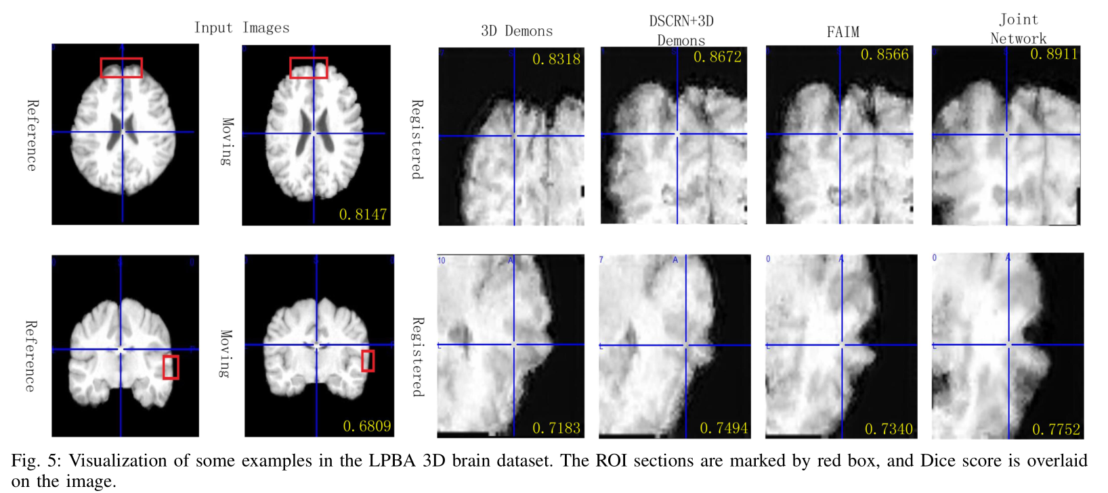
Experiment Results
3D T1-weight MRI images from 40 young adults ，which are split into 64×64×64 patches as input of the framework.

Slide 13
THANK YOU FOR LISTENING
Speaker：Sheng Lan

