Slide 1


































Object Detection by Integrating Scene-Level
Semantic Information and Border Regression
Reinforcement
Yu Quan, Zhixin Li, Canlong Zhang, Huifang Ma
Guangxi Normal University
Notes:
Ladies and gentlemen. we are glad to be here to join this forum. The topic of our presentation is Object Detection by Integrating Scene-Level Semantic Information and Border Regression Reinforcement. This work was presided over and completed by Quan. Yu et al. And supported by Guangxi Key Lab of Multi-source Information Mining & Security, Guangxi Normal University.
1

Slide 2
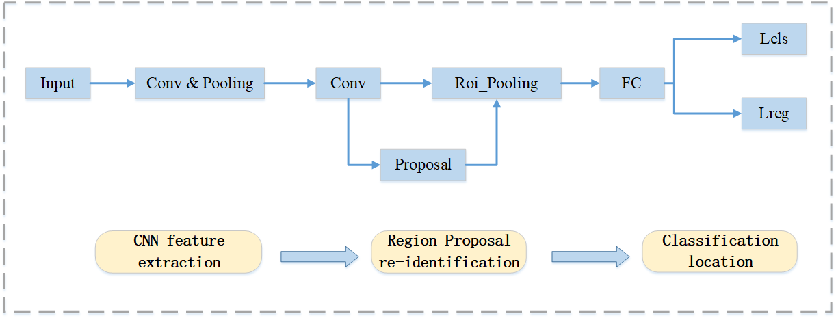
Related Work
Object Detection
Generating candidate regions
Re-identify the parts
Detecting
Notes:
Through reading large numbers of literature, we summarized that the current Object Detection work is mainly aimed at improving in three aspects: Generating candidate regions, Re-identify the parts, Object detecting.

Slide 3
CONTENTS
1
Research Highlights
2
Proposed Model
3
Experiments
4
Conclusions
Notes:
Today, our presentation will include these four parts:
Research Highlights: show the innovation of our current work compared with traditional work.
Proposed Model: shows the details of our innovation points.
The experimental results prove the effectiveness of our proposed Model.
Finally, we summarize this work.

Slide 4
［ ］
01
Research Highlights

Slide 5
Research Highlights
Backbone Network
04
01
  We propose a deep separable convolution network
  (Depth-wise Separable Convolution Network,
  D_SCNet -127 R-CNN).
Datasets
Backbone
Network
The Region Proposal Re-identification Part
  We build the scene-level region proposal
  self-attention module.
  The three branches are as follows:
SSM: Semantic Segmentation Module
RPN: Region Proposal Network Module
RPAM: Region Proposal Self-attention Module
03
02
The Bounding Box
Regression Network
Module
The Region Proposal
Re-identification Part
The Bounding Box Regression Network Module
We propose a border regression network module for joint deep reinforcement learning.
Notes:
As we mentioned before, The existing Object Detection work is mainly aimed at improving in three aspects. For the backbone network, We propose a deep separable convolution network named D_SCNet-127 R-CNN. For the region proposal re-identification part, we build the scene-level region proposal self-attention module. The module consists of three parts: First, the semantic segmentation module. Second, the region proposal network module. Finally, the region proposal self-attention module. Furthermore, for the bounding box regression network module, we propose a border regression network module for joint deep reinforcement learning.

Slide 6
［ ］
02
Proposed Model
Notes:
Now, let us elaborate on the details of these highlights.

Slide 7
Proposed Model – D_SCNet-127 Module
Contribution point
• Backbone network
• Region Proposal re-recognition
• Regression processing
  Fig 1. D_SCNet-127 R-CNN Model
Notes:
Figure 1 is the architecture of D_SCNet-127 R-CNN model.

Slide 8
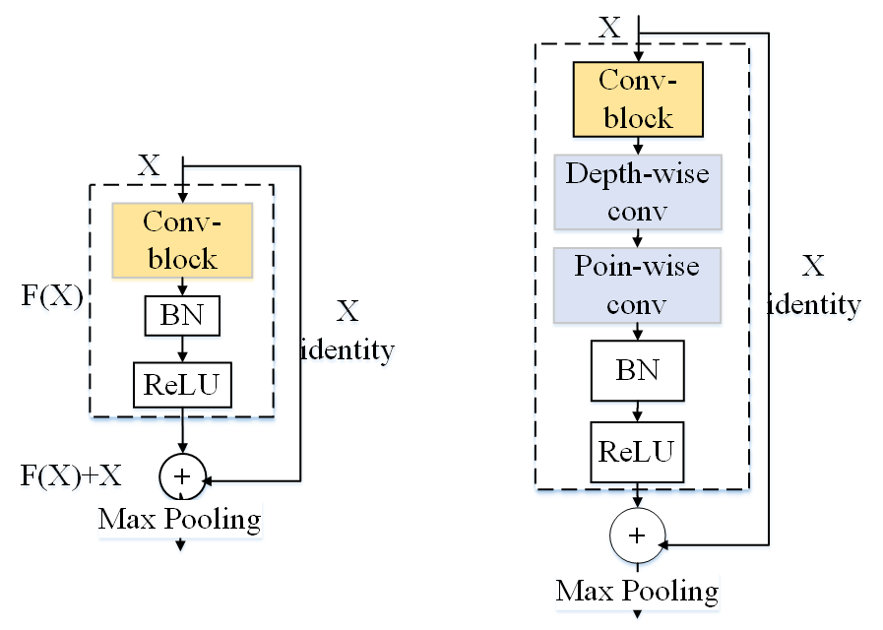
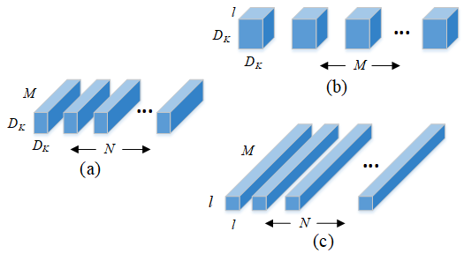
Proposed Model – D_SCNet-127 Module
Fig.2 Separable convolutional network unit.
Standard convolutional layer filter,
Deep convolution of depthseparable convolution filter, and
1 × 1 convolution.
Fig.3 D SCNet-127 R-CNN network module.
Notes:
In order to reduce the time complexity of the model, we repeat the convolutional block by separable convolutional network unit as shown in Figure. 2, (a) is a standard convolutional layer filter, and (b) and (c) is a depth convolution and a 1 × 1 convolution of a depth separable convolution filter, respectively.
In order to achieve an accurate and fast multi-scale, multi-category image object detection behavior and obtain the accurate location information and category information of the object from the input image, the network model is reconstructed based on the process of region proposal. Figure. 3 shows the structure of the backbone network based on the depth separable convolution.

Slide 9
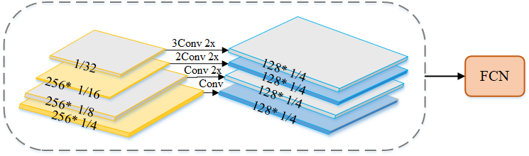
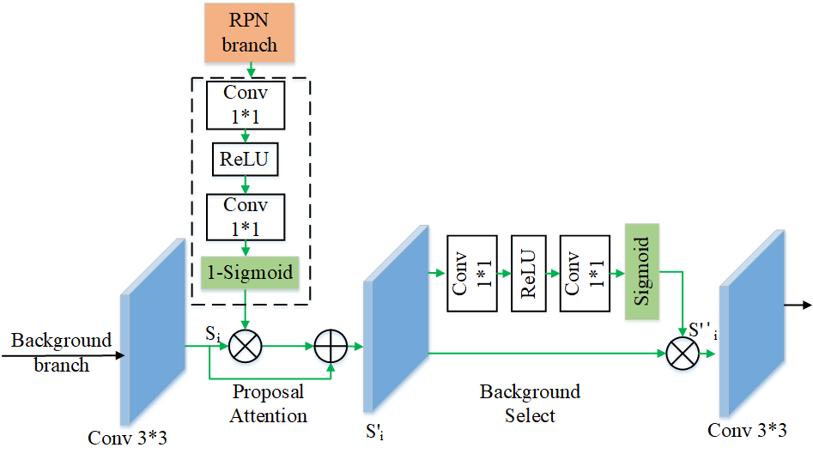
Proposed Model – Scene-Level Region Proposal Self-Attention Module
  SSM Branch
  Obtain stronger semantic features.
  Improve the performance of object detection.
  all levels of information from the FPN are combined into a single output to achieve high-density prediction
Fig.4 SSM branch structure module.
  RPAM branch
introduce a self-attention mechanism
we try to complement foreground information and background information and this self-attention module combines useful information from the RPN branch.
This makes the detection task focus more on the local object to promote the accuracy of background semantics.
Fig.5 RPAM structure module.
Notes:
For the details about Scene-Level Region Proposal Self-Attention Module, we show them in figure 4 and figure 5. The SSM branch can obtain stronger semantic features, Improve the performance of object detection, all levels of information from the FPN are combined into a single output to achieve high-density prediction. The RPAM branch introduces self-attention mechanism. The self-attention module combines useful information from the RPN branch and makes the detection task focus more on the local object to promote the accuracy of background semantics.

Slide 10
Proposed Model – Bounding Box Regression Network Module
The DQN network autonomously generates actions a (9 searches, 1 action termination) for 9 search region proposal based on the existing states in the experience pool, and determines the search by performing the reward r obtained after performing the action a in the state s route of.
When the DQN network terminates the search, the information is fed back to the experience pool, and the ROI regression network obtains the current area coordinate b and the real area coordinate according to the state s in the current experience pool, and then performs border regression on the candidate area to output the final detection the result of.
Complete a process, state s and transition to the next state s'continue to work.
Fig. 6. Framework of regression network based on reinforcement learning.
Notes:
For the details about Bounding Box Regression Network Module, We show it in figure 6. The DQN network autonomously generates actions a (9 searches, 1 action termination) for 9 search region proposal based on the existing states in the experience pool and determines the search by performing the reward r obtained after performing the action a in the state s route of.

Slide 11
［ ］
03
Experiments
Notes:
In order to prove the effectiveness of our proposed method, we conducted a fair experiment. Next, we will introduce our experimental settings.

Slide 12
Experiments-Datasets
Experimental evaluation index
This paper mainly uses the ResNet-50 network as the reference network and evaluates the proposed method from local to global on MSCOCO17, VOC12, and Cityscapes datasets.
Here, the MSCOCO dataset selects the standard COCO dataset indicators to evaluate the experiment, including average precision (AP) and average recall (AR).
Datasets description
MSCOCO dataset : including 80K images in the training set and 40K images in the test set and the verification set.
In this paper, the 40K verification set is divided into 35K and 5K datasets.
Then, the 80K training set and 35K verification set are combined to obtain a 115K training set and 5K small verification set.
Cityscapes dataset: has 5K high-resolution images (1024 2048 pixels) with accurate pixel annotation:
2975 columns, 500 Val, 1525 test.
In addition, there are 20K images with coarse annotation, which we did not use in the experiment.
Notes:
We mainly use the ResNet-50 network as the feature extractor network and evaluates the proposed method from local to global on MSCOCO17, VOC12, and Cityscapes datasets.
Here, the MSCOCO dataset selects the standard COCO dataset indicators to evaluate the experiment, including average precision (AP) and average recall (AR).

Slide 13
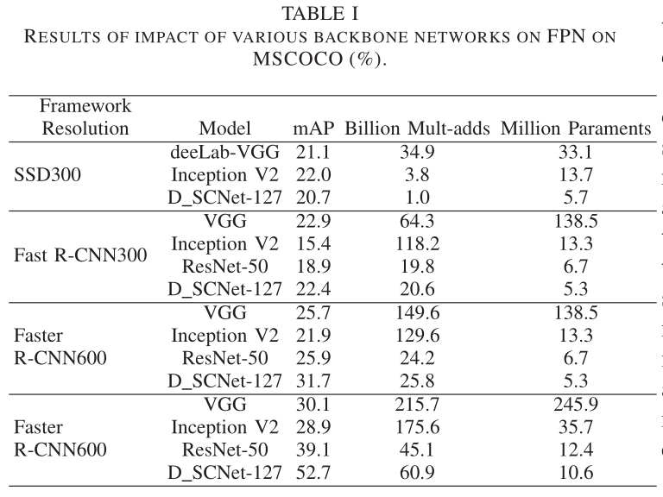
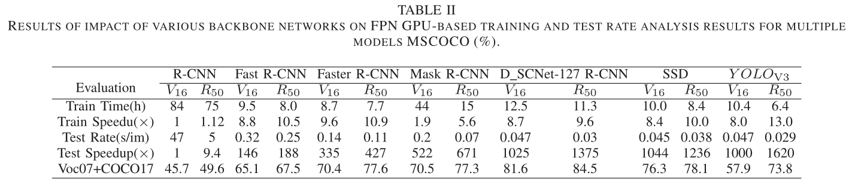
Experiments-Results
Notes:
From the table, we can see that our methods are superior to other baseline methods.

Slide 14
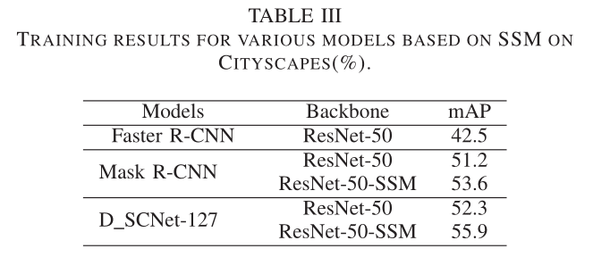
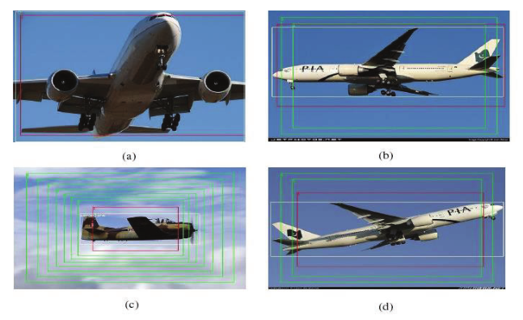
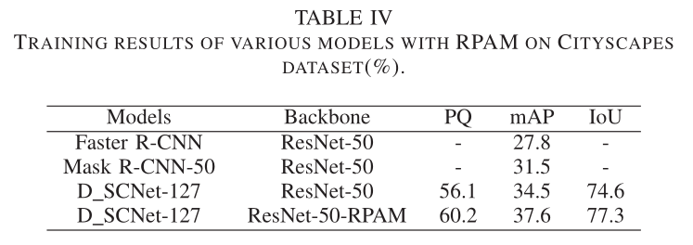
Experiments-Abalation Study
  SSM Branch
Bounding Box Regression Module
  RPAM Branch
Notes:
Next is our ablation experiment.

Slide 15
［ ］
04
Conclusions
Notes:
okay, here is our summary.

Slide 16
Conclusions
Deep separable convolutional network module.
Scene-level region proposal self-attention module.
Bounding box regression enhanced network module.
——Reduce the complexity of network parameters, obtain stronger semantic information, and achieve accurate object positioning.
Notes:
We have made innovations and improvements in three directions that can be improved in objection detection.First, we propose a Deep separable convolutional network module.Secondly, we propose a scene-level region proposal self-attention module.Finally, we deploy the DQN network in Bounding box regression enhanced network.By improving all of the above, we Reduce the complexity of network parameters, obtain stronger semantic information, and achieve accurate object positioning.

Slide 17
PPT模板下载：www.1ppt.com/moban/ 行业PPT模板：www.1ppt.com/hangye/
节日PPT模板：www.1ppt.com/jieri/ PPT素材下载：www.1ppt.com/sucai/
PPT背景图片：www.1ppt.com/beijing/ PPT图表下载：www.1ppt.com/tubiao/
优秀PPT下载：www.1ppt.com/xiazai/ PPT教程： www.1ppt.com/powerpoint/
Word教程： www.1ppt.com/word/ Excel教程：www.1ppt.com/excel/
资料下载：www.1ppt.com/ziliao/ PPT课件下载：www.1ppt.com/kejian/
范文下载：www.1ppt.com/fanwen/ 试卷下载：www.1ppt.com/shiti/
教案下载：www.1ppt.com/jiaoan/ PPT论坛：www.1ppt.cn
Thanks for listening ！
Notes:
If you have any questions and suggestions, please contact us
17

