Slide 1
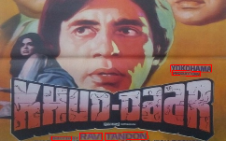
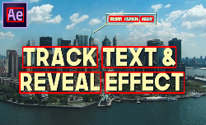
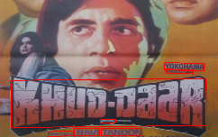
Paper ID-475: Local Gradient Difference Features for Classification of 2D-3D Natural Scene Text Images Lokesh NANDANWAR, Palaiahnakote Shivakumara, Ramachandra Raghavendra, Tong Lu, Umapada Pal and Daniel Lopresti and Nor Badrul Anuar
Motivation: Text detection performance before and after classification of 2D and 3D images
(a) Text detection by existing PSENet method in 2D and 3D text images before classification.
(b) Text detection by PSENet method in 2D and 3D text images after classification.

Slide 2
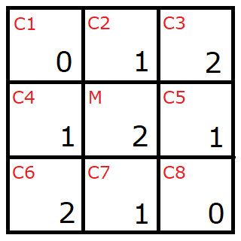
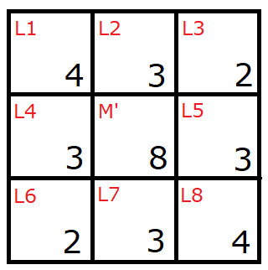
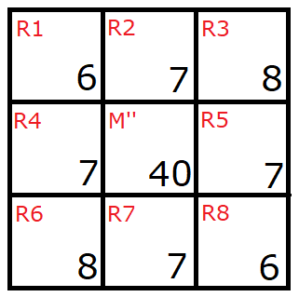

The Proposed Method
Local Gradient Difference for Candidate Pixel Detection
Gradient Window LGD Window LGR Window
$$LGD\left(M\right)=M^{′}= \left|M− C1\right|+ \left|M− C2\right|+ \left|M− C3\right|+ \left|M− C4\right|+ \left|M− C5\right|+ |M− C6| + |M− C7|+ |M− C8| = 8$$
$$LGR\left(M^{′}\right)=M^{′′}= \left|M′− L1\right|+\left|M′− L2\right| + \left|M′− L3\right|+ \left|M′− L4\right| + \left|M′− L5\right|+ \left|M′− L6\right| + \left|M′− L7\right|+ \left|M′− L8\right| = 40$$
Illustration for LGD and LGR for 3×3 Gradient window

Slide 3
The Proposed Method
Local Gradient Difference for Candidate Pixel Detection
(a) Absolute of gradient images for 2D and 3D text images
(b) Dominant pixels detection by the Max–Min clustering
(c) Local Gradient Difference (LGD) images for 2D and 3D images

Slide 4
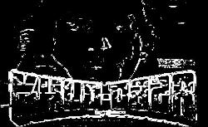
The Proposed Method
Local Gradient Difference for Candidate Pixel Detection
(d) Local Gradient Resultant (LGR) images for 2D and 3D images
(e) Max cluster results given by K-means clustering on LGR images. Candidate pixels detection based on local gradient difference.

Slide 5
The Proposed Method
COLD for Extracting Spatial Proximiy of Candidate Pixels
$$θ= \tan^{−1}\left(\frac{y_{i+1}− y_{i}}{x_{i+1}− x_{i}}\right)$$
$r= abs\left(\sqrt{{\left(y_{i+1}− y_{i}\right)}^{2}+ {\left(x_{i+1}− x_{i}\right)}^{2}}\right)$
Here $\left(x_{i},y_{i}\right)$and $\left(x_{i+1},y_{i+1}\right)$ denote the coordinates of a pair pixels. When we draw points for all the pairs in polar domain ($θ,r$ ) it results in a distribution.

Slide 6
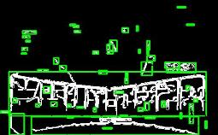
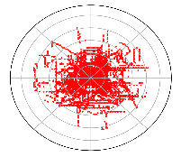
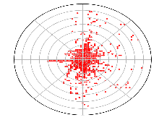
The Proposed Method
COLD for Extracting Spatial Proximiy of Candidate Pixels
(a) Connected component labeling for candidate pixels images
(b) Traversing in 360 directions to find stroke pixels for each connected component. Yellow color denotes direction and red pixel denote stroke pixels.
(c) Stroke pixels for the 2D and 3D images
(d) Cold distribution for the stroke pixels of 2D and 3D images.
Studying spatial distribution of stroke pixels through COLD.

Slide 7
The Proposed Method
Mass Features Extracted from COLD for Classification
The radius is mean distance of stroke pixel pair
mass($x_{a}$) for a ring $a{, where x}_{a}∈$ {$x_{1}$, $x_{2}$, . . . , $x_{n−1}$, $x_{n}$} is defined as a summation of a series of mass base weighted by p(a) over n rings.
Here {$x_{1}$, $x_{2}$, . . . , $x_{n−1}$, $x_{n}$} is the number of pixels in rings from range$\left(1, n\right)$, where $n$is equal to 8.
The mass is defined as follows:
$mass\left(x_{a}\right)=\sum_{k=1}^{a−1}{(n−a)×p\left(a\right)}+\sum_{k=a}^{n}{a×p\left(a\right), a∈\left(1,n\right)}$
Where $p(a)$ is the probability of number of pixels in ring $a$
$p\left(a\right)=\frac{x_{a}}{\sum_{i=1}^{n}{x_{i}}} a∈\left(1,n\right)$
Finally, we combine all mass features for all rings $a \{a∈(1,n)$} to obtain the feature vector for the input image.
This process results in the feature vector containing 8 features. The features are fed to NN for classification.

Slide 8
Experimental Results
Table: Details of different datasets for evaluation
Datasets | Type | 2D | 3D | Total
Our dataset | Image | 400 | 400 | 800
Standard Natural Scene | Image | 130 | 126 | 256
Our | Line | 513 | 505 | 1018
IIIT5k | Line | 317 | 305 | 632
COCO-Text | Line | 472 | 530 | 992
ICDAR 2013 | Line | 123 | 74 | 197
ICDAR 2015 | Line | 111 | 90 | 201
Zhong et al. | Line | 200 | 216 | 416
Ali et al. | Non-Text Images | 250 | 250 | 500

Slide 9
Experimental Results
Ablation Study
Table: Confusion matrix and average classification rate for the key steps of the proposed method on our dataset at image level(in %).
Classes | Proposed without LGD |  | Proposed without COLD |  | Proposed with density |  | Proposed Method
 | 2D | 3D | 2D | 3D | 2D | 3D | 2D | 3D
2D | 61.25 | 38.75 | 76.25 | 23.75 | 77.5 | 22.5 | 85.0 | 15.0
3D | 47.5 | 52.5 | 41.25 | 58.75 | 27.5 | 72.5 | 21.25 | 78.75
Average | 56.875 |  | 67.5 |  | 75.0 |  | 81.875

Slide 10
Experimental Results
Evaluating the Proposed Classification
Table: Classification at image level, text line level and comparative study with the existing methods in (%)
Dataset | Our dataset-image level |  |  |  |  |  | Standard dataset-image level
Methods | Zhong et al. |  | Xu et al. |  | Proposed |  | Zhong et al. |  | Xu et al. |  | Proposed
Classes | 2D | 3D | 2D | 3D | 2D | 3D | 2D | 3D | 2D | 3D | 2D | 3D
2D | 76.5 | 23.5 | 58.7 | 41.3 | 83.0 | 17.0 | 52.0 | 48.0 | 56.4 | 33.6 | 78.4 | 21.6
3D | 41.5 | 58.5 | 31.9 | 68.1 | 22.0 | 78.0 | 42.4 | 57.6 | 39.2 | 60.8 | 26.5 | 72.5
Average | 67.5 |  | 63.4 |  | 80.5 |  | 54.8 |  | 58.6 |  | 75.45
Dataset | Our dataset –Text line level |  |  |  |  |  | Standard dataset-Text line level
Methods | Zhong et al. |  | Xu et al. |  | Proposed |  | Zhong et al. |  | Xu et al. |  | Proposed
Classes | 2D | 3D | 2D | 3D | 2D | 3D | 2D | 3D | 2D | 3D | 2D | 3D
2D | 32.7 | 67.2 | 66.2 | 33.7 | 91.1 | 8.9 | 53.8 | 46.1 | 46.6 | 53.4 | 87.7 | 12.3
3D | 46.3 | 53.6 | 28.3 | 71.6 | 11.2 | 88.8 | 32.8 | 67.2 | 31.2 | 68.8 | 16.5 | 83.5
Average | 43.2 |  | 70.48 |  | 89.95 |  | 60.53 |  | 57.7 |  | 85.6
Dataset | Zhong et al dataset |  |  |  |  |  | Ali et al., Non-Text Image dataset
Methods | Zhong et al. |  | Xu et al. |  | Proposed |  | Proposed Method
Classes | 2D | 3D | 2D | 3D | 2D | 3D | 2D | 3D
2D | 67.0 | 23.0 | 74.8 | 25.2 | 92.9 | 7.1 | 82.0 | 18.0
3D | 28.4 | 65.6 | 26.0 | 64.0 | 12.8 | 87.2 | 24.0 | 76.0
Average | 66.3 |  | 69.4 |  | 90.05 |  | 78.0

Slide 11
Experimental Results
Validating the Proposed Classification
Table: Text detection performance in terms of F-measure of different methods for our and standard full dataset at image level before and after classification. BC denotes before classification and AC denotes after classification.
Table: Text recognition performance in terms of character recognition rate of different methods for our and standard dataset at line levels before and after classification. BC denotes before classification and AC denotes after classification.
Methods | Our Dataset-image level |  |  |  | Standard dataset-image level
 | BC | AC |  |  | BC | AC
 | 2D + 3D | 2D | 3D | Avg | 2D + 3D | 2D | 3D | Avg
PSEnet | 67.9 | 73.3 | 66.9 | 70.1 | 73.3 | 88.6 | 64.0 | 76.3
FOTS | 59.2 | 70.3 | 56.9 | 63.6 | 64.3 | 75.1 | 60.5 | 67.8
DB | 60.5 | 68.2 | 59.1 | 63.6 | 66.6 | 80.8 | 61.4 | 71.1
Methods | Our Dataset-Text line level |  |  |  | Standard dataset-Text line level
 | BC | AC |  |  | BC | AC
 | 2D + 3D | 2D | 3D | Avg | 2D + 3D | 2D | 3D | Avg
ASTER | 79.0 | 97.0 | 85.7 | 91.3 | 88.5 | 96.1 | 85.4 | 90.7
MORAN | 87.2 | 94.1 | 87.6 | 90.8 | 89.7 | 96.0 | 86.4 | 91.2

Slide 12
Conclusion and Future Work
We have proposed a new method for the classification of 2D and 3D text in natural scene images.
The proposed method employs a local gradient difference for detecting candidate pixels from input images.
The COLD approach used for representing the spatial relationship between candidate pixels in 2D and 3D images.
The proposed method estimates mass for extracting such observations from each ring over the COLD distribution.
The extracted mass features are fed to a Neural Network classifier for the classification of 2D and 3D images.
Experiments on classification, text detection and recognition show that the proposed classification method is effective and useful.
However, the reported results are still low. Our next target is to investigate new features for improving the proposed method classification.

Slide 13
Thank you for your patience
Questions and Suggestions

