Slide 1
Variational Deep Embedding Clustering by Augmented Mutual Information Maximization
Qiang Ji¹, Yanfeng Sun¹, Yongli Hu¹, Baocai Yin²
¹Faculty of Information Technology, Beijing University of Technology, Beijing, China
²Faculty of Electronic Information and Electrical Engineering, Dalian University of Technology, Dalian, China

Slide 2
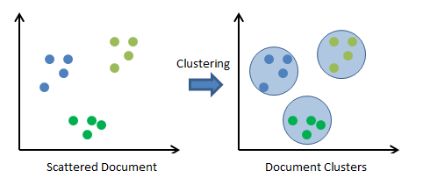
Introduction
What is Clustering?
Unsupervised learning method to classify unlabeled data into different groups
Why Clustering?
Performing the determination of the intrinsic grouping among the unlabeled dataset.
Notes:
Clustering is an important technique as it Performs the determination of the intrinsic grouping among the unlabeled dataset.

Slide 3
Introduction
Traditional clustering methods
Popular algorithms: K-means, Dbscan, GMM and Spectral clustering
Limitations
Distance metrics become unreliable for high dimensional data.
Scalability issue with large datasets.
Notes:
Clustering is an important technique as it Performs the determination of the intrinsic grouping among the unlabeled dataset.

Slide 4
Introduction
Deep clustering
Use Neural Networks to learn representations from raw data suitable for clustering.
Three essential components: neural network, network loss, and clustering loss.
Challenges
Lack of supervision signal in clustering
Degenerate solutions
Notes:
Clustering is an important technique as it Performs the determination of the intrinsic grouping among the unlabeled dataset.

Slide 5
Related Work
Existing deep clustering models can be categorised into three groups
Autoencoder based
Fine-tune the encoder latent space to make representations clustering friendly
Popular algorithms: DEC, DBC, DCN, DEPICT
Generative Model based
Extend the clustering task to generating samples from clusters
Popular algorithms: VAE, InfoGAN, ClusterGAN
Direct Optimization under Clustering Loss
Fine-tune the encoder latent space to make representations clustering friendly
Popular algorithms: JULE, DAC, IMSAT, IIC
Notes:
Clustering is an important technique as it Performs the determination of the intrinsic grouping among the unlabeled dataset.

Slide 6
Related Work
Challenges with existing models
Autoencoder based
The symmetry of the encoder-decoder architecture limits the depth of the encoder for computational feasibility.
Generative Model based
Mode collapse and slow convergence.
Direct Optimization under Clustering Loss
High risk of learning a corrupted latent space
Notes:
Clustering is an important technique as it Performs the determination of the intrinsic grouping among the unlabeled dataset.

Slide 7
VCAMI: Motivation
A good deep clustering model should have three elements
Scalability of network capacity
Robustness of loss function
Smoothness of latent space.
Notes:
Clustering is an important technique as it Performs the determination of the intrinsic grouping among the unlabeled dataset.

Slide 8
VCAMI: Scalability
Using mutual information instead of decoder to improve scalability
Maximizing MI is equivalent to maximizing Jensen-Shannon divergence (JSD)
no upper bound
where $σ\left(T\left(x\right)\right)$is a discriminator network.
Notes:
Clustering is an important technique as it Performs the determination of the intrinsic grouping among the unlabeled dataset.

Slide 9
VCAMI: Scalability
DMI
Global MI
Local MI
Notes:
Clustering is an important technique as it Performs the determination of the intrinsic grouping among the unlabeled dataset.

Slide 10
VCAMI: Robustness
Using data augmentation techniques to improve robustness clustering loss
where $x^{′}$ is a randomly perturbed version of the input $x$, $f$ is a neural network and $f(x)$ is the distribution of a discrete random variable $y$ over $K$ category.
Why degenerate solutions are avoided
Balancing reinforcement of predictions with mass equalization
Notes:
Clustering is an important technique as it Performs the determination of the intrinsic grouping among the unlabeled dataset.

Slide 11
VCAMI: Smoothness of latent space
The representation follows the Gaussian mixture distribution to obtain smooth and cluster-friendly latent space.
Notes:
Clustering is an important technique as it Performs the determination of the intrinsic grouping among the unlabeled dataset.

Slide 12
VCAMI: Model Formulation
Scalability of network capacity.
Robustness of loss function.
Smoothness of latent space.
Final model
Notes:
Clustering is an important technique as it Performs the determination of the intrinsic grouping among the unlabeled dataset.

Slide 13
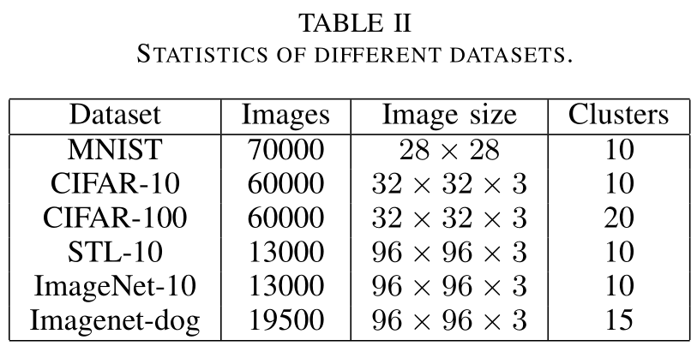
VCAMI: Experiments
Datasets
Notes:
Clustering is an important technique as it Performs the determination of the intrinsic grouping among the unlabeled dataset.

Slide 14
VCAMI: Experiments
Compared methods (13 approaches)
Notes:
Clustering is an important technique as it Performs the determination of the intrinsic grouping among the unlabeled dataset.

Slide 15
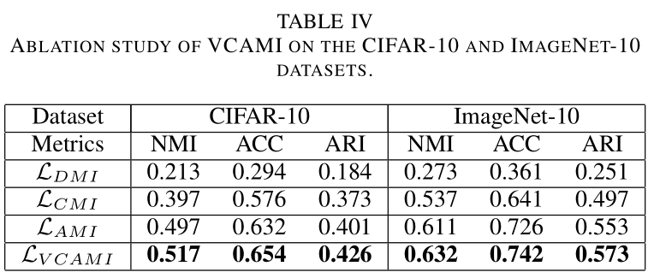
VCAMI: Experiments
Ablation Study
Notes:
Clustering is an important technique as it Performs the determination of the intrinsic grouping among the unlabeled dataset.

Slide 16
Conclusion
We proposed augmented mutual information that combine the mutual information estimation of continuous variables and the accurate calculation of mutual information of discrete variables.
From the perspective of VAE, we prove that minimizing reconstruction loss is equivalent to maximizing the mutual information of the input and its latent representation.
We use variational inference to constrain the representation to have desired statistical characteristics specific to a prior, which are more stable training than adversarial learning.
Notes:
Clustering is an important technique as it Performs the determination of the intrinsic grouping among the unlabeled dataset.

Slide 17
Thanks!

