Slide 1
Moto: Enhancing Embedding with Multiple Joint Factors for Chinese Text Classification

Slide 2
Motivation & Question
Moto
Motivation:
Most existing representation models are specially designed for English materials, which may fail in Chinese
Pinyin, Wubi codes, and radicals are good semantic carriers while previous researches neglected to find an effective way to combine them.
Question:
How to employ the mechanism to capture the effective parts of each granularity
How to combine the different features captured from different representations

Slide 3
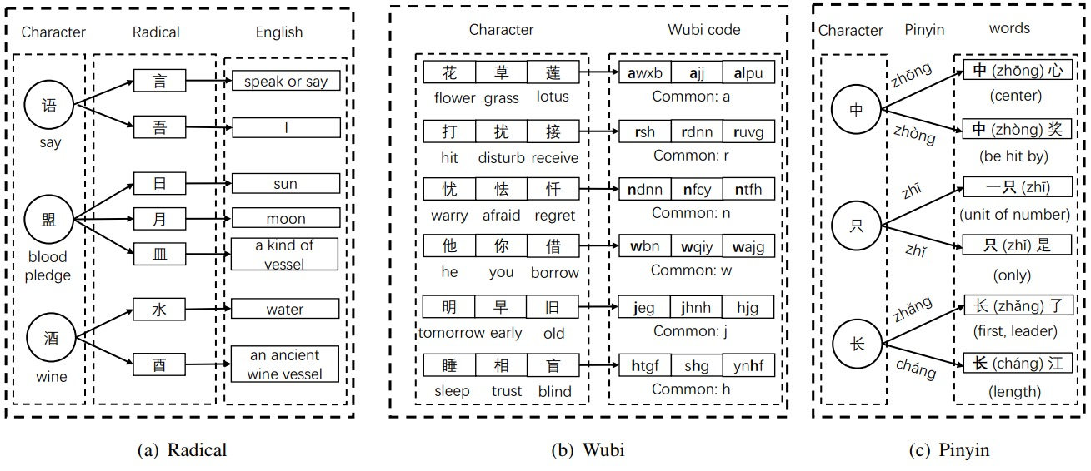
Background
Moto
Notes:
Figure (a) indicates that radicals can show more details of characters;
Figure (b) shows that Wubi code can capture the structure information of characters;
Figure (c) expresses that the Pinyin (with pronounce) is important to Chinese characters

Slide 4
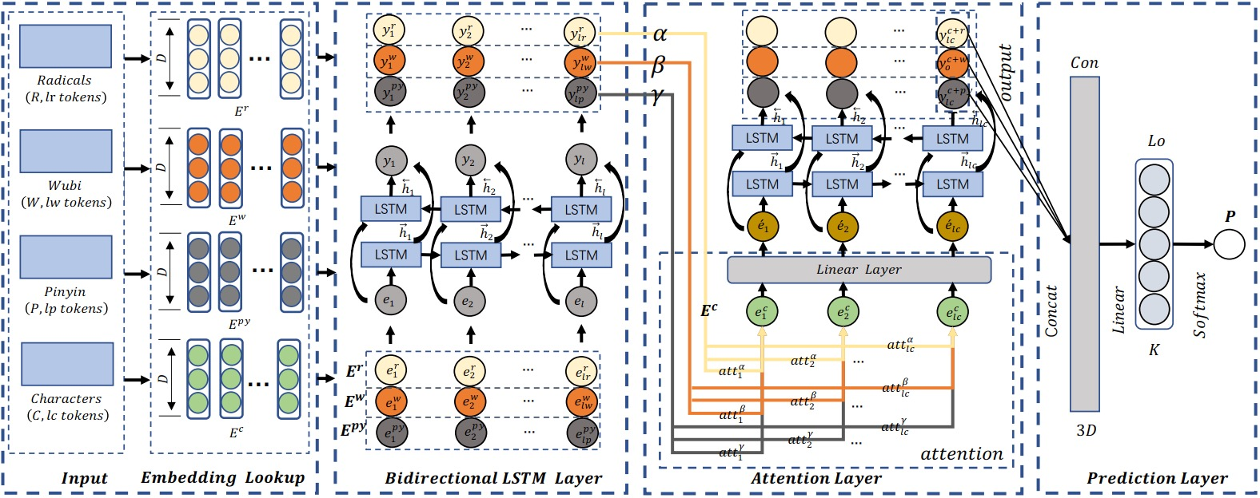
Architecture
Moto
Notes:
Four parts in Moto

Slide 5
Input layer
Moto
Given a Chinese-character sequence $C$ which contains $lc$ characters, i.e., $C=\left\{c_{1},c_{2},…,c_{lc}\right\}$
$C$ can be mapped into the other three sequences via $Open Chinese dictionary, Wubi Library, and Pypinyin Library$,
and then, we can get:
$R=\left\{r_{1},r_{2},…,r_{lr}\right\}$, $W=\left\{w_{1},w_{2},…,w_{lw}\right\}, and Py=\left\{{pyr}_{1},{py}_{2},…,{py}_{lp}\right\}$
Therefore, embedding of $C$, $R$, $W$ and $Py$ can be described as :
$E^{c}∈R^{lc∗D}$, $E^{r}∈R^{lr∗D}$, $E^{w}∈R^{lw∗D},E^{py}∈R^{lp∗D}$ via Gensim (word2vec tool)

Slide 6
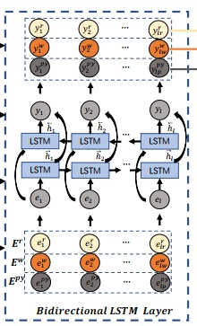
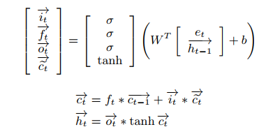
Bidirectional LSTM Layer
Moto
Given a specific feature embedding sequence $E=\{e_{1},e_{2},…,e_{n}\}$, the whole progress in the forward LSTM is calculated as follows:
where $W=W_{i}⊕$ $W_{f}⊕ W_{o}$ $⊕W_{\tilde{c}}$
and $b=b_{i}⊕$ $b_{f}⊕ b_{o}$ $⊕b_{\tilde{c}}$
Outputs of BiLSTM
$$Y^{r}=\left\{y_{1}^{r},y_{2}^{r},…,y_{lr}^{r}\right\}$$
$$Y^{w}=\{y_{1}^{w},y_{2}^{w},…,y_{lw}^{w}\}$$
$$Y^{py}=\{y_{1}^{py},y_{2}^{py},…,y_{lp}^{py}\}$$

Slide 7
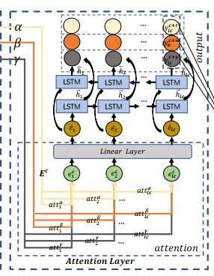
Attention Layer
Moto
Notes:
We utilize the attention mechanism to calculate the weight of different element $y_{i}^{r}∈Y^{r}$ at the $j$-$th$ ${BiLSTM}^{c} cell$, which is described as ${re}_{i,j}$ and $α_{i,j}$represents the weight rate of $y_{i}^{r}$ in $Y^{r}$
Then, we can get an overall attention result by the multiplying operation and sum them. Furthermore, we employ a Linear layer on the concatenation of ${att}_{j}^{α}$ and $e_{j+1}^{c}$. Finally, it outputs a sequence $Y_{lc}^{c+r}$

Slide 8
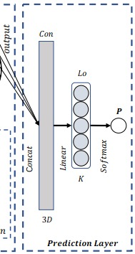
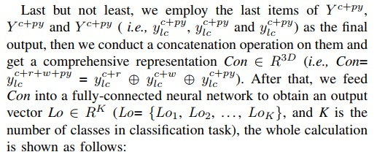
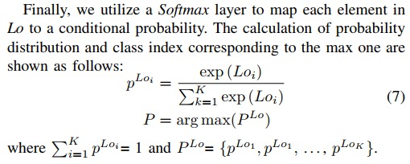
Prediction Layer
Moto

Slide 9
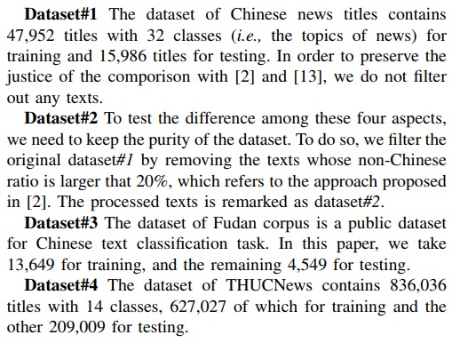
Datasets
Moto
Chinese news titles(#1, #2), Fudan corpus, and THUCNews

Slide 10
Results
Moto

Slide 11
Conclusion
Moto
The order of importance in semantic of Chinese is that $Moto\left(C\right)>Moto\left(Py\right)>Moto\left(R\right)>Moto(W)$
Our method Moto is 3.02% higher the second method $C−BiLSTM(C+R+W+Py)$ in average $F_{1}$-value in four datasets. Specifically, Moto improve the $F_{1}$-value of four datasets: 1.28%, 2.11%, 1.24%, and 3.26%. In addition, our Moto achieves the SOTA in precision (1.89% average improvement)

Slide 12
Thank you

