Slide 1
CKG: Dynamic Representation Based on Context and Knowledge Graph

Slide 2
Motivation & Question
CKG
Motivation:
Current neural language representation models can hardly capture structure-information (ie, similar, opposite), which is composed in global knowledge graph
How to void misunderstanding the true meaning of some polysemous words in a specific context turns to be a problem
Question:
How to extend or find the multi-meanings of a polysemous automatically
Which of the extended meanings should be chosen to represent the central word

Slide 3
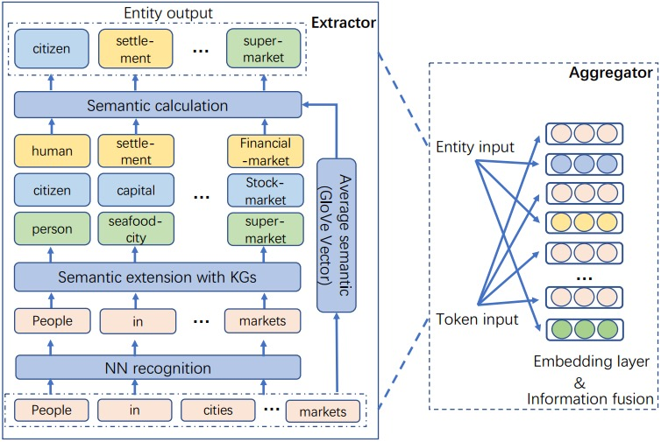
Overview of CKG Model
CKG
CKG consists of two parts:
Exactor:
Responsible for capturing multiple concrete meanings
of some entities they could have
Aggregator:
Utilized to figure out the most possible ones of those
extended meanings in a concrete sentence or context and
fusing the results with central entities in footnote style
origin | People in cities usually buy apples in the local markets.
fused | People (citizen) in cities (settlement) usually buy apples (fruit) in the local markets (supermarket).

Slide 4
Overview of CKG Model
CKG
(1). Exactor:
Input sequence: $\left\{w_{1},{ w}_{2},…,w_{n}\right\}$
where $n:the length of input sequence$ and $w_{n}=Glove(w_{n})$
Entity and its extensions: {$e_{1},e_{2},…,e_{n}\} \{e_{m,1},e_{m,2}, e_{m,3}\}$
(2). Aggregator:
Calculate each element in {$e_{m,1},e_{m,2}, e_{m,3}$} of the central entity $w_{m}$ with the average vector of sequence W = $\left\{w_{1},{ w}_{2},…,w_{n}\right\}$ and elect the most similar one, which is described as the following equation
$Aggregator\left(\left\{w_{1},{ w}_{2},…,w_{n}\right\}, \left\{e_{1,1},e_{1,2},…, e_{m,3}\right\}\right)=\{{(w}_{1},e_{1,2}),…,{(w}_{n},e_{n,3})\}$

Slide 5
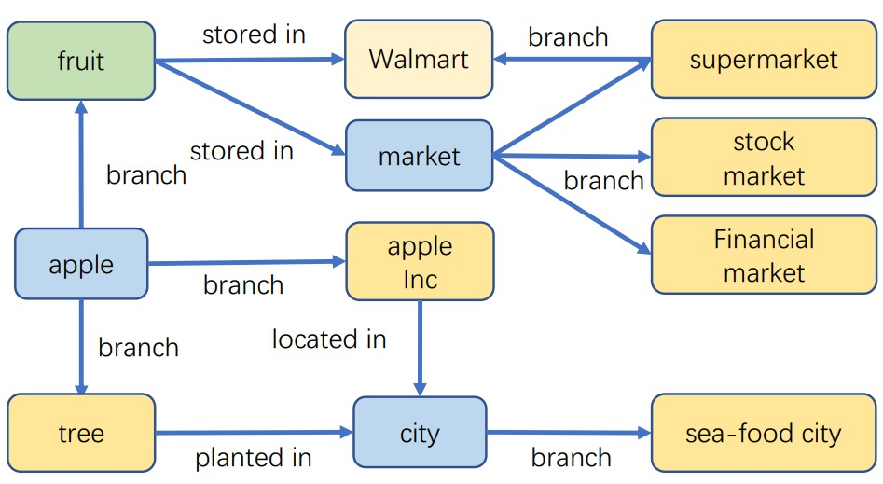
Exactor
CKG
Given an extended route $(e_{m,1}^{r} ,e_{m,2}^{r},e_{m,3}^{r}, …,e_{m,k}^{r})$, where $e_{m,k}^{r}$ represents the $k$-$th$ hop extension in route r of central entity m.
Assumption: $e_{m,k}^{r}⇒e_{m,k−1}^{r}$
Then: $e_{m,1}^{r}$ $⇐$ $e_{m,2}^{r}$ $⇐ …⇐$ $e_{m,k}^{r}$
Then: $e_{m,1}^{r}$ $⇐$ ($e_{m,2}^{r}$, $e_{m,3}^{r}, …,e_{m,k}^{r}$)
Where each former element in the set cover the information of the later ones, which satisfies the Markov property.
Therefore, we can convert the extension problem into a Markov chain, In other words, we only take the first hop extension.
Partial Knowledge Graph from Dbpedia.

Slide 6
Aggregator
CKG
$$V_{avg}= \frac{\sum_{i}{w_{i}}}{len(w_{1},{ w}_{2},…,w_{n})}$$
$$e_{m}→{arg.max}_{k∈\left\{e_{m,1},e_{m,2}, e_{m,3}\right\}}(cos⁡(Glove\left(k\right),V_{avg}))$$
Example: After the calculation, ‘apple’ $→$ ‘fruit’

Slide 7
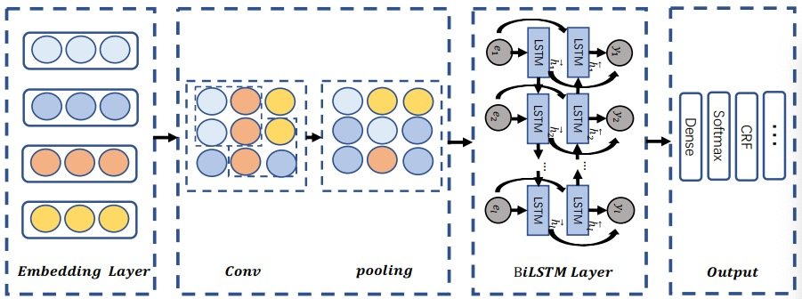
Semantic Feature Extraction for Dimension Reduction
CKG
Semantic feature extraction from input embedding so that we can not only save
the training time, but also avoid vanishing gradient.

Slide 8
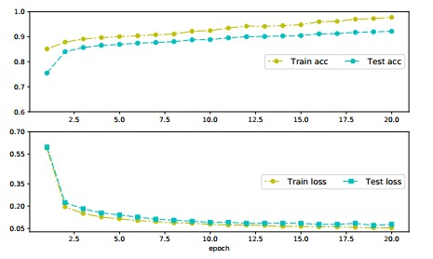
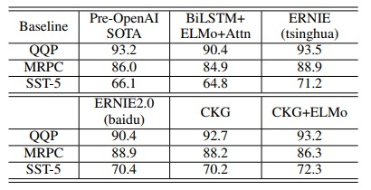
Main benchmarks and comparison
CKG
Benchmarks
Word analogy task
Stanford Question Answering Dataset (SQuAD v1.1)
Quora Question Pairs
Stanford Natural Language Inference (SNLI)
Named Entity Extraction (NER)
Comparison of models in word similarity with rank of sepearman. And the comparison of word analogy in semantic, syntactic, average.
The detailed information on the dataset of SNLI. The upper figure represents the accuracy results of training and test in different epochs, and the lower figure indicates the losses of them
Comparison among CKG+ELMo and other models in QQP, SST-5, and MRPC tasks

Slide 9
Conclusion
CKG
﻿Designed a Extractor responsible for semantic extension of central words by traversing the first hop nodes in global world Knowledge Graph
﻿Presented a Aggregator utilized to figure out the most possible extension of the central word in a concrete context
﻿Implemented 1-CNN algorithm for dimension reduction and semantic feature extraction. And then employed BiLSTM architecture to train a context-dependent representation model

Slide 10
Thank you

