Slide 1




Cross-Lingual Text Image Recognition
via
Multi-Task Sequence to Sequence Learning
Zhuo Chen^{1,2}, Fei Yin^{1,2}, Xu-Yao Zhang^{1,2}, Qing Yang^{1,2}, Cheng-Lin Liu^{1,2,3}
¹National Laboratory of Pattern Recognition, Institute of Automation,
Chinese Academy of Sciences
²School of Artificial Intelligence, University of Chinese Academy of Sciences
³CAS Center for Excellence in Brain Science and Intelligence Technology
Notes:
Ladies and gentlemen. I am Zhuo Chen from Institute of Automation of Chinese Academy of Sciences. I am really grateful to give my presentation about my paper - Cross-Lingual Text Image Recognition via Multi-Task Sequence to Sequence Learning.

Slide 2


OUTLINE
1
Introduction
2
Methods
3
Experiments
4
Conclusion
Notes:
There are four main aspects to this topic, introduction, methods, experiments and conclusion.

Slide 3
Introduction
Background
Ever-increasing trend of exchange between different languages
People have trouble in recognizing foreign texts in natural scene
Challenge
All schemes for handling this problem are cascaded
Apart system is potentially error prone
Notes:
With the development of the Internet and the globalization of economy, transforming text images to understandable information automatically has become an intense demand.
To the best of our knowledge, all schemes for handling this problem are separating it into two parts, Mono-Lingual Text Image Recognition (MLTIR) and machine translation (MT), illustrated in the Figure.
Nevertheless, this kind of apart system is potentially error prone.

Slide 4
Methods
Framework
Multi-task learning framework
  Cross-lingual text image recognition
  Mono-lingual text image recognition
Sequence to sequence learning
  Attention
  BLSTM + CTC
Notes:
Inspired by the above observations, we propose a novel end-to-end method for CLTIR.
The multi-task system contains a main task for CLTIR and an auxiliary task for MLTIR.
In this manner, the auxiliary task can promote the main task.
As shown in the figure, the proposed architecture contains three major parts, namely a sharing convolutional image encoder, a source language decoder with BLSTM and CTC , and a convolutional sequence to sequence learning module consists of semantic encoder, target language decoder and an alignment model.
The BLSTM-CTC model is designed to recognize text from image in the same language, and the convolutional sequence to sequence learning module is for the target language.

Slide 5
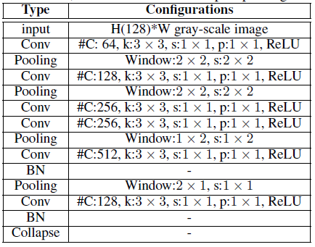
Methods
Architecture
  Input: Pixel of original image after normalization to height of 64.
  Convolution layers generate feature sequence from input.
  Collapse layer transcribe feature map to high-level representation.
Notes:
We use CNN to build a 6-layer network for convolutional feature extraction.
First, before being fed into the network, all the images are normalized to the same height.
Then a stack of feature maps are extracted by the a series of convolutional layers.

Slide 6
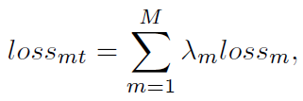
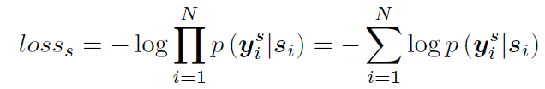

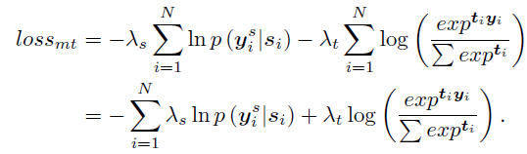
Methods
Objective
Multi-task learning
Mono-lingual text image recognition
Cross-lingual text image recognition
Overall
Notes:
The parameters of the whole network are updated by backpropagation jointly.
Naturally, final loss of the network will be the combination of each subnet, which can be formalized as: eq1
And the loss of two tasks can be formulated as: eq2 eq3
By substituting (2) and (3) into (1), the loss of our system can be calculated as: eq4

Slide 7
Methods
Benchmark Systems
Notes:
In addition to our proposed multi-task CLTIR system, we also implement several systems on the same dataset for comparison, the single-task system and the cascade system, as shown in the figure.

Slide 8
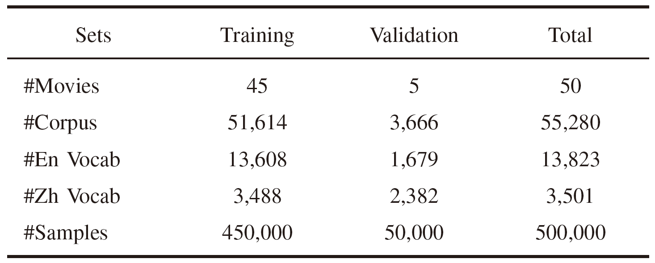
Experiments
Datasets
  Movies and their related bilingual subtitles
Notes:
Our system is proposed to recognize cross-lingual text images, but there was no existing text recognition dataset with label in other language.
Considering it is difficult to collect and label a new dataset, we utilize movies and their related bilingual subtitles which are wildly used in our daily life.
Details of the CLTIR dataset are shown in the Table.

Slide 9
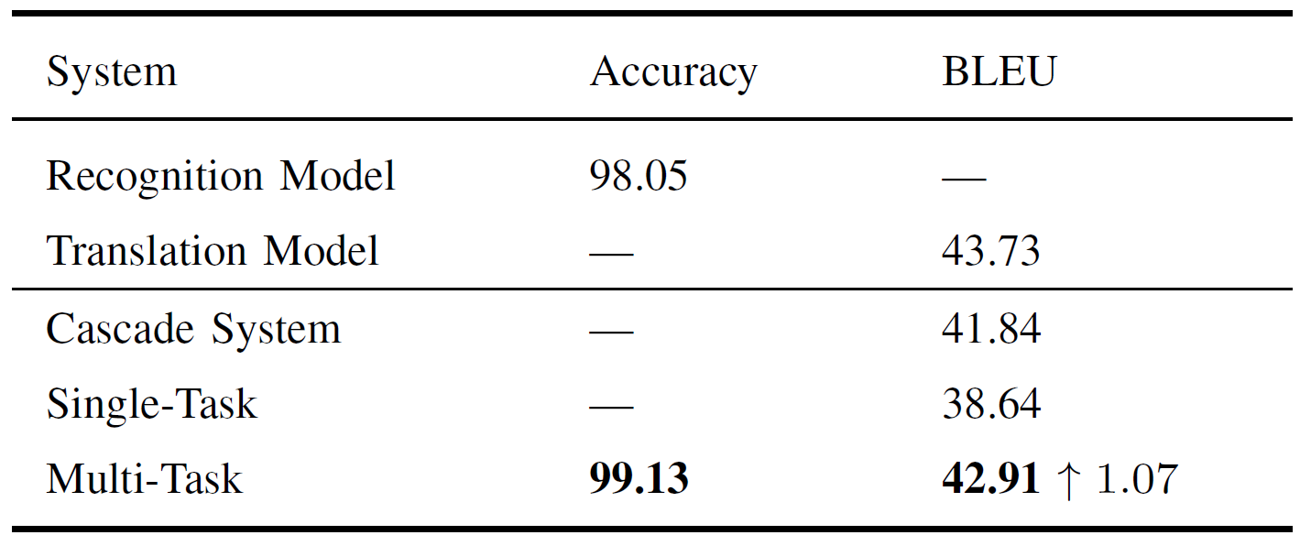
Experiments
Results of CLTIR
Notes:
We evaluate systems mentioned above on the newly collected dataset.
As seen in the table, the proposed system get promising results.
Compared with cascade system and single-task system, the multi-task system is better on both source and target language recognition task.
When recognizing texts in source language, the multitask system is even better than the typical text recognition model.
And for CLTIR, the multi-task system has achieved a higher BLEU score than the benchmark of cascade system.

Slide 10
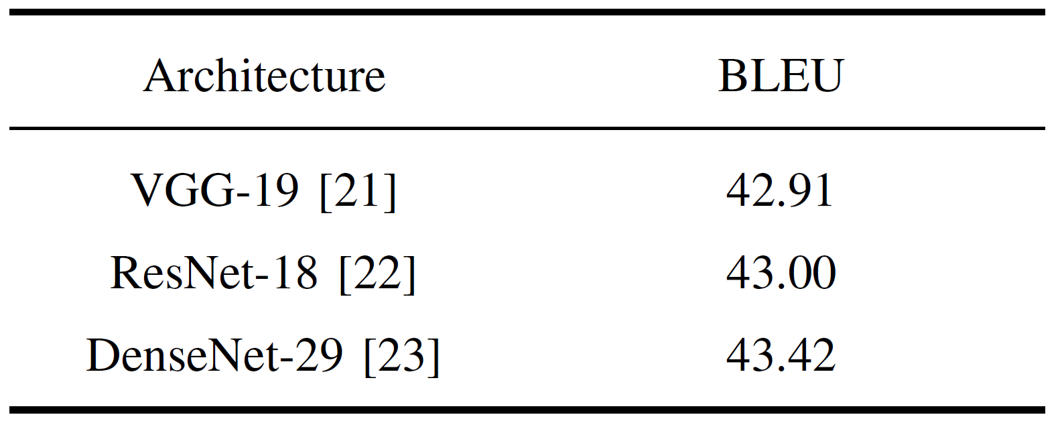
Experiments
Ablation Study
Notes:
Furthermore, we have also altered the architecture of image encoder in the multi-task system.
As illustrated in the table, all three architectures can achieve promising performance, demonstrating generalization of the proposed method.
Besides, by replacing the VGG-19 with ResNet-18 or DenseNet-29, the BELU can be further improved.

Slide 11
Conclusion
Contribution
  New problem called CLTIR
  Novel end-to-end multi-task system with two different sequence to sequence learning methods
  Promising results on the dataset of movie subtitle images
Future Works
  Larger datasets
  Better performance
Notes:
In this paper, we propose a multi-task CLTIR system, which has achieved superiority results in both source and target language text image recognition fields.
The major contributions of this work are in three aspects.
First, we raise a new problem called CLTIR.
Second, we propose a novel end-to-end multi-task system with two different sequence to sequence learning methods.
Finally, the proposed framework achieves promising results on the dataset of movie subtitle images.
Our work is the first attempt in CLTIR task, and provides a baseline benchmark in this field. Possible extensions include the training and testing on larger datasets, integration with grammatical and semantic parsing.

Slide 12
Thanks && Question
Notes:
That's my presentation, thanks for your attention. Does anyone has any questions?

