Slide 1
Radical Counter Network for Robust Chinese
Character Recognition
(ICPR 2020)
Yun-qing Li, Yi-xing Zhu, Jun Du, Chang-jie Wu, Jian-shu Zhang
University of Science and Technology of China, Hefei, Anhui, P.R.China
lyq123@mail.ustc.edu.cn , zyxsa@mail.ustc.edu.cn, jundu@ustc.edu.cn,
wujc@mail.ustc.edu.cn , xysszjs@mail.ustc.edu.cn

Slide 2
Content
Background & Motivation
Proposed Model
Experiment results

Slide 3
Content
Background & Motivation
Proposed Model
Experiment results

Slide 4
Background & Motivation
Due to the large character categories and scarce data on uncommon characters, recognition model needs to handle few-shot or zero-shot conditions.
Mainly researches can be divided into character-based recognition (CR) and
radical-based character recognition (RCR), but with the following shortcomings:
The CR methods can recognize common characters well but unable to handle unseen situation.
Some RCR methods have successfully achieved great performance in unseen condition but need RNN-based decoder for sequence decoding.

Slide 5
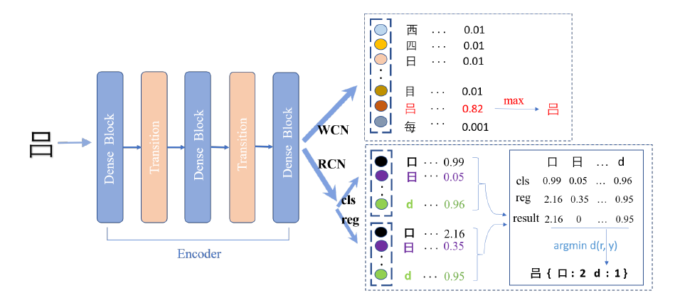
Proposed Model
RCN model contains:
CNN-based encoder
FCN-based decoder
radical classification module (RCM)
To judges whether the radicals exist.
radical regression module (RRM)
To estimate the number of existing radicals.
Fig1 : The comparison of the structure of RCN and WCN

Slide 6
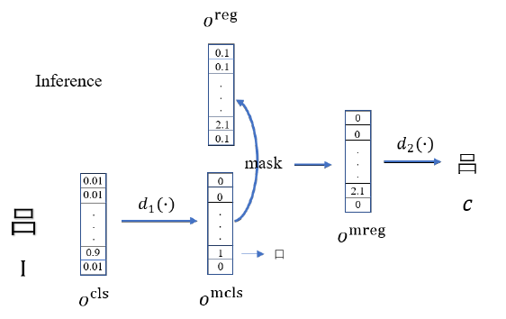
Proposed Model
Train:
$$L_{RCN}=\frac{1}{n}\sum_{i=1}^{n}{\sum_{j=0}^{1}{y_{ij}^{cls}}log}\left(o_{ij}^{cls}\right)+\frac{λ}{n}\sum_{i=1}^{n}{d(o_{i}^{m}, }y_{i}^{reg})$$
$$d\left(o_{i}^{m}, y_{i}^{reg}\right)={\left\|o_{i}^{m}−y_{i}^{reg}\right\|}^{2}$$
Inference:
$$o^{mcls}=arg\max_{y^{cls}εY}{d_{1}(o^{cls}, y^{cls})}$$
$$o^{mreg}=o^{mcls}∙o^{reg}$$
Fig 2: The illustration of the entire inference process
$$c=arg\min_{y^{reg}εY}{d_{2}(o^{mreg}, y^{reg})}$$

Slide 7
Proposed Model
M-RCN
We combine these two decoders as a new multi-task network to get both global and local information from the shared encoder.
Training
$$L=L_{RCN}+μ\sum_{i=1}^{K}{y_{i}^{WCN}log⁡(o_{i}^{WCN})}$$
Inference
We only utilize the output parts of RCN to produce the predicted character.
Fig 1 : The architecture of M-RCN

Slide 8
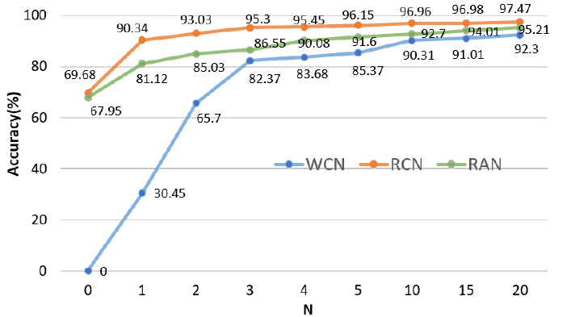
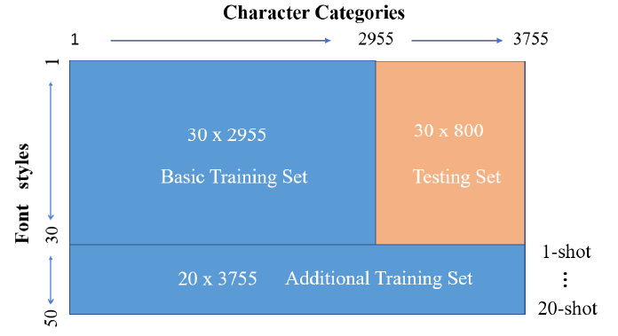
Experiment results
Experiment on Printed Character Dataset
Fig 3 : The illustration of dividing training set and testing set for the printed character experiment.
Fig 4 : The performance comparison among WCN, RAN and the proposed RCN with respect to the newly added font styles N.

Slide 9
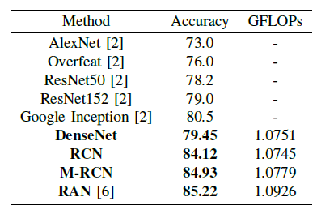
Experiment results
Experiment on Scene Character Dataset
Chinese Text in the Wild (CTW) is a large dataset of street view images which has approximate 1 million samples. The composition of CTW set is much complicated, mainly containing 6 different attributes : 3D-raised, complex background, occluded, distorted, handwritten and wordart.
Table1: Comparison of accuracy rate (%), model GFLOPs among RCN, M-RCN and some other methods

Slide 10
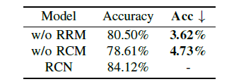
Experiment results
Ablation Studies
1. Different Modules
Table2: Comparison of among RCN, w/o RCM, RCN w/o RRM and RCN.
2. Different Distance Metrics
Table3: Comparison of different distance metrics
Note: Ed - Euclidean distance Cd - Cosine distance

Slide 11
Thank you for listening !

