Slide 1
Few Shot Learning Framework to Reduce Inter-observer Variability in Medical Images
Sohini Roychowdhury
Director Machine Learning,
Fourthbrain.ai
Ex-Volvocars USA

Slide 2
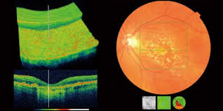
Introduction
Medical Imaging domain suffers consistently from the “small data” challenge.
Generating large volumes of annotated data is costly, time intensive and subjective.
Need exists for automated assessment of labelled data using on few samples (few-shot).
Optical Coherence Tomography (OCT) images suffer from high variability owing to image acquisition system [1].
Existing works show aggregate OCT segmentation performances per image stack, but per-image-level subjectivity for annotated labels remains.
Source: http://www.jbopticians.co.uk/about_us/topcon-3d-oct-scan/index.html

Slide 3
Key Contributions
Novel Few-shot Learning models for generation of multiple regional proposals per image:
Global Thresholding
Parallel Echo State Networks (ESN)[2]
Few shot U-net [3]
Novel target Label Selection Algorithm (TLSA) to select the best label automatically.
End-to-end system design to receive stacks of OCT images and automatically select best manual label for 60-97% images.

Slide 4
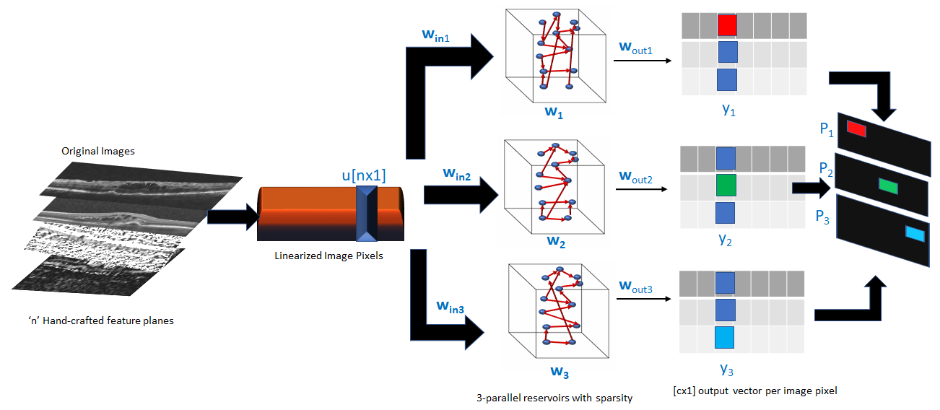
Parallel ESN Method
S. Roychowdhury and L. S. Muppirisetty, “Fast proposals for image and video annotation using modified echo state networks,” in 2018 17th IEEE
International Conference on Machine Learning and Applications (ICMLA). IEEE, 2018, pp. 1225–1230.

Slide 5
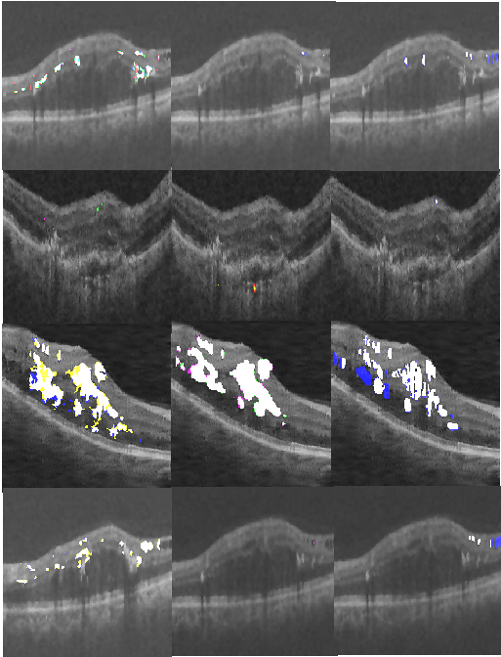
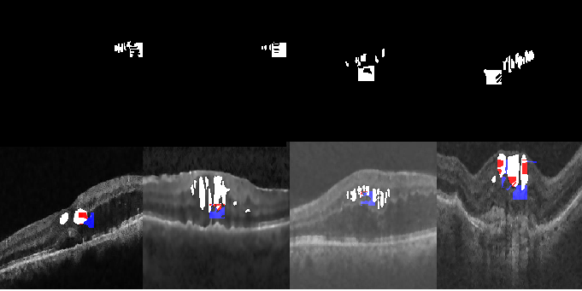
Experiments
B. Target Label Selection
A. Noisy Label Generation

Slide 6
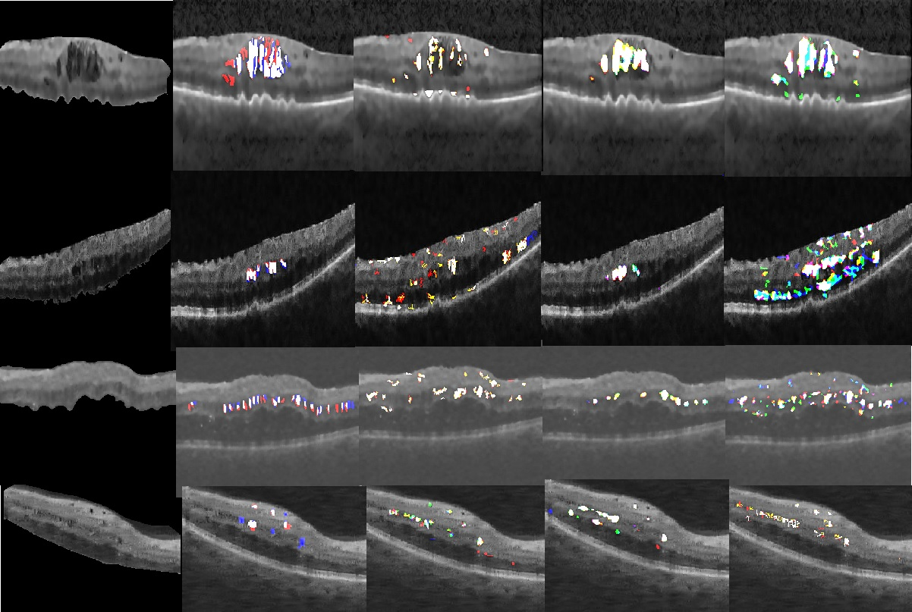
Results

Slide 7
References
[1] G. Girish, B. Saikumar, S. Roychowdhury, A. R. Kothari, and J. Rajan, “Depthwise separable convolutional neural network model for intraretinal cyst segmentation,” IEEE EMBC, 2019.
[2] S. Roychowdhury and L. S. Muppirisetty, “Fast proposals for image and video annotation using modified echo state networks,” in 2018 17th IEEE International Conference on Machine Learning and Applications (ICMLA). IEEE, 2018, pp. 1225–1230.
[3] G. Girish, B. Thakur, S. R. Chowdhury, A. R. Kothari, and J. Rajan, “Segmentation of intra-retinal cysts from optical coherence tomography images using a fully convolutional neural network model,” IEEE journal of biomedical and health informatics, vol. 23, no. 1, pp. 296–304, 2018.

