Slide 1
Fine-Tuning DARTS for Image Classification
Muhammad Suhaib Tanveer
Muhammad Umar Karim Khan
Chong-Min Kyung

Slide 2
Table of Contents
Introduction
Motivation
Contribution
Related Work
Problems in Differentiable Architecture Search (DARTS)
Proposed Solution
Results
Conclusion
Bibliography
2

Slide 3
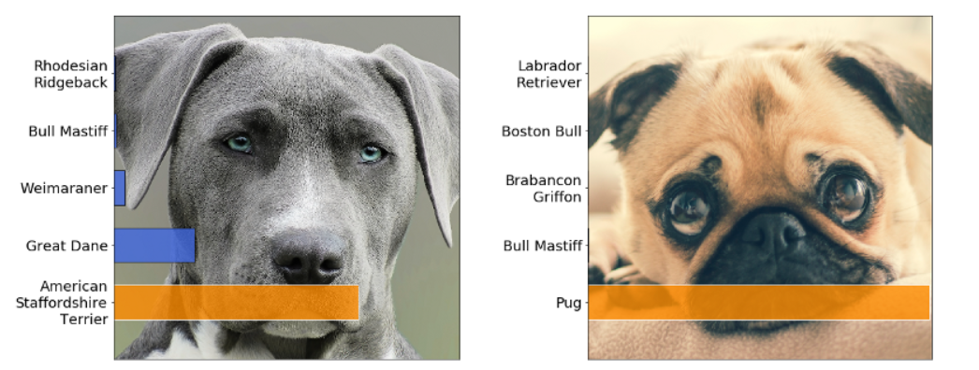
Introduction(1/3)
Image classification is a fundamental computer vision task.
Image classification is employed in a number of different industries.
Some popular industries that employ image classification are automobile, retail, security and healthcare industry.
Handcrafted deep neural networks have achieved great results on image classification.
However, designing such networks requires substantial human effort.
Fig. 1. An example of image classification on Dog Breed dataset [1].
[1]: https://github.com/floydhub/image-classification-template
3

Slide 4
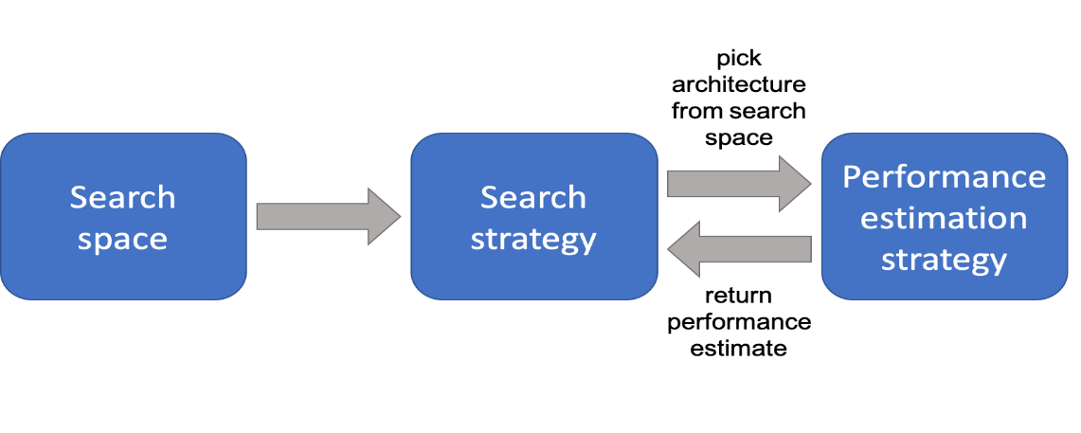
Introduction(2/3)
Therefore, Neural Architecture Search (NAS), has been widely adopted.
NAS methods have achieved astonishing results on the image classification task.
Initially, NAS approaches used Reinforcement learning and Evolutionary Algorithms.
Fig. 2. Flow diagram of Neural Architecture Search (NAS) method.
4

Slide 5
Introduction(3/3)
However, these approaches required substantial computational resources and time.
Therefore, Differentiable Architecture Search (DARTS), a stochastic gradient descent approach of NAS was introduced.
DARTS achieved competitive results at a significantly lower computational cost.
However, DARTS makes numerous approximations to speedup leading to inferior performance.
5

Slide 6
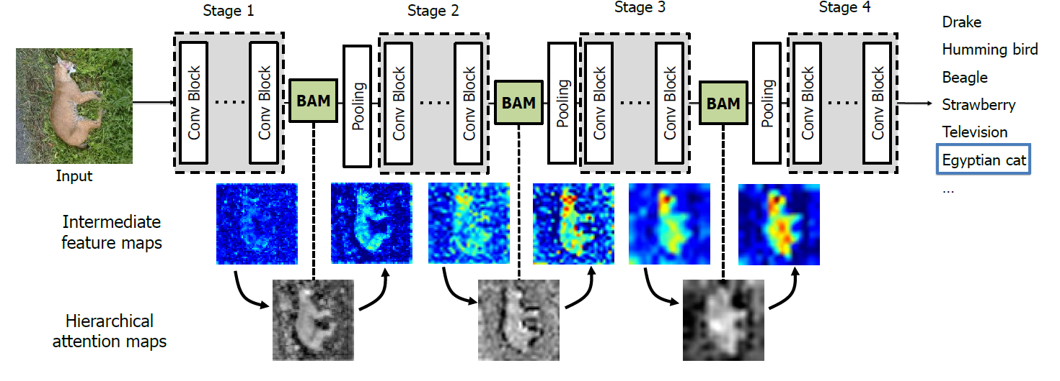
Motivation(1/1)
Neural Architecture Search methods do not make use of previous research.
Fine-tuning is a proven method for improving performance of a neural network.
Attention modules have proven to be effective for improving classification accuracy.
Performance of a neural network is extremely sensitive to the input layer.
Fig. 3. Visual representation of bottleneck attention module [2].
[2]: Park, J., Woo, S., Lee, J. Y., & Kweon, I. S. (2018). Bam: Bottleneck attention module. arXiv preprint arXiv:1807.06514.
6

Slide 7
Contribution(1/1)
Introduction of fixed operations (in form of attention module) to fine-tune DARTS.
First implementation to our knowledge which uses fixed operations for fine-tuning a Neural Architecture Search method.
Introduction of dual-stem approach instead of single-stem approach.
Achieving state-of-the-art results on Fashion-MNIST, COMP-CARS and
MIO-TCD datasets.
First implementation to our knowledge which uses a Neural Architecture Search method for classification on Fashion-MNIST, COMP-CARS and MIO-TCD datasets.
7

Slide 8
Related Work(1/3)
Reinforcement learning, evolutionary algorithms, sequential model-based and stochastic gradient-based optimization approaches are usually used for NAS.
NAS-Net [3] uses reinforcement learning with a controller RNN to design a cell.
Amoeba-Net [4] uses an evolutionary method to search for the optimal architecture.
Progressive Neural Architecture Search (PNAS) [5] uses a sequential model-based optimization strategy to guide the search through the search space.
[3] B. Zoph, V. Vasudevan, J. Shlens, and Q. V. Le, “Learning transferable architectures for scalable image recognition,” in Proceedings of the IEEE conference on computer vision and pattern recognition, pp. 8697–8710, 2018.
[4] E. Real, A. Aggarwal, Y. Huang, and Q. V. Le., “Regularized evolution for image classifier architecture search,” in AAAI, 2018.
[5] C. Liu, B. Zoph, M. Neumann, J. Shlens, W. Hua, L.-J. Li, L. Fei-Fei, A. Yuille, J. Huang, and K. Murphy, “Progressive neural architecture search,” Lecture Notes in Computer Science, p. 19– 35,2018.
8

Slide 9
Related Work(2/3)
Neural Architecture Optimization Network (NAO-Net) [6] uses an encoder, predictor and a decoder.
NAO-Net reduces the search time to 200 GPU Days and produces good results.
Self-Evaluated Template Network (SETN) [7] proposes to use an evaluator and a template network.
SETN achieves impressive results at a very low search cost (1.8 GPU Days).
Stochastic Neural Architecture Search (SNAS) [8] proposes to constrain architecture parameters to be a one-hot vector.
This approach helps to tackle the inconsistency in optimizing objectives between architecture search and evaluation stage.
They reduce the search cost significantly while giving competitive performance.
[6] R. Luo, F. Tian, T. Qin, E. Chen, and T.-Y. Liu, “Neural architecture optimization,” in Advances in neural information processing systems, pp. 7816–7827, 2018.
[7] X. Dong and Y. Yang, “One-shot neural architecture search via self-evaluated template network,” in Proceedings of the IEEE International Conference on Computer Vision, pp. 3681–3690, 2019.
[8] S. Xie, H. Zheng, C. Liu, and L. Lin, “SNAS: stochastic neural architecture search,” in International Conference on Learning Representations, 2019.
9
Notes:
The encoder maps neural network architectures to a continuous space. The predictor uses that continuous representation as input and predicts the accuracy. The decoder maps that continuous representation back to the neural network architecture.

Slide 10
Related Work(3/3)
Differentiable Architecture Search (DARTS) [9] introduces a differentiable and continuous search space instead of a discrete search space.
Step 1: Place Normal and Reduction cells Manually.
Input
Image
Fixed Operations
Normal
Cell
Normal
Cell
Normal
Cell
…
Reduction
Cell
Reduction
Cell
Image Class
Step 2: Search for optimal Normal and Reduction Cell architectures given their fixed placement and inter-connections.
Update weights and cell architecture iteratively
Optimal Normal and Reduction Cells.
Step 3: Perform conventional training with the optimal cell architectures over the training data.
Final Training
Final Neural Network
with optimal weights
Fig. 4. Step-wise depiction of DARTS.
[9]: H. Liu, K. Simonyan, and Y. Yang, “DARTS: Differentiable architecture search,” in International Conference on Learning Representations, 2019.
10
Notes:
and achieves remarkable efficiency, incurring a low search cost.

Slide 11
Problems in DARTS(1/2)
Multiple approximations have been used in DARTS, leading to reduced performance.
The architecture ‘α’ is updated after a single update of the weights ‘w’ rather than the optimal weights ‘w′ (α)’:
$\text{∇}\text{α}\text{L}\text{val} \text{(}\text{w}\text{′}\text{(}\text{α}\text{),}\text{α}\text{)}$ ≈ ∇ _{α}L_{val} (w−ξ∇_{w}L_{train}(w$\text{,}$α),α)
A finite difference approximation has been used to reduce the computational complexity of obtaining the gradient of the architecture ‘α’ with the validation data.
$$∇_{\text{α}\text{,}\text{w}}^{2}\text{L}\text{train}\text{(}\text{w}\text{,}\text{α}\text{)}∇_{w^{′}}\text{L}\text{val} \text{(}w^{′}\text{,}\text{α}\text{)}≈ \frac{∇_{α}\text{L}\text{train}\text{(}w^{+}\text{,}\text{α}\text{)} − ∇_{α }\text{L}\text{train}\text{(}w^{−}\text{,}\text{α}\text{)}}{2ε}$$
11

Slide 12
Problems in DARTS(2/2)
With these approximations, the convergence of DARTS to the optimal architecture is yet to be theoretically proven.
These approximations are crucial to DARTS as these provide the significant
speedup.
However, as common to approximations, they lead to inferior performance.
12

Slide 13
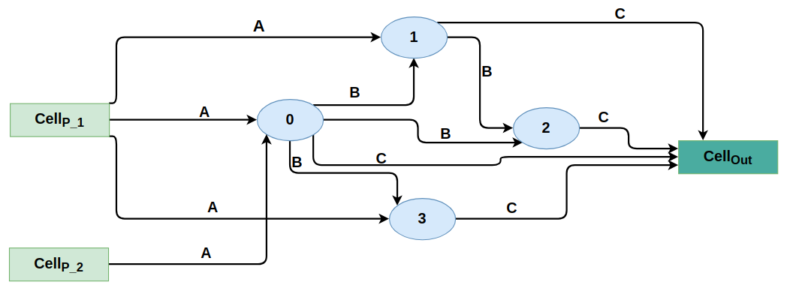
Proposed Solution (1/7)
In DARTS, there are ‘M’ possible connections and ‘N’ possible operations.
Thus, the cell architecture can be represented by a matrix α ∈ ℝ^{M*N} .
Propose to extend α as α ∈ ℝ^{M′*N′} .
$M^{′}>M \&{ N}^{′} ≥N$
$N^{′}=N+ \left|O\left(αF\right)−O(α)\right|$
$N^{′}=N, if αF ∀ α$
Fig. 4. DARTS cell architecture.
13

Slide 14
Proposed Solution (2/7)
When the architecture α is updated, only the architecture parameters from α are updated and α_{F} remains fixed.
DARTS Our Approach
Input
Input
Fixed Operations
Fixed Operations
$$\text{α}\text{(}\text{i}\text{,}\text{j}\text{)}≔\int_{\begin{aligned} \text{α}\text{(}\text{i}\text{,}\text{j}\text{)} \text{otherwise}\text{,} \\ \end{aligned}}^{ \text{α}\text{(}\text{i}\text{,}\text{j}\text{) }\text{− }\text{γ}\text{∆}\text{α}\text{(}\text{i}\text{,}\text{j}\text{)}\text{L}\text{val}\text{(}\text{w}\text{′}\text{,}\text{α}\text{) }\text{if} \text{i} \text{≤ }\text{M}\text{, }\text{j} \text{≤}\text{N} }{}$$
Replicated ‘n’ number of times
Cell searched using DARTS
Cell searched using DARTS
Replicated ‘n’ number of times
Fixed Operations
Attention Module
$$w′=\text{w}\text{−}\text{ξ}\text{∇}\text{w}\text{L}\text{train}\text{(}\text{w}\text{,}\text{α}\text{)}\text{. }$$
Output
Fixed Operations
Output
Fig. 5. Comparison of DARTS [4] and our approach. Block marked in grey indicate the difference between the two approaches
.
14

Slide 15
Proposed Solution (3/7)
By introducing α_{F}, we have two distinct advantages.
First, α_{F} can be based on any recent manually-designed architecture, thus making use of past efforts in architecture design.
Second, part of the architecture is somewhat independent of the DARTS method.
So, the approximations of the DARTS method do not carry their influence to α_{F} resulting in robust performance.
15

Slide 16
Proposed Solution (4/7)
We use the attention modules described in [10] as α_{F} as it is highly intuitive and shows good performance.
The attention module adaptively recalibrates channel-wise feature responses by explicitly modeling interdependencies between channels.
Attention module has 2 nodes (3 connections) and 3 operations, so α_{F} ∈ ℝ^{3*3}.
[10]: J. Hu, L. Shen, and G. Sun, “Squeeze-and-excitation networks,” in Proceedings of the IEEE conference on computer vision and pattern
recognition, pp. 7132–7141, 2018.
16

Slide 17
Proposed Solution (5/7)
Reduction ratio r is a hyper-parameter that allows us to vary the capacity and computational cost of the attention module in the network.
Input
H*W*C
Global Pooling
1*1*C
FC
1*1*C/r
ReLU
1*1*C/r
FC
1*1*C
Sigmoid
1*1*C
Reshape
H*W*C
Output
Fig. 6. The schema of attention module. ’FC’ represents fully-connected layer.
17
Notes:
n the squeeze phase, each attention module makes use of
a global average pooling operation. The squeeze phase is
followed by the excitation phase which makes use of two
small fully-connected layers. The excitation phase is followed
by an inexpensive channel-wise scaling/reshaping operation.

Slide 18
Proposed Solution (6/7)
Rather than passing redundant information to both inputs of the first cell of the neural network, I propose applying two different transformations to the input image.
Passing the first transformed image to the first cell as the first input, and the second transformed image to the first cell as the second input.
In this way, different information is passed to the first cell of the neural network.
18
Notes:
.

Slide 19
Proposed Solution (7/7)
Single Stem Dual Stem
Input
Input
2-D Convolution
2-D Convolution
Batch Normalization
Batch Normalization
1st Cell
ReLU
2nd Cell
2-D Convolution
Rest of the network
Batch Normalization
Output
ReLU
2-D Convolution
Batch Normalization
1st Cell
2nd Cell
Rest of the network
Output
Fig. 7. Comparison of single-stem and dual-stem approach.
19
Notes:
.

Slide 20
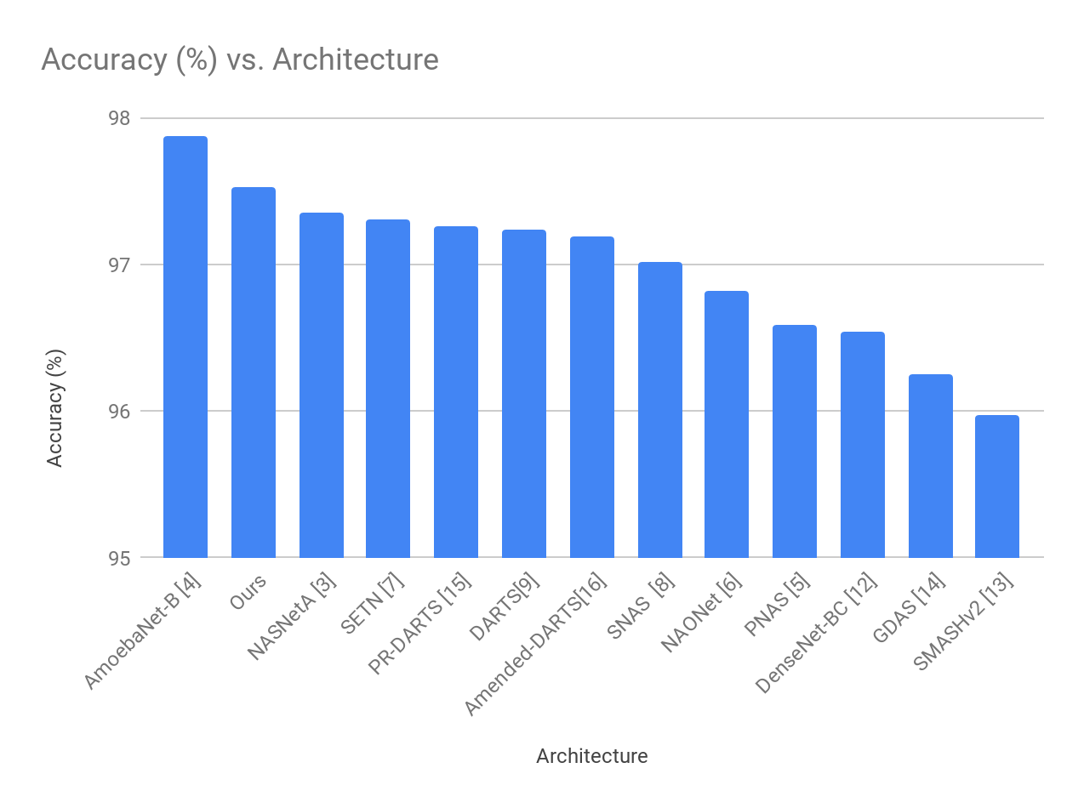
Experimental Results (1/12)
CIFAR-10 [11]
[11]: A. Krizhevsky, G. Hinton, et al., “Learning multiple layers of features from tiny images,” tech. rep., Citeseer, 2009.
20

Slide 21
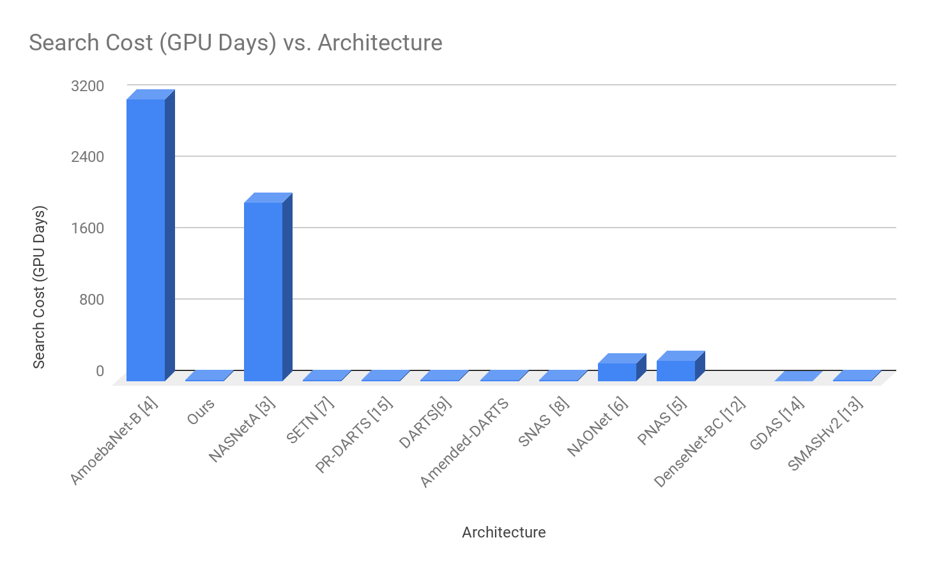
Experimental Results (2/12)
CIFAR-10 [11]
[11]: A. Krizhevsky, G. Hinton, et al., “Learning multiple layers of features from tiny images,” tech. rep., Citeseer, 2009.
21

Slide 22
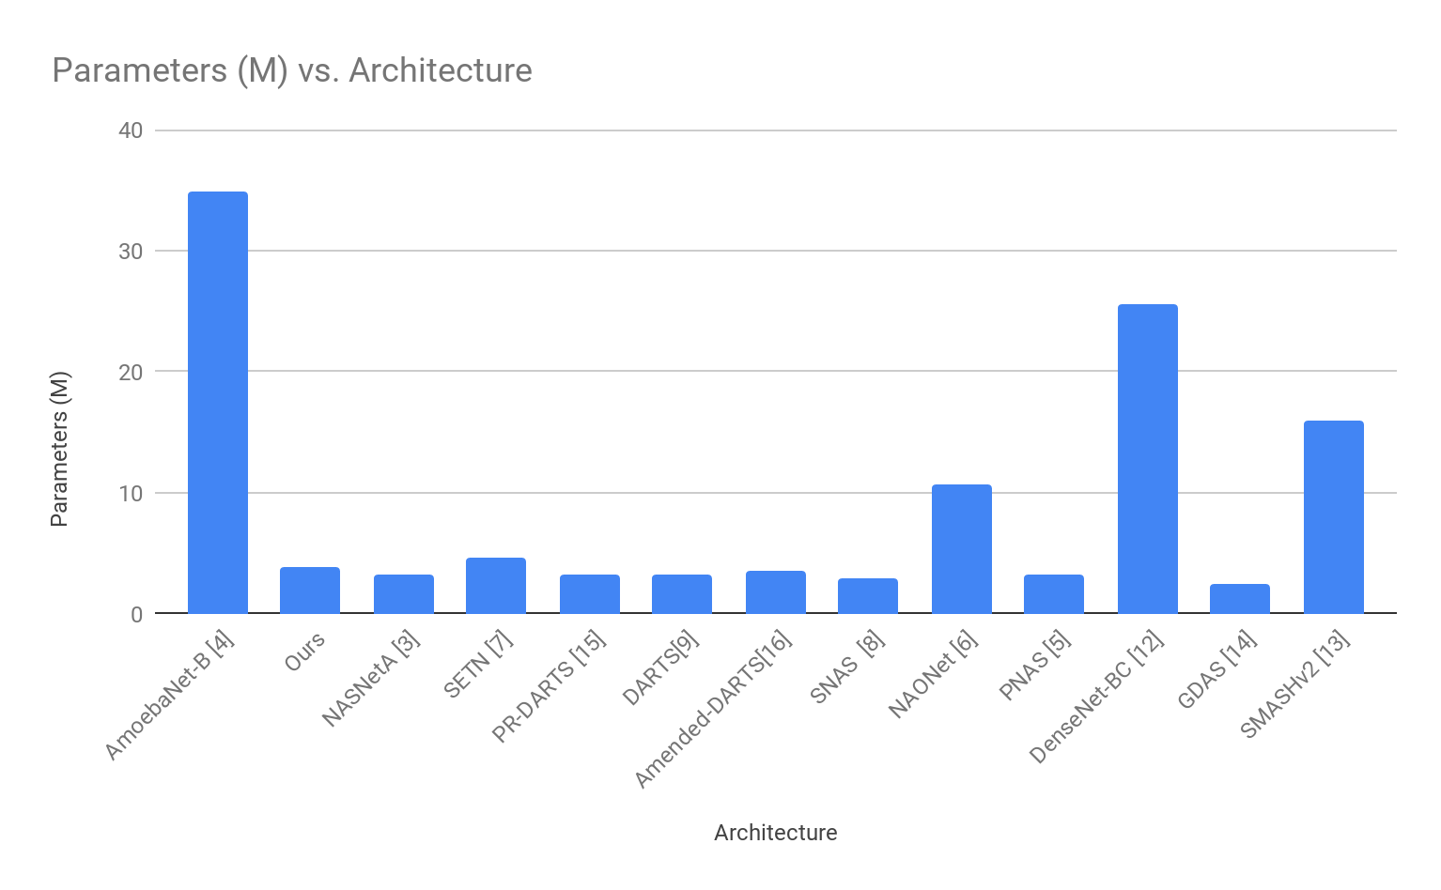
Experimental Results (3/12)
CIFAR-10 [11]
[11]: A. Krizhevsky, G. Hinton, et al., “Learning multiple layers of features from tiny images,” tech. rep., Citeseer, 2009.
22

Slide 23
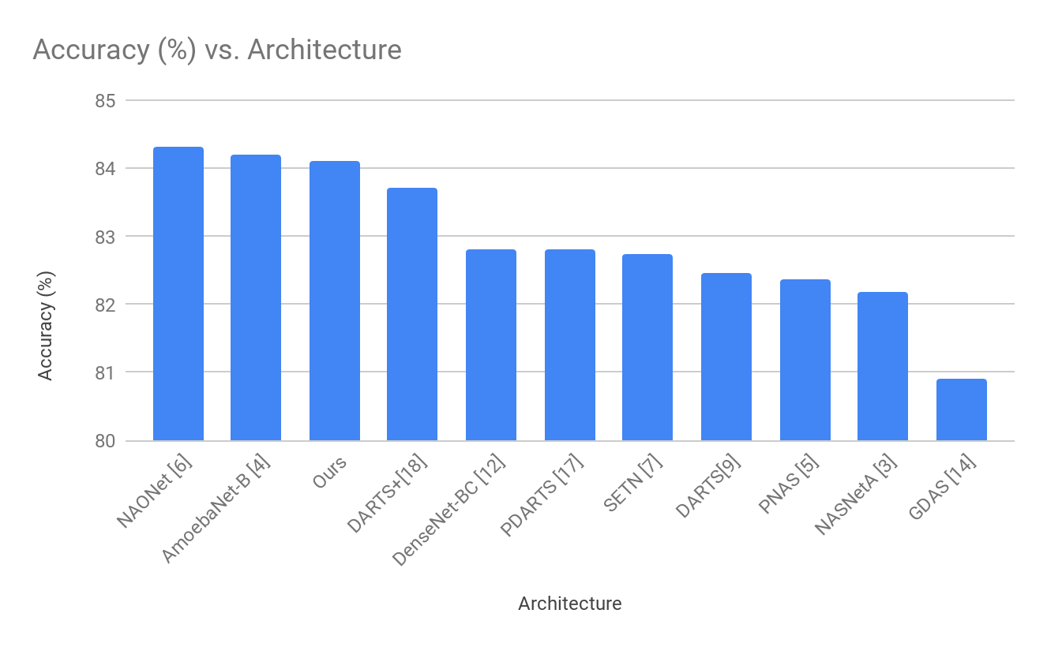
Experimental Results (4/12)
CIFAR-100 [11]
*: Search cost on CIFAR-10.
[11]: A. Krizhevsky, G. Hinton, et al., “Learning multiple layers of features from tiny images,” tech. rep., Citeseer, 2009.
23

Slide 24
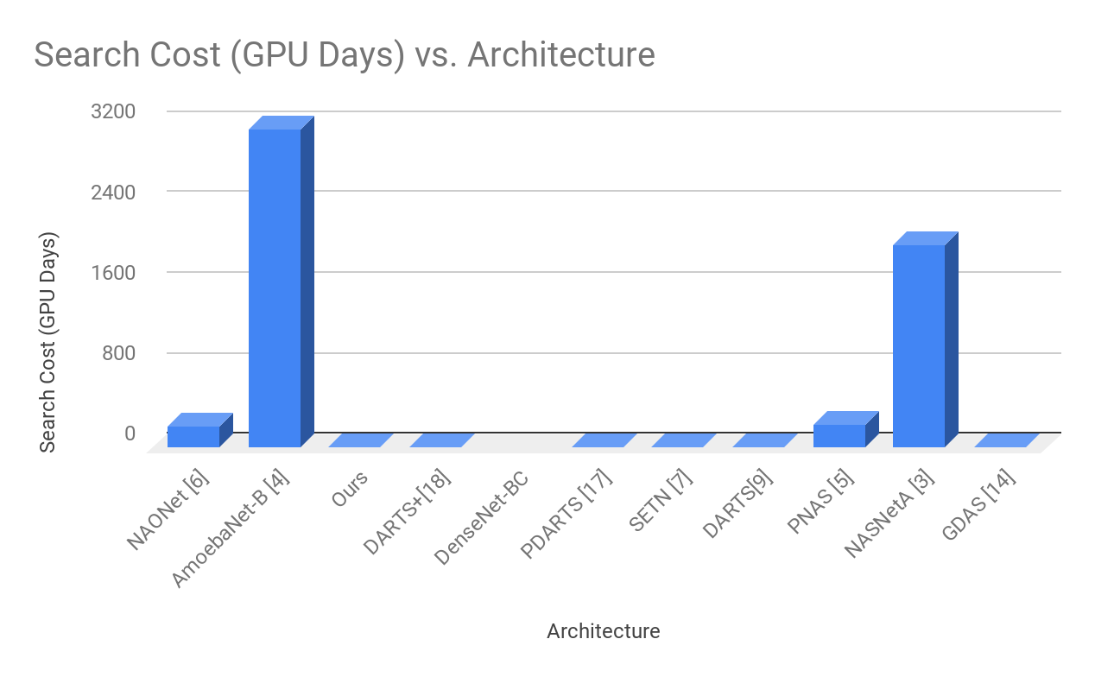
Experimental Results (5/12)
CIFAR-100 [11]
[11]: A. Krizhevsky, G. Hinton, et al., “Learning multiple layers of features from tiny images,” tech. rep., Citeseer, 2009.
24

Slide 25
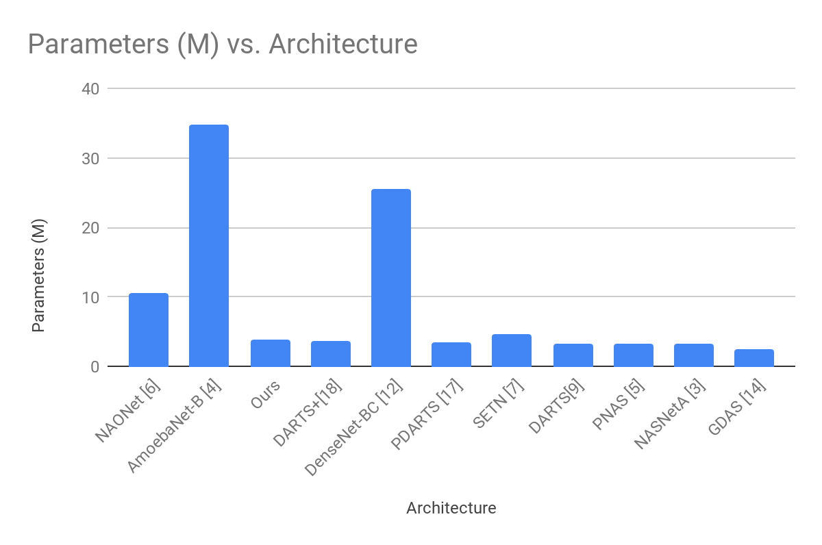
Experimental Results (6/12)
CIFAR-100 [11]
[11]: A. Krizhevsky, G. Hinton, et al., “Learning multiple layers of features from tiny images,” tech. rep., Citeseer, 2009.
25

Slide 26
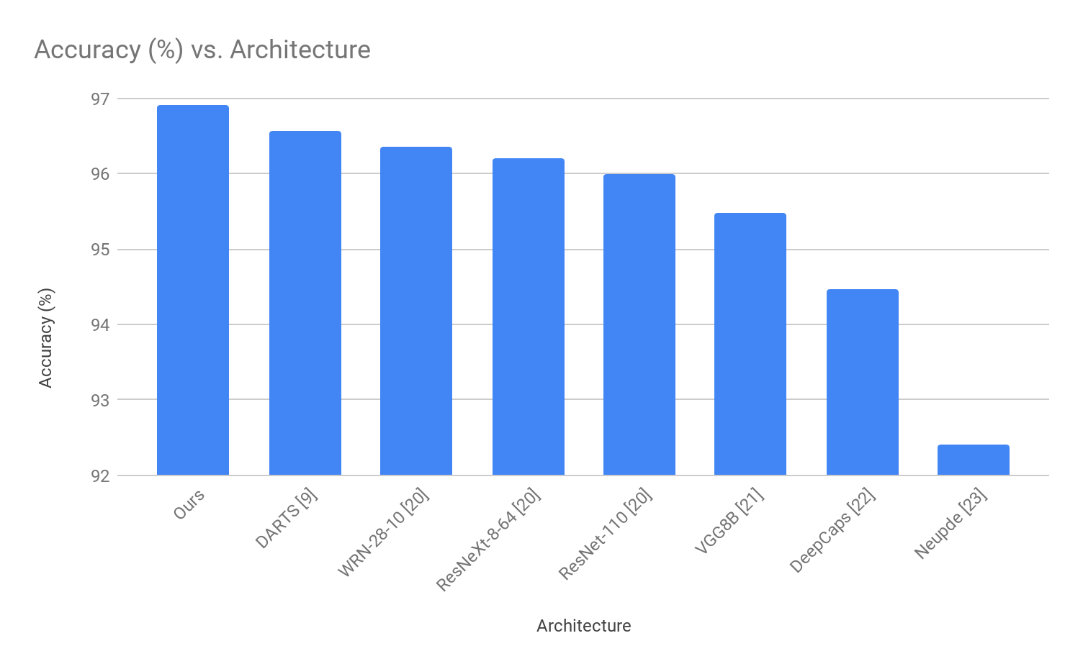
Experimental Results (7/12)
Fashion-MNIST
[19]: H. Xiao, K. Rasul, and R. Vollgraf, “Fashion-mnist: a novel image dataset for benchmarking machine learning algorithms,” 2017.
26

Slide 27
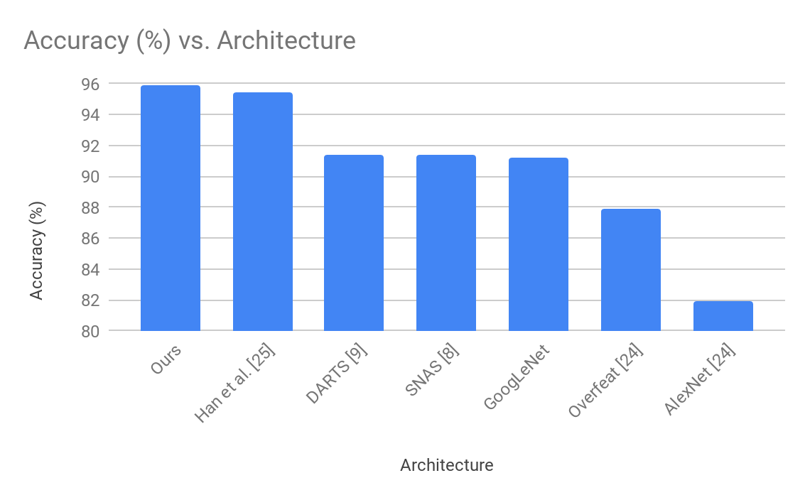
Experimental Results (8/12)
COMP-CARS (Web-Natured) [24]
[24]: L. Yang, P. Luo, C. C. Loy, and X. Tang, “A large-scale car dataset for fine-grained categorization and verification,”
CoRR, vol. abs/1506.08959, 2015.
27

Slide 28
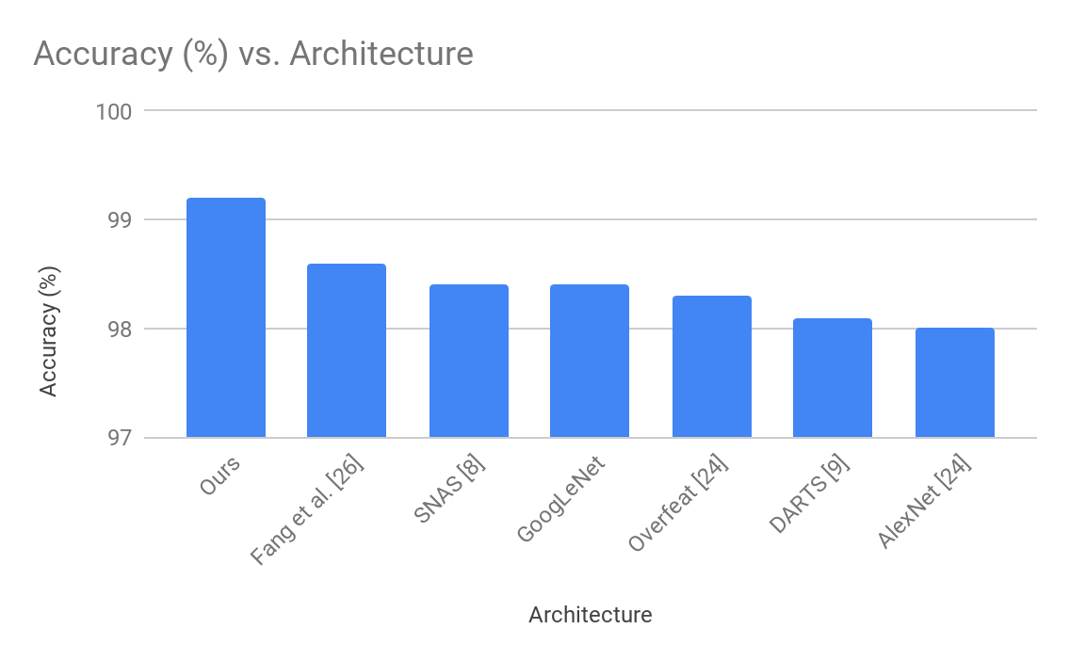
Experimental Results (9/12)
COMP-CARS (Surveillance-Natured) [24]
[24]: L. Yang, P. Luo, C. C. Loy, and X. Tang, “A large-scale car dataset for fine-grained categorization and verification,”
CoRR, vol. abs/1506.08959, 2015.
28

Slide 29
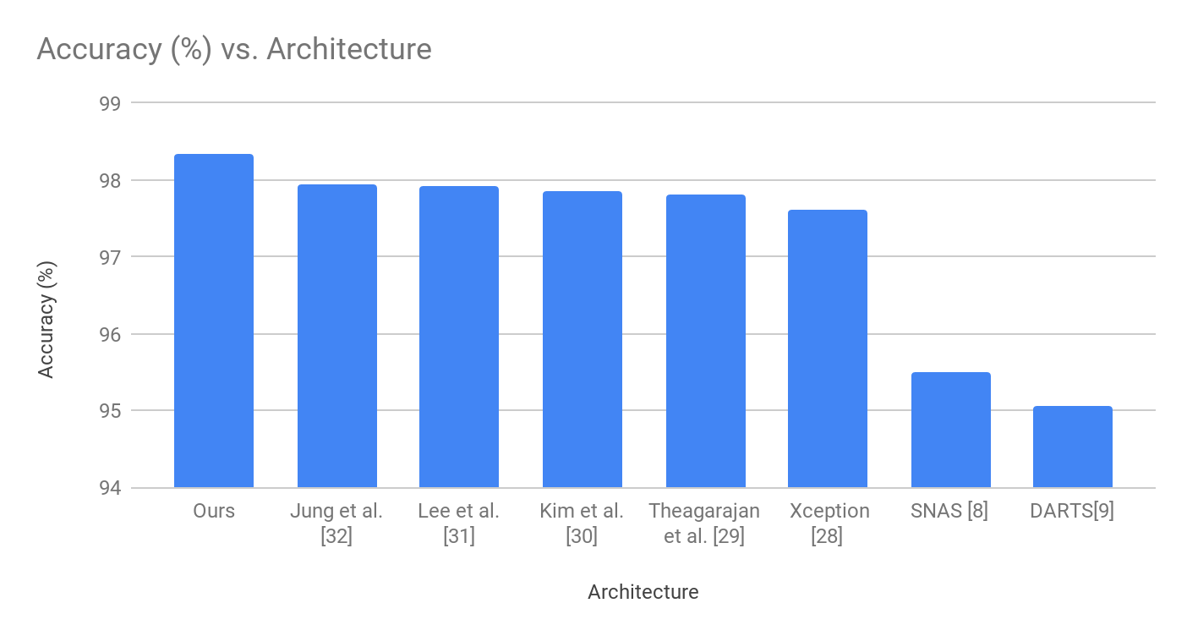
Experimental Results (10/12)
MIO-TCD [27]
[27]: Z. Luo, F. Branchaud-Charron, C. Lemaire, J. Konrad, S. Li, A. Mishra, A. Achkar, J. Eichel, and P. Jodoin, “Mio-tcd: A new benchmark
dataset for vehicle classification and localization,” IEEE Transactions on Image Processing, vol. 27, pp. 5129–5141, Oct 2018.
29

Slide 30
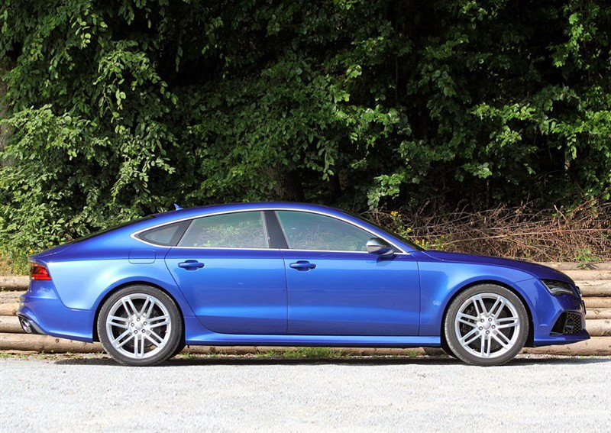
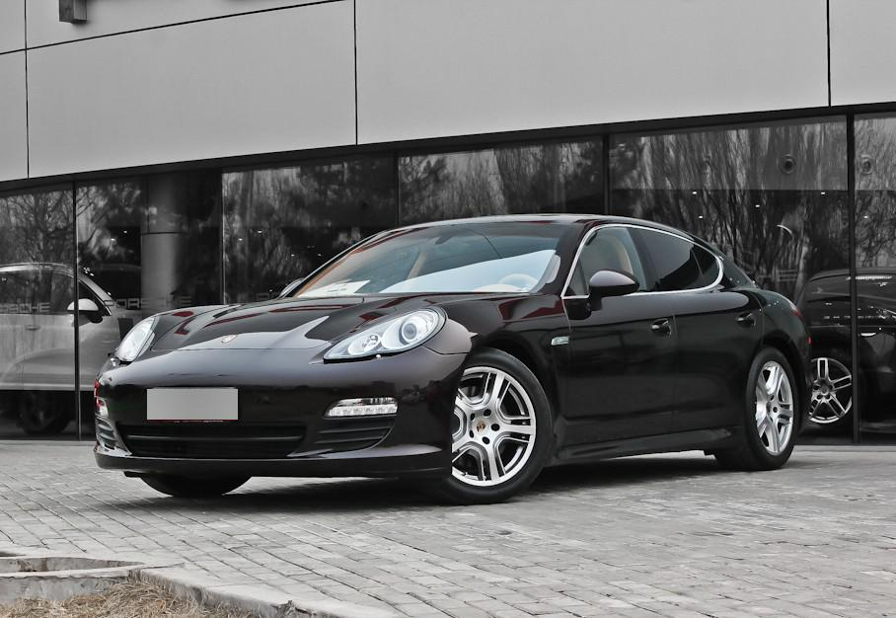
Experimental Results (11/12)
Qualitative Results:
Image | Ours | DARTS[8] | SNAS[9] | Ground Truth
 | Audi RS7 | Audi RS5 | Audi RS3 | Audi RS7
 | Porsche Panamera | Porsche Panamera Hybrid | Porsche Panamera Hybrid | Porsche Panamera
30

Slide 31
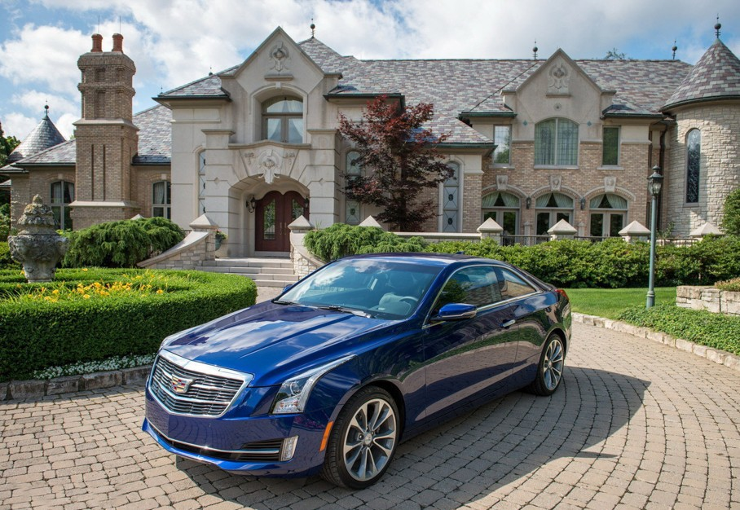
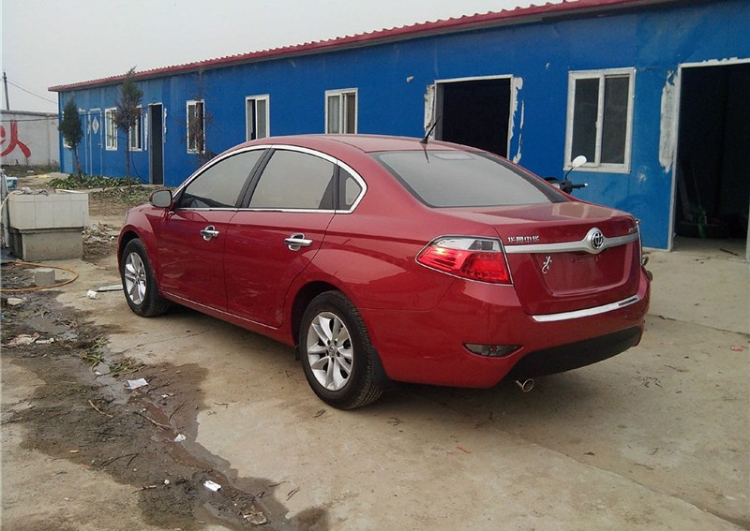
Experimental Results (12/12)
Image | Ours | DARTS[8] | SNAS[9] | Ground Truth
 | Cadillac ATS | Cadillac ATS-L | Cadillac ATS-L | Cadillac ATS
 | Zhonghua H330 | Zhonghua H320 | Zhonghua H320 | Zhonghua H330
31

Slide 32
Conclusion (1/1)
Based on the proven success of fine-tuning in manually designed architectures, we propose to fine-tune DARTS by adding fixed operations.
These operations are independent of the approximations used in DARTS, so it results in superior performance.
Contrary to DARTS, we use a dual-stem approach at the inputs of the first cell.
We were able to obtain state-of-the-art results on Fashion-MNIST, COMP-CARS and MIO-TCD datasets while our results on other datasets were also competitive.
32

Slide 33
Bibliography (1/3)
[1]: https://github.com/floydhub/image-classification-template.
[2]: Park, J., Woo, S., Lee, J. Y., & Kweon, I. S. (2018). Bam: Bottleneck attention module. arXiv preprint arXiv:1807.06514.
[3]: B. Zoph, V. Vasudevan, J. Shlens, and Q. V. Le, “Learning transferable architectures for scalable image recognition,” in Proceedings of the IEEE conference on computer vision and pattern recognition, pp. 8697– 8710, 2018.
[4]: E. Real, A. Aggarwal, Y. Huang, and Q. V. Le., “Regularized evolution for image classifier architecture search,” in AAAI, 2018.
[5]: C. Liu, B. Zoph, M. Neumann, J. Shlens, W. Hua, L.-J. Li, L. Fei-Fei, A. Yuille, J. Huang, and K. Murphy, “Progressive neural architecture search,” Lecture Notes in Computer Science, p. 19– 35,2018.
[6]: R. Luo, F. Tian, T. Qin, E. Chen, and T.-Y. Liu, “Neural architecture optimization,” in Advances in neural information processing systems, pp. 7816–7827, 2018.
[7]: X. Dong and Y. Yang, “One-shot neural architecture search via self-evaluated template network,” in Proceedings of the IEEE International Conference on Computer Vision, pp. 3681–3690, 2019.
[8]: S. Xie, H. Zheng, C. Liu, and L. Lin, “SNAS: stochastic neural architecture search,” in International Conference on Learning Representations, 2019.
[9]: H. Liu, K. Simonyan, and Y. Yang, “DARTS: Differentiable architecture search,” in International Conference on Learning Representations, 2019.
[10]: J. Hu, L. Shen, and G. Sun, “Squeeze-and-excitation networks,” in Proceedings of the IEEE conference on computer vision and pattern
recognition, pp. 7132–7141, 2018.
[11]: A. Krizhevsky, G. Hinton, et al., “Learning multiple layers of features from tiny images,” tech. rep., Citeseer, 2009.
[12]: G. Huang, Z. Liu, L. Van Der Maaten, and K. Q. Weinberger, “Densely connected convolutional networks,” in Proceedings of the IEEE conference on computer vision and pattern recognition, pp. 4700–4708, 2017.
[13]: A. Brock, T. Lim, J. M. Ritchie, and N. Weston, “Smash: one-shot model architecture search through hypernetworks,” arXiv preprint
arXiv:1708.05344, 2017.
[14]: X. Dong and Y. Yang, “Searching for a robust neural architecture in four gpu hours,” in Proceedings of the IEEE Conference on Computer Vision and Pattern Recognition, pp. 1761–1770, 2019.
33

Slide 34
Bibliography (2/3)
[15]: K. A. Laube and A. Zell, “Prune and replace nas,” arXiv preprint arXiv:1906.07528, 2019.
[16]: K. Bi, C. Hu, L. Xie, X. Chen, L. Wei, and Q. Tian, “Stabilizing darts with amended gradient estimation on architectural parameters,” arXiv preprint arXiv:1910.11831, 2019.
[17]: X. Chen, L. Xie, J. Wu, and Q. Tian, “Progressive differentiable architecture search: Bridging the depth gap between search and evaluation,” arXiv preprint arXiv:1904.12760, 2019.
[18]: H. Liang, S. Zhang, J. Sun, X. He, W. Huang, K. Zhuang, and Z. Li, “Darts+: Improved differentiable architecture search with early stopping,” arXiv preprint arXiv:1909.06035, 2019.
[19]: H. Xiao, K. Rasul, and R. Vollgraf, “Fashion-mnist: a novel image dataset for benchmarking machine learning algorithms,” 2017.
[20]: Z. Zhong, L. Zheng, G. Kang, S. Li, and Y. Yang, “Random erasing data augmentation,” arXiv preprint arXiv:1708.04896, 2017.
[21]: A. Nøkland and L. H. Eidnes, “Training neural networks with local error signals,” arXiv preprint arXiv:1901.06656, 2019.
[22]: J. Rajasegaran, V. Jayasundara, S. Jayasekara, H. Jayasekara, S. Seneviratne, and R. Rodrigo, “Deepcaps: Going deeper with capsule networks,” in The IEEE Conference on Computer Vision and Pattern Recognition (CVPR), June 2019.
[23]: Y. Sun, L. Zhang, and H. Schaeffer, “Neupde: Neural network based ordinary and partial differential equations for modeling time- dependent data,” arXiv preprint arXiv:1908.03190, 2019.
[24]: L. Yang, P. Luo, C. C. Loy, and X. Tang, “A large-scale car dataset for fine-grained categorization and verification,” CoRR, vol. abs/1506.08959, 2015.
[25]: K. Han, J. Guo, C. Zhang, and M. Zhu, “Attribute-aware attention model for fine-grained representation learning,” in Proceedings of the 26th ACM International Conference on Multimedia, MM ’18, (New York, NY, USA), pp. 2040–2048, ACM, 2018.
[26]: J. Fang, Y. Zhou, Y. Yu, and S. Du, “Fine-grained vehicle model recognition using a coarse-to-fine convolutional neural network architecture,” IEEE Transactions on Intelligent Transportation Systems, vol. 18,pp. 1782–1792, 2017.
[27]: Z. Luo, F. Branchaud-Charron, C. Lemaire, J. Konrad, S. Li, A. Mishra, A. Achkar, J. Eichel, and P. Jodoin, “Mio-tcd: A new benchmark
dataset for vehicle classification and localization,” IEEE Transactions on Image Processing, vol. 27, pp. 5129–5141, Oct 2018.
34

Slide 35
Bibliography (3/3)
[28]: F. Chollet, “Xception: Deep learning with depthwise separable convolutions,” in Proceedings of the IEEE conference on computer vision and pattern recognition, pp. 1251–1258, 2017.
[29]: R. Theagarajan, F. Pala, and B. Bhanu, “Eden: Ensemble of deep networks for vehicle classification,” in Proceedings of the IEEE Conference on Computer Vision and Pattern Recognition Workshops, pp. 33–40, 2017.
[30] P.-K. Kim and K.-T. Lim, “Vehicle type classification using bagging and convolutional neural network on multi view surveillance image,” in Proceedings of the IEEE Conference on Computer Vision and Pattern Recognition Workshops, pp. 41–46, 2017.
[31] J. Taek Lee and Y. Chung, “Deep learning-based vehicle classification using an ensemble of local expert and global networks,” in Proceedings of the IEEE Conference on Computer Vision and Pattern Recognition Workshops, pp. 47–52, 2017.
[32] H. Jung, M.-K. Choi, J. Jung, J.-H. Lee, S. Kwon, and W. Young Jung, “Resnet-based vehicle classification and localization in traffic surveillance systems,” in Proceedings of the IEEE Conference on Computer Vision and Pattern Recognition Workshops, pp. 61–67, 2017.
35

Slide 36
THANK YOU!

