Slide 1
Innovative Training Networks
INSPiRE-MED
Tensor Factorization of Brain Structural Graph for Unsupervised Classification in Multiple Sclerosis
B. Barile¹, A. Marzullo², C. Stamile³, F. Durand-Dubief⁴, D. Sappey-Marinier^{1,5}
1 - CREATIS, Université Claude Bernard-Lyon1, INSA-Lyon, France
2 - Department of Mathematics and Computer Science, University of Calabria, Italy
3 - R&D Department CGnal Milan, Italy
4 - Hôpital Neurologique, Service de Neurologie, Hospices Civils de Lyon, Bron, France
5 - CERMEP - Imagerie du Vivant, Université de Lyon, Bron, France

Slide 2
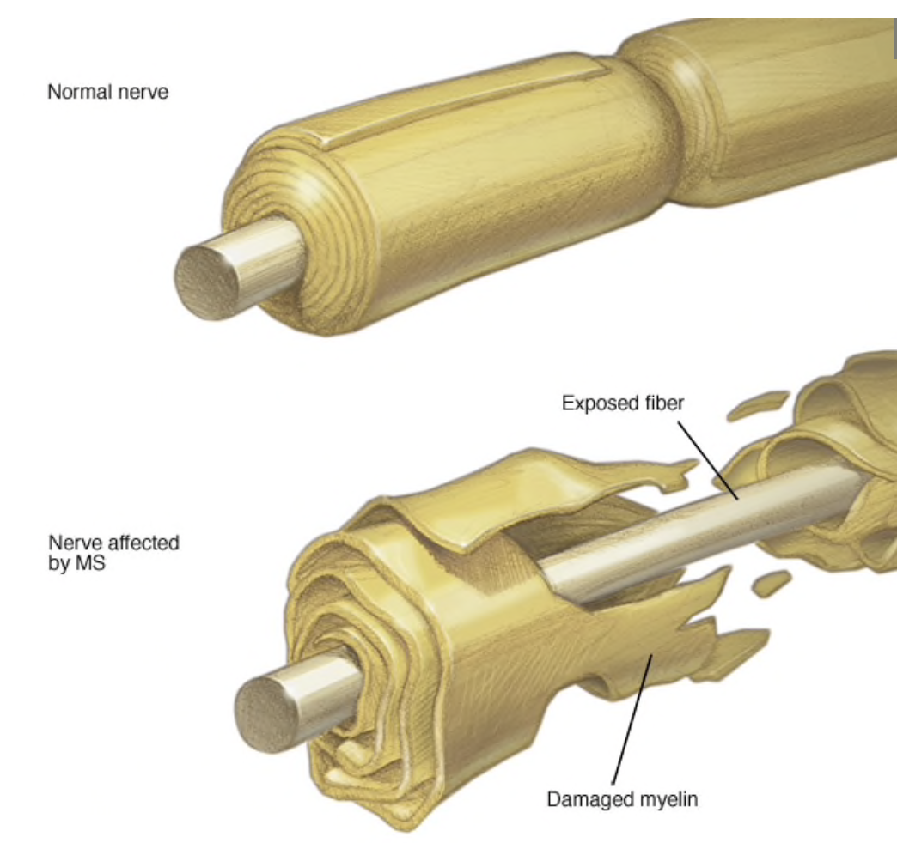
Multiple Sclerosis (MS)
MS is an immune-mediated inflammatory disease of the central nervous system (CNS) that cause disability due to disruption of myelinated fiber and axon degeneration with unknown etiology (environment + genetic factors)
The clinical status of each patient evolves along different profiles. In 85%, they follow three phases: CIS, RRMS, SPMS.
Disability
Time
Clinically Isolated Syndrome (CIS)
Relapsing Remitting (RR)
Secondary Progressive (SP)

Slide 3
Data Acquisition
MR examinations were performed on a 1.5T Siemens Sonata system (Siemens Medical Solution, Erlangen, Germany) using an 8-channel head-coil. The MR protocol consisted in the acquisition of a sagittal 3D-T1 sequence (1 × 1 × 1 mm³, TE/TR = 4/2000 ms) and an axial 2D-spin-echo DTI sequence (TE/TR = 86/6900 ms; 2 × 24 directions of gradient diffusion; b = 1000 s.mm⁻², spatial resolution of 2.5 × 2.5 × 2.5 mm³) oriented in the AC-PC plane.
Exams: The MS population consisted of seventy patients ditributed in four clinical profiles: 12 CIS, 30 RR and 28 SP, examined longitudinally every 6 months during 3 years and then every year during 4 more years. A total of 452 exams was obtained.

Slide 4
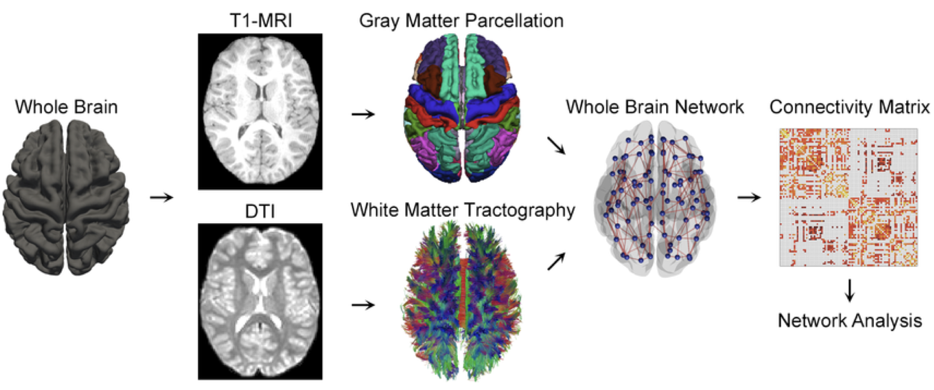
Data Preprocessing
Following MRI acquisition, the grey matter parcellation was performed on 3D T1-weighted images (Freesurfer software using the Desikan Atlas) and anatomically constrained probabilistic streamline tractography was performed on DTI images (MRtrix software).
Both data were combined to obtain structural connectivity graphs of the brain.

Slide 5
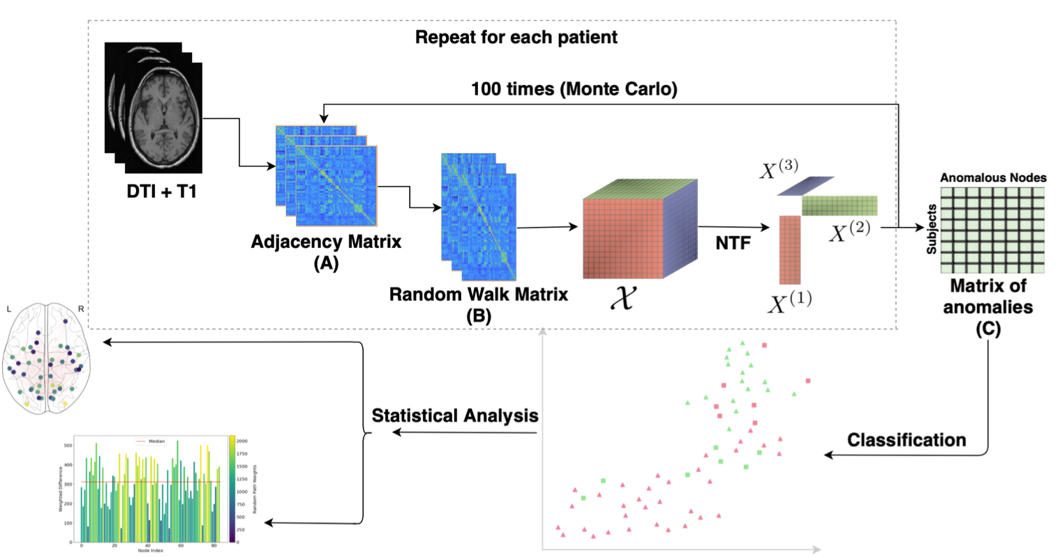
Proposed Method
Recursive Method Steps:
Start: Adjacency Matrix (A)
generate multiple Markovian Random Walks (MRW) and obtain MRW matrix B
repeat for each time step of a patient
generate 3D tensor from all B matrices
apply NTF and retrieve factorized anomalous components
apply 100 Monte Carlo iterations and count anomalies
Repeat for each patient
Use anomalies for classification (k-means)

Slide 6
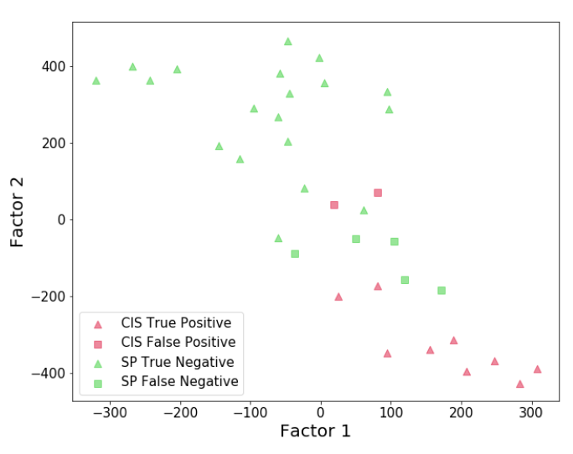
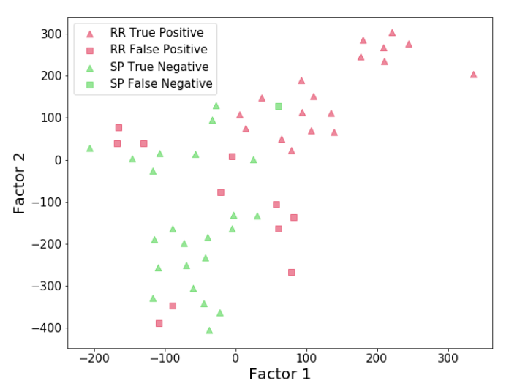
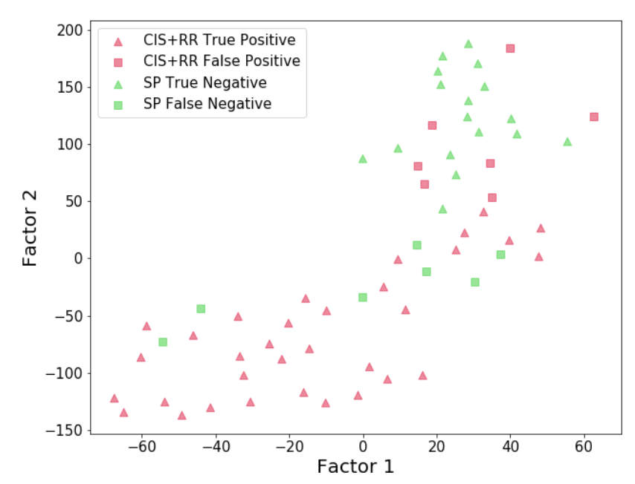
Results and Conclusions
Performance Results:
Best results are obtained comparing CIS and SPMS
Comparing RRMS patients with SPMS patients some degree of overlap is noticeable
Interpretability:
Using NTF we are able to understand the underline pathway followed by the model for classifying MS clinical phenotypes
The Frontal, Temporal and Parietal brain network links resulted the most anomalous providing highly important features for discriminating

