Slide 1
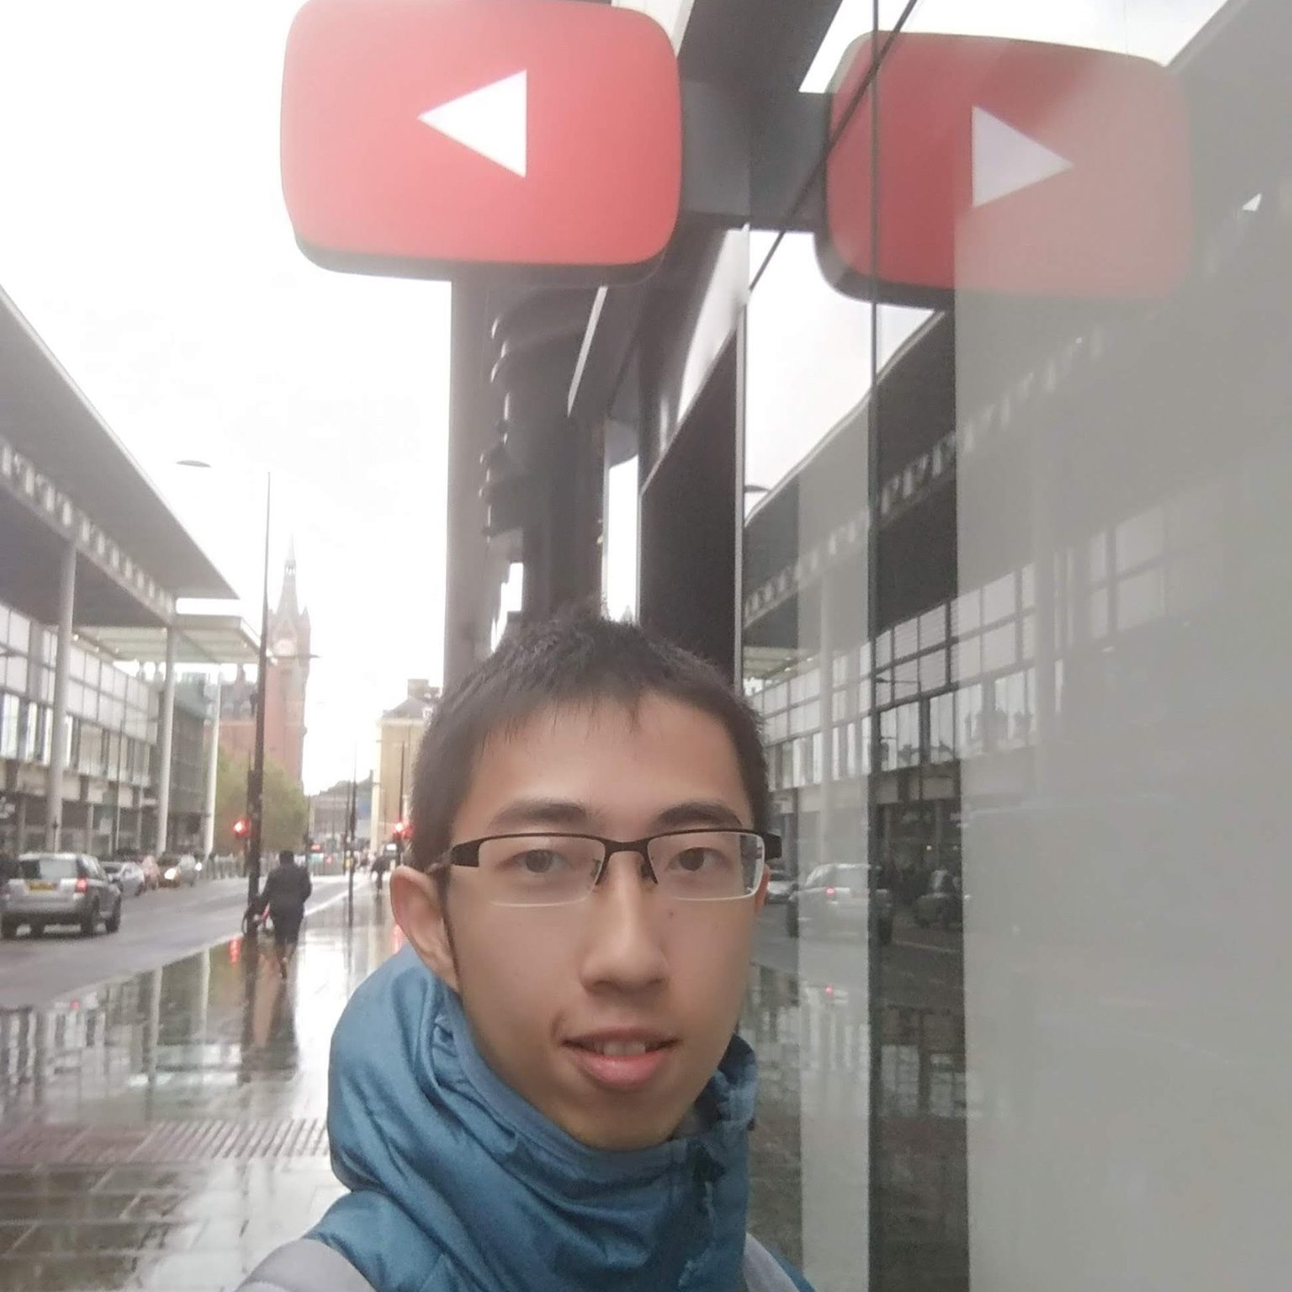
Learning Low-Shot Generative Networks for Cross-Domain Data
*indicate equal contribution
*Hsuan-Kai Kao¹
*Cheng-Che (SunnerLi) Lee²
Wei-Chen Chiu²
¹Academia Sinica
²National Chiao Tung University
Notes:
Hi, we introduce our paper - Learning Low-Shot Generative Networks for Cross-Domain Data

Slide 2
Introduction
Notes:
Deep generative models have been one of the most popular research topics nowadays.
Especially, generative adversarial networks (or so call GAN) can generate synthetic data with high quality.
The success of learning generative process largely relies on a huge quantity of training data,
but the heavy data consumption particularly limits their applicability when attempting to learn the generator for a novel data collection with little amount of samples.
In this work, we want to train a generative model with limited data.
However, Directly solving this problem is much challenging. ​
Thus, for easing the difficulty, we introduce a large amount of data which represent source-domain data and is designed to have correspondence with limited data.
And we here represent limited data as target-domain data.

Slide 3
Introduction

Slide 4
Introduction
Learn the target generator on the two condition:
Few target samples
Correspondence across source and target domain.
Two methods to solve the problem from different perspective:
Latent-Disentanglement-Oriented (LaDo)
Generative-Hierarchy-Oriented (GenHo)
Notes:
In a nutshell, while given a source domain with rich data and the correspondence between different domains,
we discuss the problem of learning a target-domain generator on the condition that there only exists few target samples,
together with the domain shift across source and target domain.
Two approaches are proposed to address the problem from different perspectives, which are Latent-Disentanglement-Oriented (LaDo) and Generative-Hierarchy-Oriented (GenHo) models

Slide 5
Data
Notes:
We use realistic fifty thousand shoes and human faces as our dataset.​
In the problem setting, we randomly choose 50, 100 and 500 samples from dataset as target domain data.​
Because we assume the structure of image as shared correspondence.​
To preserve the structure,​ we adopt style transfer on the remaining images as source domain data ,
which is expected to only have difference on appearance with target-domain data.​

Slide 6
Data
Notes:
We use realistic fifty thousand shoes and human faces as our dataset.​
In the problem setting, we randomly choose 50, 100 and 500 samples from dataset as target domain data.​
Because we assume the structure of image as shared correspondence.​
To preserve the structure,​ we adopt style transfer on the remaining images as source domain data ,
which is expected to only have difference on appearance with target-domain data.​

Slide 7
Contribution
Learning a standalone generator with a few samples.
Two approaches are proposed, including Latent-Disentanglement-Oriented (LaDo) and Generative-Hierarchy-Oriented (GenHo)
Reveal the insights on latent distribution of generative networks under low-shot setting
Apply our methods on CelebA dataset to alleviate the constraint for more realistic scenario
Notes:
Our contributions are listed here. ​
First, we define and explore a new challenging problem of learning a standalone target-domain generator with a few target-domain samples.​
Second, we propose two approaches to address the problem from different perspectives, Latent-Disentanglement-Oriented (LaDo) and Generative- Hierarchy-Oriented (GenHo) models.​
Third, our experiments reveal the insights on latent distribution of generative networks under low-shot setting.​
At last, we apply our methods on CelebA dataset to alleviate the constraint for more realistic scenario

Slide 8
Purposed methods - LaDo
Notes:
Here we firstly demonstrate the LaDo, that assume the latent space of the target-domain data can be disentangled into
domain-invariant subspace and domain-specific subspace.
Particularly, we firstly train the content encoder, source-domain appearance encoder and source generator,
And using the learned knowledge in source domain to help train the target generator.

Slide 9
Purposed methods - GenHo
Notes:
In the LaDo approach, the capability of target-domain generator heavily relies on having latent space well disentangled,
which could be occasionally hard to achieve or suffer from unstable training due to the challenge of low-shot scenario.
we further propose GenHo that aims to directly integrate the characteristics of our cross-domain data into the underlying generative procedure captured by a generator.
Here shows the full picture of GenHo. With comparison to LaDo, our GenHo model decomposes a generator into a cascade of two sub-networks, including content-generator and appearance-generator.
As in the training procedure of GenHo, we carefully design and decompose into several steps,
which can be categorized by two groups: content-related steps and appearance-related steps.
With series of individual steps, the content and appearance information can be well disentangled within the generator,
and the target generator can be obtained.

Slide 10
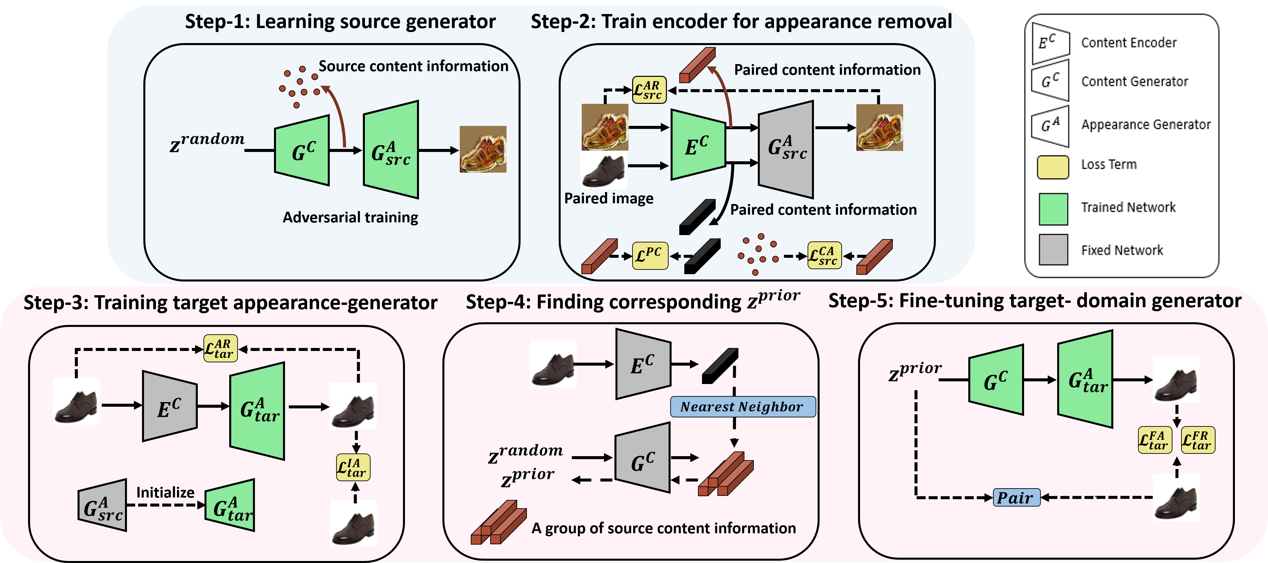
Purposed methods - GenHo
Notes:
In Content-related steps, we firstly train source generator with rich amount of data and obtain the source appearance generator,
and further utilize it to train the encoder for appearance removal.
These two steps is mainly responsible to capture the distribution of diverse content information from the source domain,
for the future use in the target-domain generator.

Slide 11
Purposed methods - GenHo
Notes:
The remaining in the training procedure focus on integrating the well-trained content space with the target-domain appearance-generator to build up the final target-domain generator.
Step-3 trains target-domain appearance-generator to generate target-domain images by taking content latent vectors as input.
To further boost the performance,
Step-4 finds the matches between the low-shot target-domain samples and the latent prior,
in which these matches are used by Step-5 to fine-tune the whole target-domain generator.

Slide 12
Experiment
Notes:
For the quantitative evaluation, we compare our proposed methods with three different baseline models.
Both our LaDo and GenHo generally obtain the best or competitive performance in comparison to all the baselines.
It verifies that our models can well capture the content diversity from the source-domain and are able to generate high-quality target-domain samples.

Slide 13
Experiment
Notes:
In qualitative evaluation, we demonstrate the generated result with only 50 target samples for training.
Our method can simultaneously give results of good quality.
Particularly, GenHo model performs the best and we contribute this to the well design choice.

Slide 14
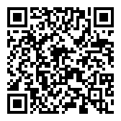
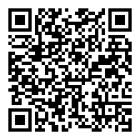
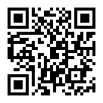
Learning Low-Shot Generative Networks for Cross-Domain Data
Paper
Supplementary material
Hsuan-Kai Kao
Researcher Assistant / Academia Sinica
hkkao@iis.sinica.edu.tw
Cheng-Che (SunnerLi) Lee
Deep Learning Researcher / MediaTek
nctusunnerli.cs06g@nctu.edu.tw
Code
Wei-Chen Chiu
Professor / NCTU
walon@cs.nctu.edu.tw
Notes:
Thanks for your attention. Please refer to our supplement for more experiments, ablation study, and discussion.

