Slide 1

25th International Conference on Pattern Recognition (ICPR2020)
Yingna Su, Yaqing Ding, Jian Yang and Hui Kong
Nanjing University of Science and Technology
Presented by: Yingna Su
A two-step approach to Lidar-Camera calibration
Notes:
Hello, everyone. In this video I'm going to present the paper “A two-step approach to Lidar-Camera calibration”.

Slide 2
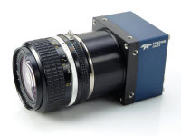
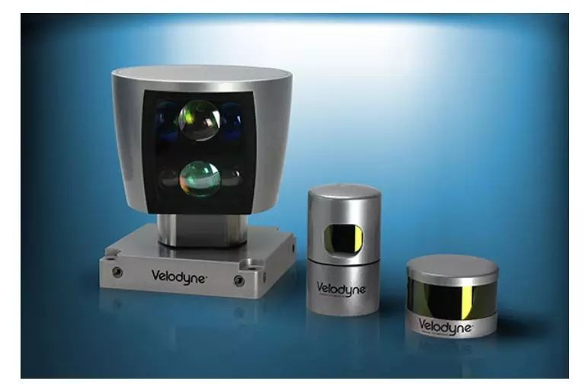
25th International Conference on Pattern Recognition (ICPR2020)
Introduction
Sensor | Pros | Cons
 | Cameras can perceive color and texture information from the surrounding environment, and can achieve high performance on object classification, recognition and semantic segmentation. | However, it is very difficult for single camera to obtain accurate 3D information. In addition, images can be significantly affected by strong exposures, shadows, or extreme lighting variations.
 | Lidar sensor can provide accurate 3D information, and can work well under low light conditions or even at night. | However, it does not provide rich color and texture information, and its resolution is low. Thus, it is difficult to extract semantic information from Lidar data.
Notes:
Autonomous [ɔːˈtɒnəməs] vehicles and robots are typically equipped with camera and Lidar sensor. Camera can perceive rich color and texture information from the surrounding environment, but it's sensitive to lighting variations [,veəri:'eiʃənz]. Lidar sensor can provide accurate 3D data, but without color information. Fusion of lidar and camera is usually performed to take good advantages of both sensors.

Slide 3
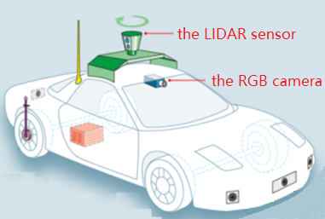
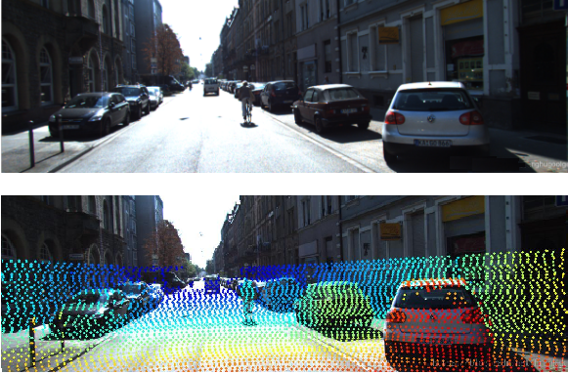
25th International Conference on Pattern Recognition (ICPR2020)
Introduction
Lidar-camera
calibration
Estimate 6-DOF
transformation
Rigid Connection
Fusion of Lidar and camera data
Notes:
Generally, Lidar and camera are rigidly mounted on top of a vehicle, as the figure shows. One needs sensor calibration, i.e., estimate the six-Degree Of Freedom transformation between Lidar and camera coordinate frames to fuse their data.

Slide 4
25th International Conference on Pattern Recognition (ICPR2020)
Related work
the appearance-based methods:
utilize correspondence matching between high curvature regions
the motion-based methods:
exploit the trajectories of Lidar and camera.
Notes:
The existing calibration methods can be generally divided into two categories, the appearance-based methods which utilize [ˈjuːtəlaɪz] correspondence [ˌkɒrəˈspɒndəns] matching between high curvature [ˈkɜːvətʃər] regions, and the motion-based methods which exploit the trajectories [trəˈdʒektərɪz] of Lidar and camera. The former can obtain high accuracy but is sensitive to the initial value, while the latter are on the contrary.
In this paper, we propose a hybrid method utilizing advantages of both categories.

Slide 5
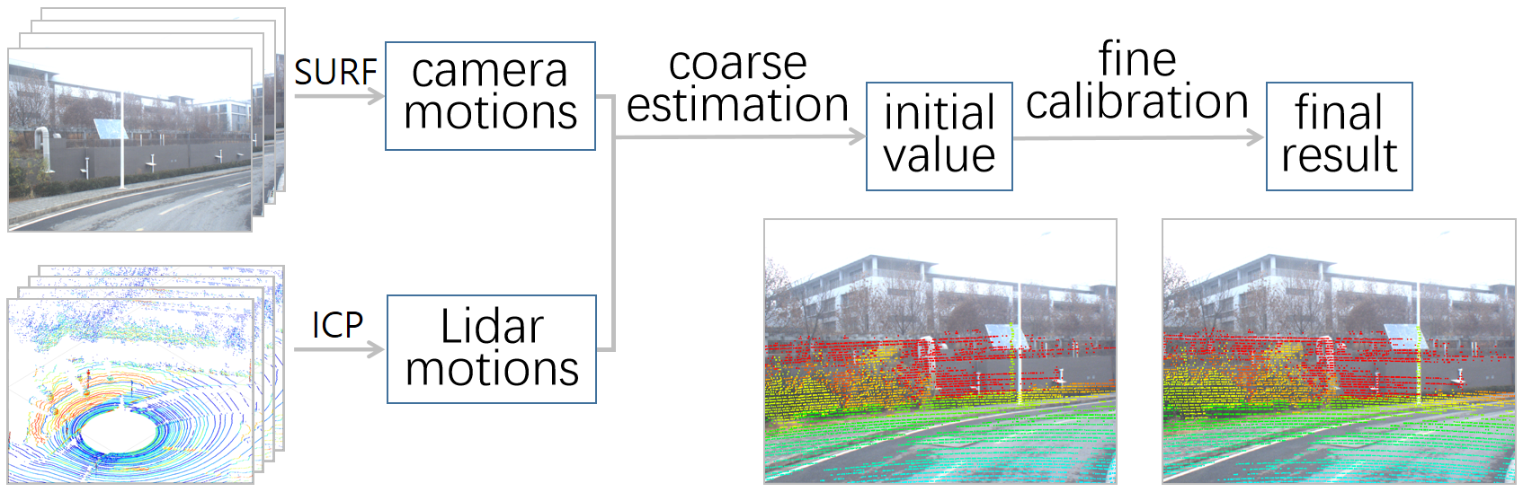
25th International Conference on Pattern Recognition (ICPR2020)
Two-step Lidar-camera calibration
Overview of the proposed Lidar-camera calibration method
Notes:
Our approach consists of two stages: coarse estimation and fine calibration.
In the coarse step, we perform a motion-based initial transformation parameters estimation.
The fine step utilizes ICP algorithm to improve the coarse estimation.
Next I’ll present details of the two steps.

Slide 6
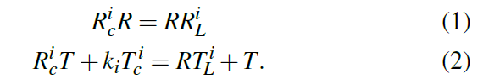






25th International Conference on Pattern Recognition (ICPR2020)
The first step: coarse calibration
The rigid-mounted camera and Lidar should satisfy the following constraints：
where and are the camera and Lidar motion. is the rigid transformation.
Eq. (1) is equal to
where are the rotation axes of the rotation matrices .
Notes:
First, we extend the normal hand-eye calibration to the Lidar-camera calibration problem. Based on the hand-eye calibration, the rigid-mounted camera and Lidar should satisfy the following constraints, where rc and tc are the relative camera motions that can be estimated using some well-known methods, such as the six-point algorithm with bundle adjustment. Rl and tl are the relative lidar motions that can be obtained by ICP algorithm. Equation. (one) is equal to equation (three), where nc and nl are the rotation axes of rc and rl, respectively.
Now the hand-eye calibration has been converted to a classical problem that finds the rotation between two sets of vectors and can be solved by SVD based algorithm.Instead, we will give a closed-form solution which is more efficient and does not suffer from any degenerate [dɪ'dʒenərət] configurations.

Slide 7

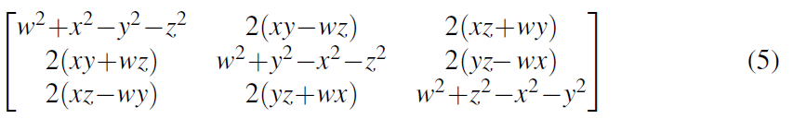

25th International Conference on Pattern Recognition (ICPR2020)
The first step: coarse calibration
We define the following cost function:
We use the unit quaternion to parameterize the rotation matrix R:
with the unit quaternion constraint .
Notes:
we define the following cost function. Our aim is to find the rotation matrix R which minimizes equation (4), from which we will obtain the relative rotation matrix between the camera and lidar sensor. We use the unit quaternion [kwə'tɜːnɪən] to parameterize the rotation matrix. The advantage of quaternion formulation is its convenience for derivative [dɪˈrɪvətɪv] calculating.

Slide 8
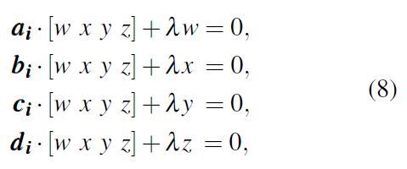

25th International Conference on Pattern Recognition (ICPR2020)
The first step: coarse calibration
We can use the Lagrange multiplier and define the following function:
To find the minimum of F, the partial derivatives of F should be zero.
Then we obtain four polynomial equations:
where are known coefficients calculated from the camera and lidar motions.
Notes:
Now we can use the Lagrange [lə'ɡrɑndʒ] multiplier and define the following function as shown in equation (six). To find the minimum of F, the partial derivatives[dɪˈrɪvətɪvz] of F should be zero. Then we obtain four polynomial [,pɒlɪ'nəʊmɪəl] equations. We use the hidden variable[ˈveəriəbl] technique to solve equation (8) and obtain the rotation matrix. Once the rotation matrix is known, the translation matrix can be calculated from equation (2).

Slide 9
25th International Conference on Pattern Recognition (ICPR2020)
The second step: fine calibration
The generation of the point cloud in the camera coordinate system：
Left: the corner points (marked in green circle). Middle: the 3D point cloud corresponding to the corner points in the world coordinate system. Right: the point cloud transformed from the world coordinate system to the camera coordinate system.
Notes:
With the initial calibration parameters, the second step is to utilize icp algorithm to register two point clouds in the camera and Lidar coordinate system, respectively, to refine the coarse estimation. The point cloud in the camera coordinate frame can be generated based on Zhang's Camera Calibration Algorithm. We first assemble[əˈsembl] all the corner points to generate a point cloud. Then we transform the point cloud from the world coordinate system to the camera coordinate system with the extrinsic[eksˈtrɪnzɪk] parameters obtained from zhang’s method.

Slide 10
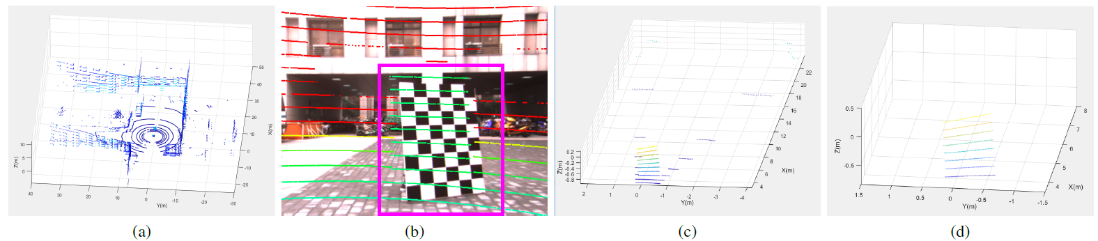
25th International Conference on Pattern Recognition (ICPR2020)
The second step: fine calibration
The generation of the point cloud in the Lidar coordinate system：
(a) The raw Lidar data.
(b) The result of the coarse calibration of the Lidar data re-projected onto the image. We keep only the point that
are re-projected onto the checkerboard and the surrounding area (shown within the purple box).
(c) The remained point cloud.
(d) The final point cloud in the Lidar coordinate system.
Notes:
Correspondingly, the point cloud in the Lidar coordinate system can be extracted from raw Lidar data. As the figure shows, we filter the raw data, keeping only the points that are re-projected onto the checkerboard and the surrounding area. Then a plane fitting method is used to obtain the final point cloud.

Slide 11
25th International Conference on Pattern Recognition (ICPR2020)
The second step: fine calibration
Use the ICP algorithm with the coarse initialization to obtain fine calibration result.
(a)(b)(c) and (e)(f)(g) are the point cloud of the checkerboard pattern with different positions in the camera and the Lidar coordinate system, respectively.
(d) and (h) are the point cloud originated from the fusion of (a)(b)(c) and (e)(f)(g), respectively.
With the coarse calibration result (i), we use ICP algorithm to register the two merged point cloud (d) and (h) to get the fine calibration result (j).
Notes:
In this way, we collect 6 pairs of point clouds of the checkerboard pattern at different positions and in different orientations in the camera and Lidar coordinate systems, respectively.
Finally, we use the ICP algorithm with the initialization obtained by coarse estimation step, to register the point clouds and then get the fine calibration result.

Slide 12
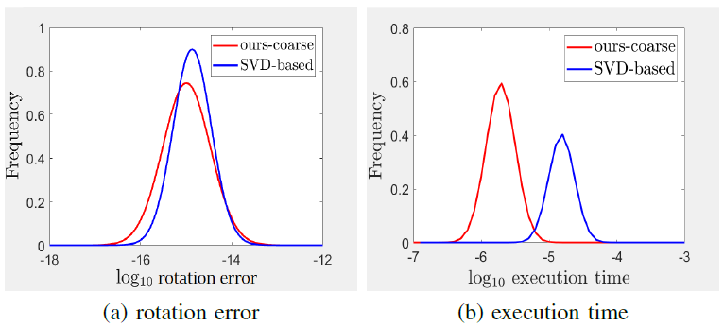
25th International Conference on Pattern Recognition (ICPR2020)
Experiments
Coarse calibration
Notes:
For the evaluation of coarse calibration, we compare our closed-form solution against the state-of-the-art SVD-based algorithm with synthetic data. The figures show kernel smoothed histograms of log10 rotation
error and execution[ˌeksɪˈkjuːʃn] time, respectively. As we can see, our method can effectively reduce the run time while
possessing similar accuracy as the SVD-based algorithm.

Slide 13
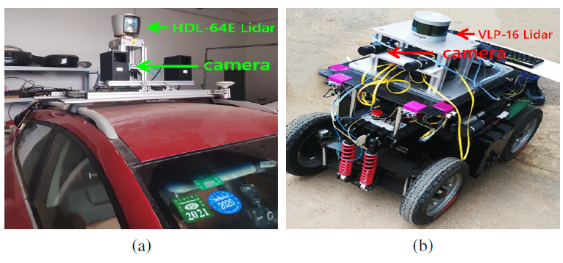
25th International Conference on Pattern Recognition (ICPR2020)
Experiments
Fine calibration
Experimental Setup. (a) An unmanned car equipped with the HDL- 64E Lidar and the PointGrey Flea3 camera. (b) A mobile robot equipped with the VLP-16 Lidar and the PointGrey Flea3 camera.
Notes:
Then, the proposed complete two-step approach is evaluated with real data captured from two different platforms. The first is an unmanned car equipped with a 64 scan lines Lidar and a camera. The second is a mobile robot with a 16 scan lines lidar and a camera.

Slide 14
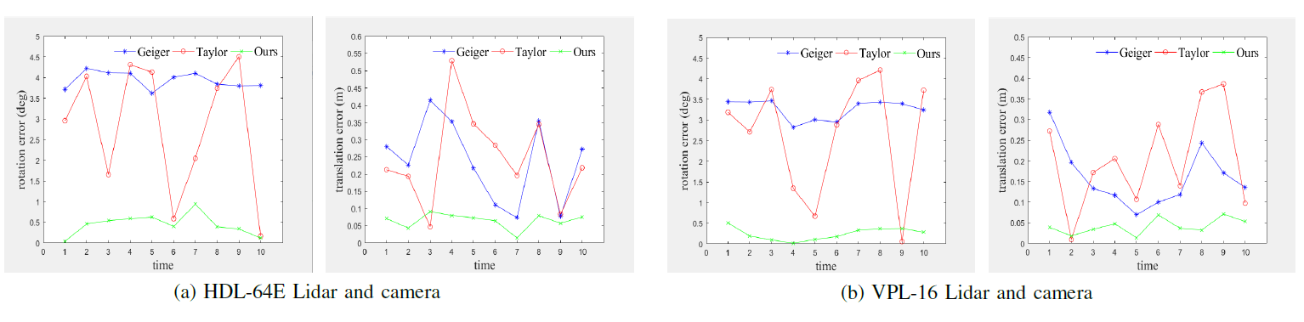
25th International Conference on Pattern Recognition (ICPR2020)
Experiments
Fine calibration
The comparison results of the rotation error (the 1st and the 3rd subfigure) and the translation error (the 2nd and the 4th subfigure) by our method and the other two methods.
Notes:
We compare our method with two state of the art algorithms denoted as Geiger ['gaigə] and taylor. As shown, our method is more robust than comparable methods.

Slide 15
25th International Conference on Pattern Recognition (ICPR2020)
Experiments
Fine calibration
Notes:
The qualitative [ˈkwɒlɪtətɪv] calibration result is displayed to present the comparison intuitively [ɪnˈtjuːɪtɪvli]. The calibration results from the left to right column are from Geiger, Taylor and our method, respectively. The first row shows the result captured by the sixty-four scan lines Lidar. The second row shows the sixteen lines Lidar results. As shown, our calibration method achieves the best results.

Slide 16
Thank you!
Contact us: suyingna@njust.edu.cn
Notes:
That’s all. Thank you for watching. welcome to contact us if there’s any question.

