Slide 1
3D Audio-Visual Speaker Tracking with A Novel Particle Filter
Presenter: Yongheng Sun
Major：Computer Application Technology

Slide 2
Outline
Research Background
Research Method
Experiments
Research Content

Slide 3
Outline
Research Background
Research Content
Research Method
Experiments

Slide 4
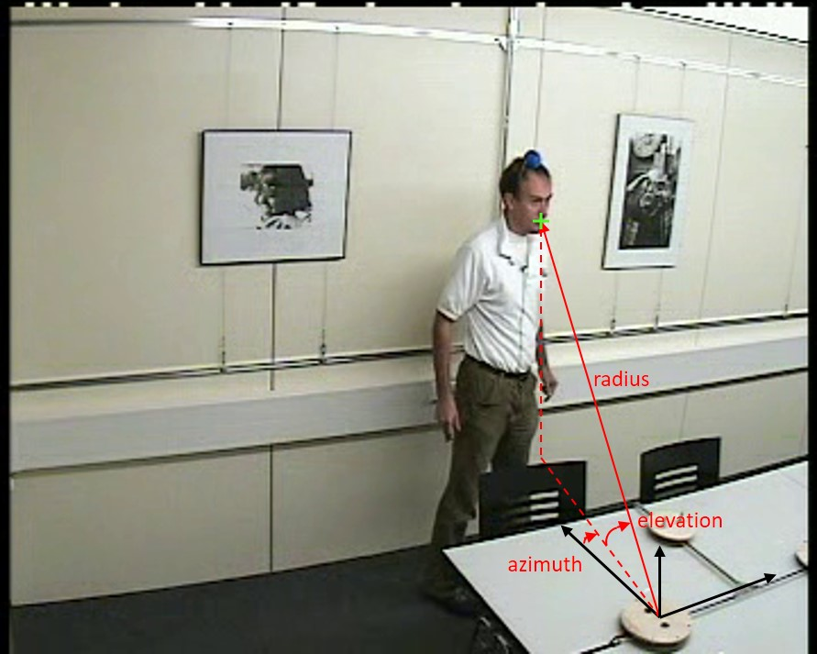
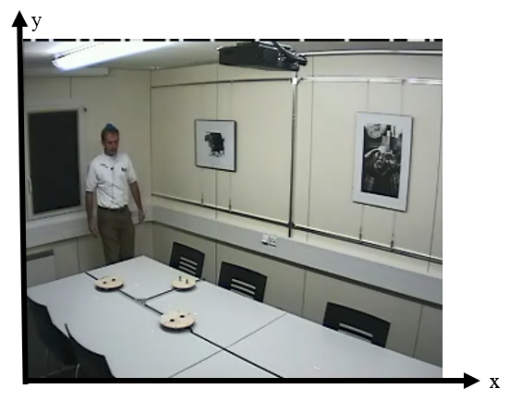
Audio-Visual Fusion Speaker Tracking
Audio-visual
Coordinate system
Complementarity
Redundancy
Accuracy
Robustness
3D
2D (image plane)
Notes:
视听融合的说话人跟踪旨在利用音视频信号各自的优点以提高跟踪的精度和鲁棒性

Slide 5
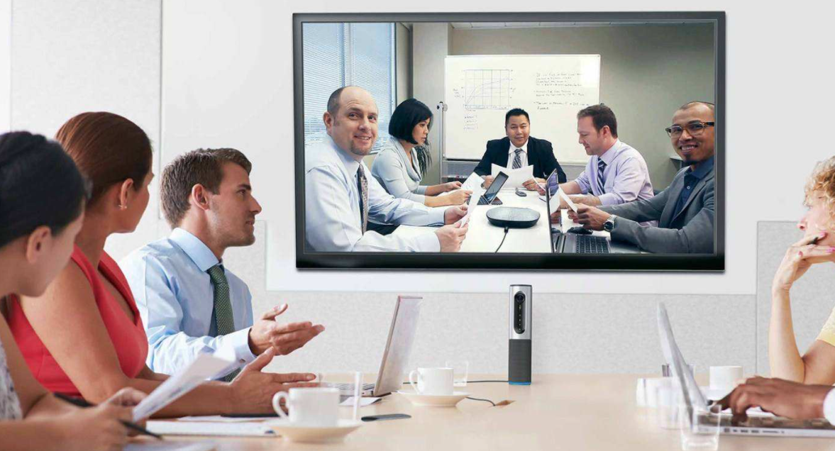
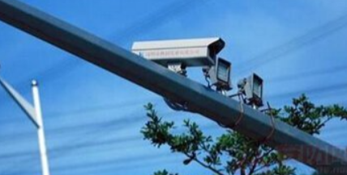
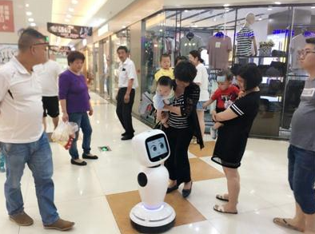
Applications
Video Conference
Delivery Robot
Security Monitoring
Intelligent Guide Robot
Notes:
应用：视频会议；送餐机器人；安全监控；智能导购机器人等

Slide 6
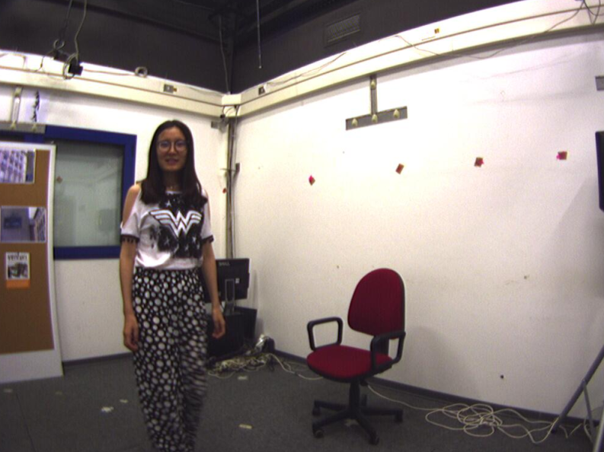
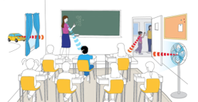
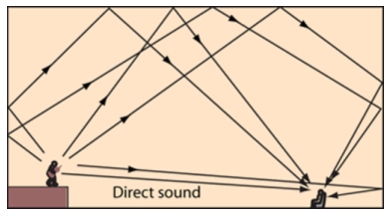
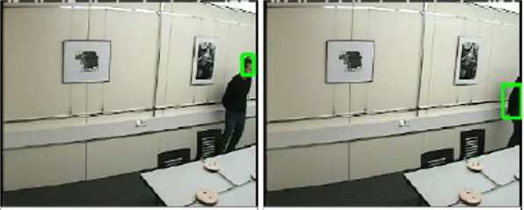
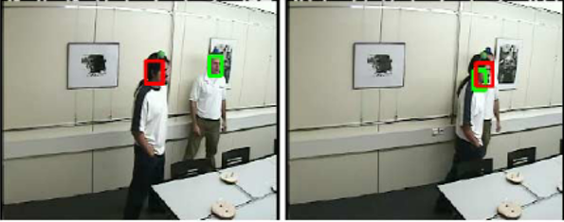
Challenges
Modality heterogeneity
vs
Audio modality Video modality
Audio
noise reverberation
Video
disappear occlude
Notes:
难点：音视频模态异质性；噪声、混响；消失、遮挡等

Slide 7
Related Works
Audio tracking
Time delay estimation based methods
Steered beamforming based methods
High resolution spectrum based Methods
Video tracking
Generative based methods
Discriminative based methods
Tracking frameworks
Bayesian framework based method
Kalman Filter
Extended Kalman Filter
Particle Filter
Linear, Gaussian system
Non-Linea, Gaussian system
Non-Linea, Non-Gaussian system
Notes:
音频定位方法主要有基于到达时间差的方法、基于波束形成的方法和基于高分辨率谱估计的方法；基于视频的目标跟踪方法主要可以分成生成式的目标跟踪方法和判别式的目标跟踪方法；跟踪框架主要是基于贝叶斯滤波的框架，主要有卡尔曼滤波方法、扩展卡尔曼滤波方法和粒子滤波方法

Slide 8
Related Works
Multi-modality fusion methods
Early fusion Later fusion Hybrid fusion
Can make full use of the correlation between modalities
Data is homogeneous; Strong scalability
Retain the advantages of early and later fusion
Data has large heterogeneous
Cannot make full use of the correlation between modalities
Notes:
多模态融合方法主要有早期融合、后期融合、混合融合。各有优劣

Slide 9
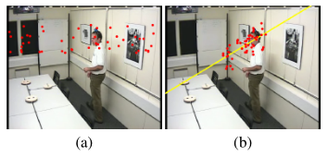
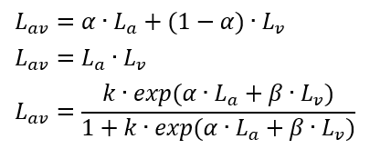
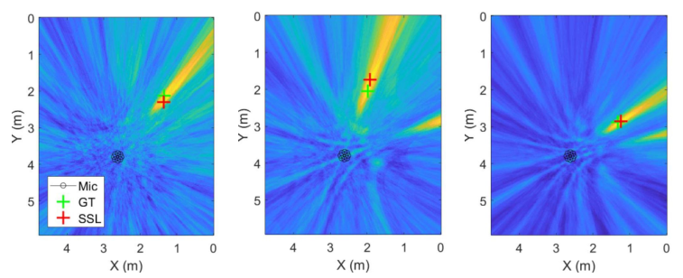
Related Works
Audio for new born particles Likelihood combination
(Complimentary) (Redundancy)
Audio GCF at the speaker-height plane estimated by visual modality (assistance)
Notes:
音视频融合方法举例：互补性、冗余性、相互辅助性

Slide 10
Outline
Research Background
Research Method
Experiment
Research Content

Slide 11
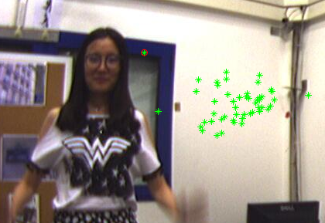
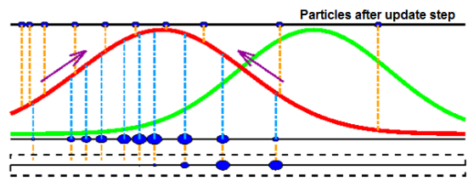
Research Content
Speaker tracking failure and restart tracking
Particle weight degradation
3D likelihood function setting
Tracking failure
Particle weight degradation
Notes:
研究内容有三点：跟踪失败的恢复；粒子权重的退化；粒子3D似然函数的设置

Slide 12
Outline
Research Background
Research Method
Experiments
Research Content

Slide 13
Research method
Pipeline of the audio-visual speaker tracking
Notes:
整体流程图，三个部分分别主要解决前述对应的三个问题

Slide 14
Research method
Pipeline of the audio-visual speaker tracking
Tracking failure
Notes:
对应第一个问题：跟踪失败

Slide 15
Research method
Pipeline of the audio-visual speaker tracking
Particle weight degradation
Notes:
对应第二个问题：粒子权重衰减严重

Slide 16
Research method
Pipeline of the audio-visual speaker tracking
3D likelihood
Notes:
对应第三个问题：3D似然的设置

Slide 17
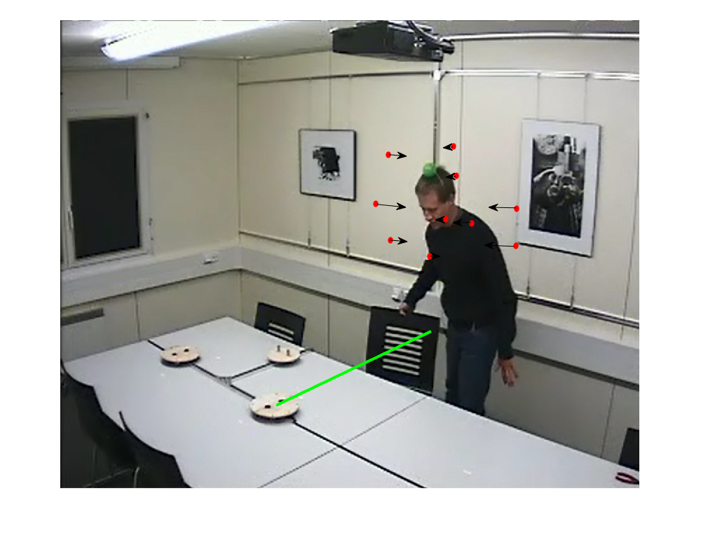
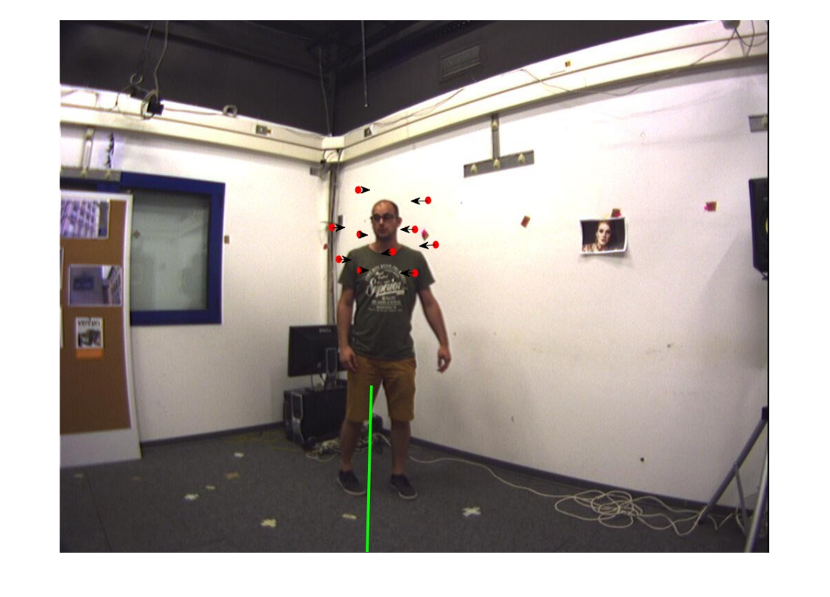
Research method
Particle relocation based on audio localization
$θ^{(n)}←$ $θ^{(n)}$+k$∙C_{\tilde{θ}}∙1_{av}(\tilde{θ}−θ^{(n)})$
AV16.3
CAV3D
Notes:
简单说粒子朝着音频检测的角度方向移动

Slide 18
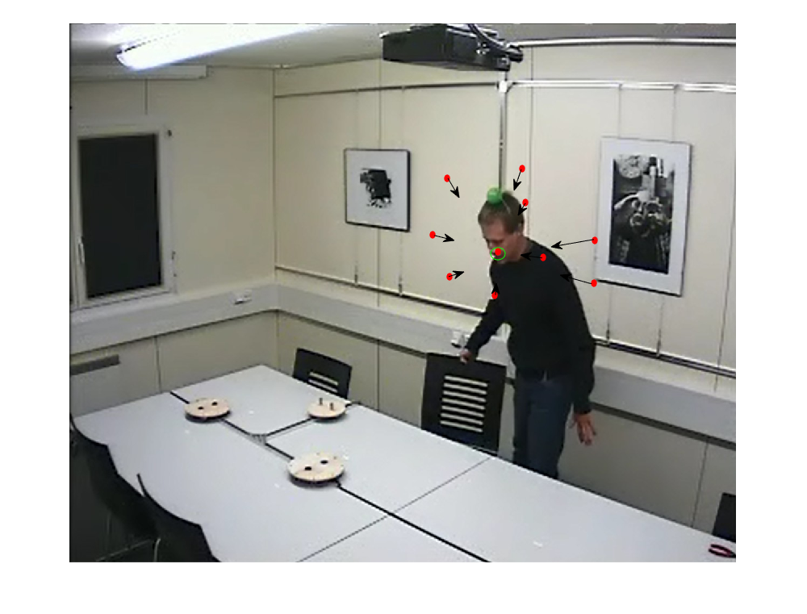
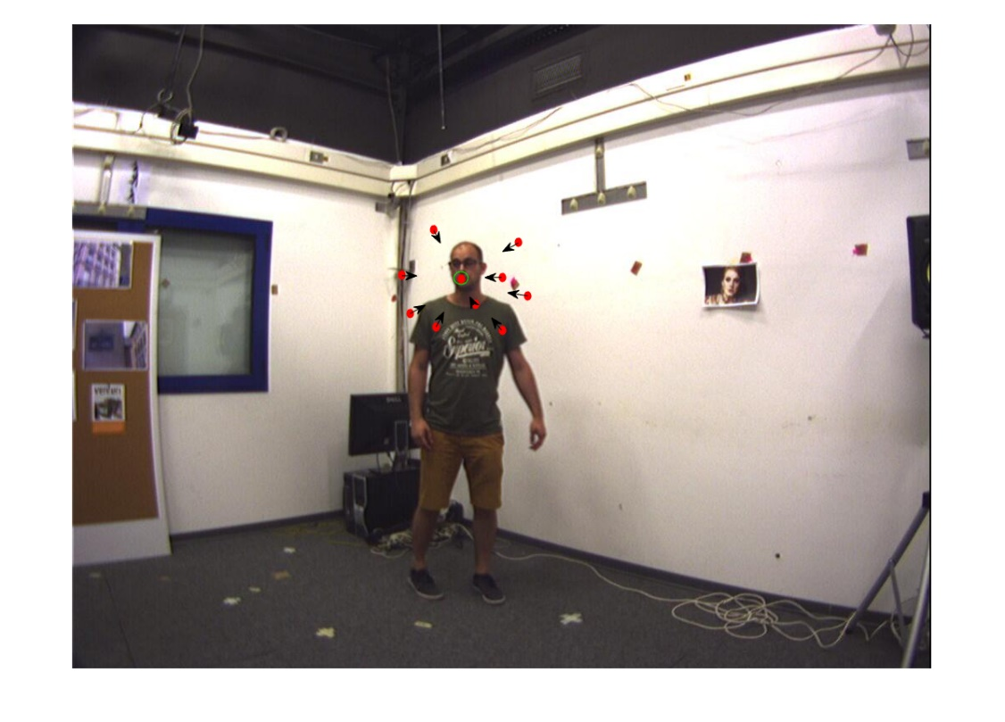
Research method
Particle relocation based on audio-visual likelihood
$θ^{(n)}←$ $θ^{(n)}$+k$∙ (θ^{(gbest)}−θ^{(n)})$
$φ^{(n)}←$ $φ^{(n)}$+k$∙ (φ^{(gbest)}−φ^{(n)})$
AV16.3
CAV3D
Notes:
简单说粒子朝着全局最优粒子的方向移动

Slide 19
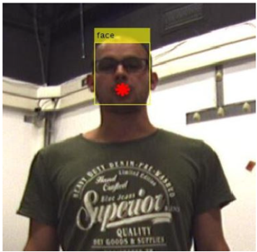
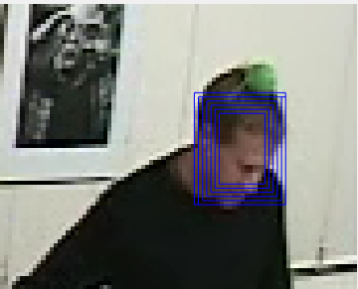
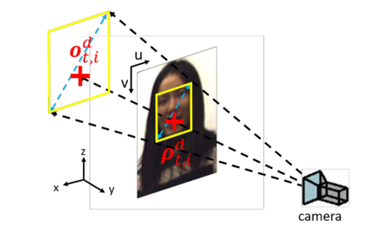
Research method
Speaker distance estimation
Face detection (>40%) Adaptive color histogram matching (>80%)
Distance estimation
Notes:
人脸检测和自适应颜色直方图匹配估计说话人在图像平面的尺寸，利用先验尺寸和摄像机投影模型估计距离

Slide 20
Research method
Distance likelihood
$$L_{ρ}=exp⁡(−λ∙|D_{p}−D_{est}|)$$
Particle likelihood
$L_{p}=$ $L_{ρ}∙L_{a}^{α}∙L_{v}^{β}$
Speaker state estimation
$${\tilde{p}}_{3D}=\sum_{i=1}^{N}{w^{(n)}∙p^{(n)}}$$
Particle resampling
$$ESS=\frac{{(\sum_{i=1}^{N}{w^{(i)}})}^{2}}{\sum_{i=1}^{N}{{(w^{(i)})}^{2}}}<\frac{N}{2}$$
Notes:
粒子似然等于距离似然与角度似然的乘积；说话人状态估计以及粒子重采样的条件

Slide 21
Outline
Research Background
Research Method
Experiments
Research Content

Slide 22
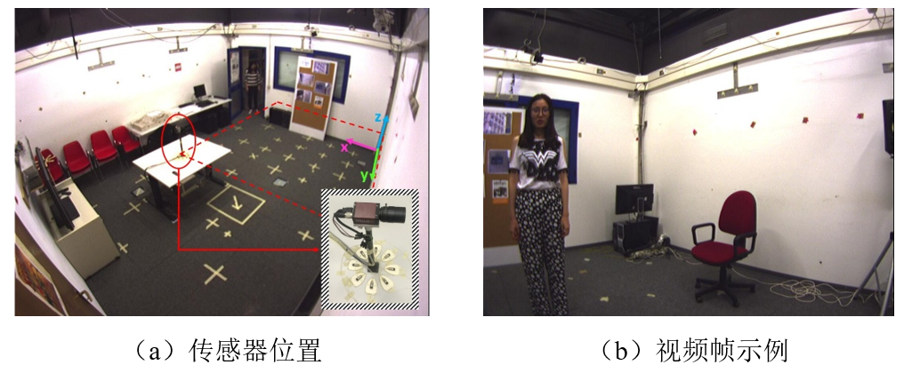
Experiments
CAV3D dataset
AV16.3 dataset
Position of sensors
Example
Position of sensors
Examples
Notes:
实验使用的数据集

Slide 23
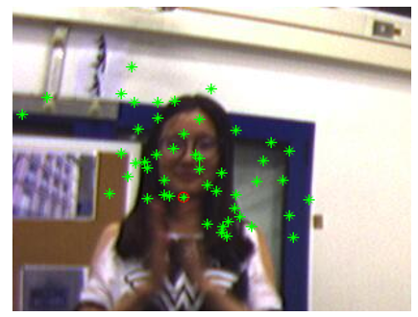
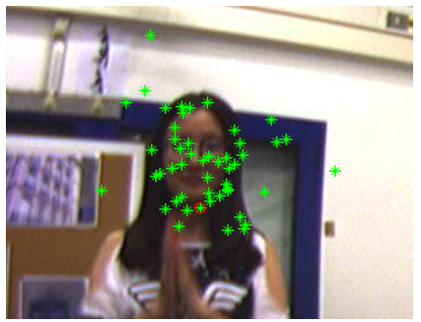
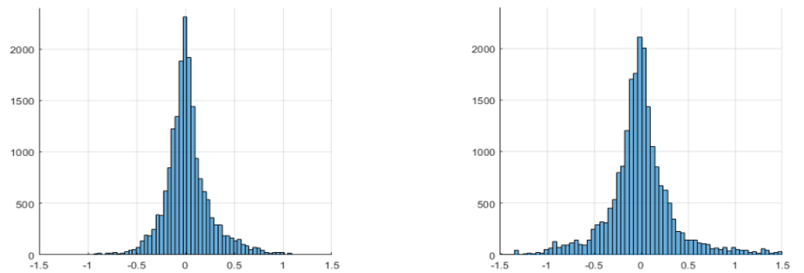
Experiments
Particle relocation
Speaker distance estimation error
Particle distribution without relocation
Particle distribution with relocation
By face detection By adaptive color histogram
Notes:
实验中间结果

Slide 24
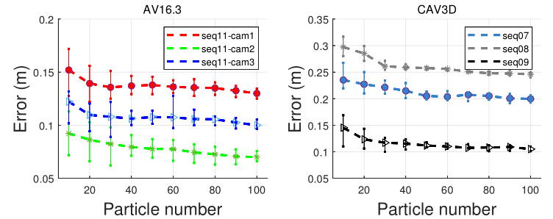
Experiments
Tracking results on CAV3D seq08
Tracking error with different number of particles
X Y Z
Notes:
部分结果

Slide 25
Experiments
CAV3D
AV16.3
 |  | Ours |  |  | Ref1
 |  | AO | VO | AV | AV
3D | TLR(%) | 58 | 46 | 20 | 32
 | MAE(m) | 0.50 | 0.70 | 0.21 | 0.30
2D | TLR(%) | 54 | 41 | 3 | 7
 | MAE(pixel) | 56 | 79 | 12 | 16
 | Ours |  |  | Ref1 | Ref2
 | AO | VO | AV | AV | AV
3D MAE(m) | 0.59 | 0.28 | 0.10 | 0.17 | 0.12
2D MAE(pixel) | - | - | 4.25 | 7.09 | 4.51

