Slide 1
Developing Motion Code Embedding for Action Recognition in Videos
25th International Conference on Pattern Recognition (ICPR) – Milan, Italy
Maxat Alibayev, David Paulius, and Yu Sun
Department of Computer Science & Engineering,University of South Florida, Tampa, Florida, USA
This material is based upon work supported by the National Science Foundation under Grant No. 1812933 and 1910040
Notes:
Greetings IROS!
Max: My name is Max…
David: … and my name is David, and we will both be giving a summary of our paper, which is entitled “Estimating Motion Codes from Video Demonstrations”.

Slide 2
Overview of Work
Motion codes – embedding of a motions based on a manipulation’s salient features in form of binary strings
Salient features are outlined in motion taxonomy – hierarchy of mechanical and physical features for describing manipulation from robotics perspective.
Mechanics of motion: contact, trajectory and state change
We propose a verb classification framework to predict verbs by combining motion codes with visual features.
Notes:
In this paper, we build upon our previous work of embedding manipulation or action as a binary string or code, known as motion codes. These motion codes comprise of several mechanical and physical properties that are relevant to robotics (such as contact and trajectory). These features are organized in a hierarchical structure known as the motion taxonomy. In this work, we propose a deep learning approach to obtain these motion codes directly from videos of demonstrations of action.

Slide 3
Motivation for Taxonomy
Motion representation is a challenge, as human language (words or verbs to describe motion) can be ambiguous.
Conventionally, we can represent verbs for motion as vectors.
Word2Vec – context-based method to derive word vectors
Distances between vectors learned from word-based context do not relate to mechanics.
Example: words ‘pour’ and ‘tap’ are closer than ‘tap’ and ‘poke’
Notes:
From our own work on knowledge representation, we observed that it is a challenge to describe manipulations with words, as human language is inherently ambiguous. This problem also extends when we try to communicate the idea of motions to robots.
In machine learning, motions are typically represented as vectors, which are learned using methods such as Word2Vec. However, these embeddings do not reflect mechanical characteristics of motions, and therefor, distances between these vectors do not make sense.

Slide 4
Motivation for Taxonomy
Instead of using vectors from Word2Vec, motion codes can be used as motion representation for action recognition tasks.
Motion codes can be obtained in an unsupervised manner.
Classifier such as neural networks can detect feature components
In this work, we illustrate how motion codes can improve verb classification over baseline models.
Notes:
Instead of using vectors from Word2Vec, which rely on natural language, we proposed that motion codes are better suited to represent motions for tasks such as activity recognition or affordance learning. In this paper, we implemented a deep learning model that can be used to predict motion codes by individually classifying each feature of the taxonomy and combining them together into single motion codes.

Slide 5
Using the Motion Taxonomy
The taxonomy is used to embed manipulations as motion codes.
A manipulation is an action where an active object acts upon or manipulates a (set of) passive object(s).
Specifically, we note:
Contact between active and passive objects
Active object trajectory and (relative) passive object trajectory
Notes:
In our previous work, we formally presented the motion taxonomy structure on this slide. Before explaining
We defined a motion taxonomy that represents the most important mechanical characteristics in manipulation motions. We consider a manipulation to be any interaction between active and passive objects, and we can describe this interaction using attributes such as: interaction type, which describes whether the active and passive objects make any contact or not, and if they do, we can describe the type of engagement, or deformation that happens, and we can define the duration of contact that happens. In addition to that, we can also define the trajectory that is observed among the manipulated objects.
[Dr. Sun’s suggestion: “we defined a motion taxonomy that represents the most important mechanical characteristics in manipulation motions” instead of “we illustrate the motion taxonomy”]

Slide 6
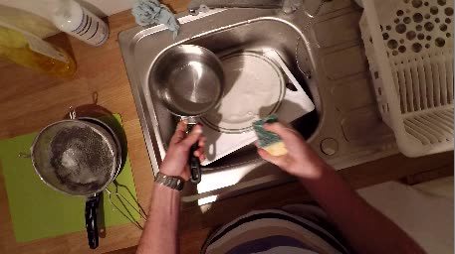
Motion Code Prediction
Given an input video of demonstration...
... a classifier (i.e. deep model) can process it based on the attributes of the motion taxonomy...
Motion Classifier (Deep NN)
Motion Classifier (Neural network)
Motion Taxonomy
INPUT: Motion Sequence
Motion Taxonomy
INPUT: Motion Sequence
OUTPUT:
Motion Code
(e.g. 11100110010000001)
… to assign a motion code to this demonstration.
Notes:
The key idea of this taxonomy is to allow us to obtain motion codes from demonstration. The pipeline to obtain these motion codes is as follows: given an input demonstration video, we can use a motion classifier that is trained on the motion taxonomy to produce a motion code as output.

Slide 7
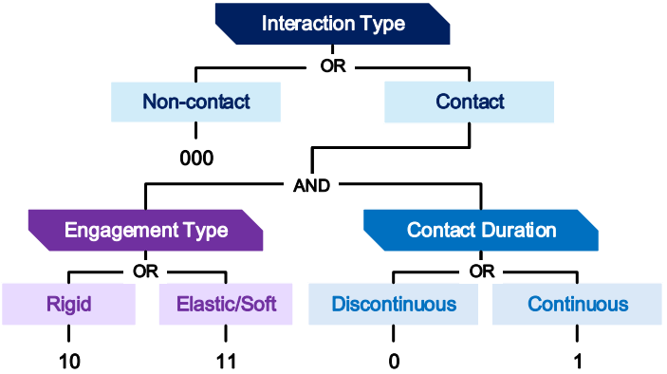
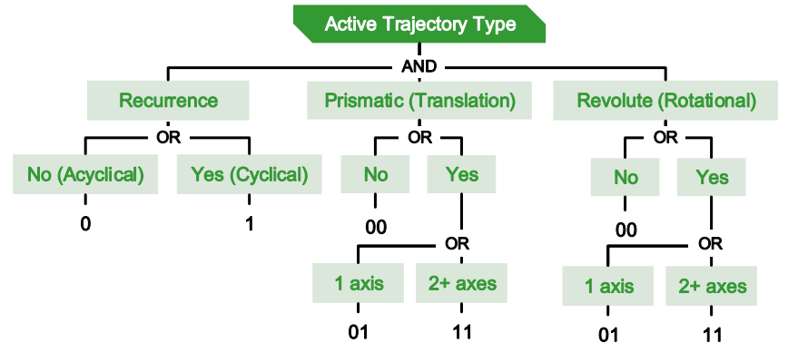
Motion Taxonomy Structure
Figure 1 (from paper) – Illustration of taxonomy
Notes:
To facilitate the prediction of motion codes from videos, we simplified the taxonomy to the following structure. Just as before, we still consider interaction type, engagement type and contact duration. However, we simplified the trajectory description of the active and passive objects. For active objects, we retain the same sub-features, but we classify prismatic and revolute trajectory as either non-existent, 1 axis, or 2 or more axes. For passive objects, we only note whether there exists any trajectory relative to the active object or not.

Slide 8
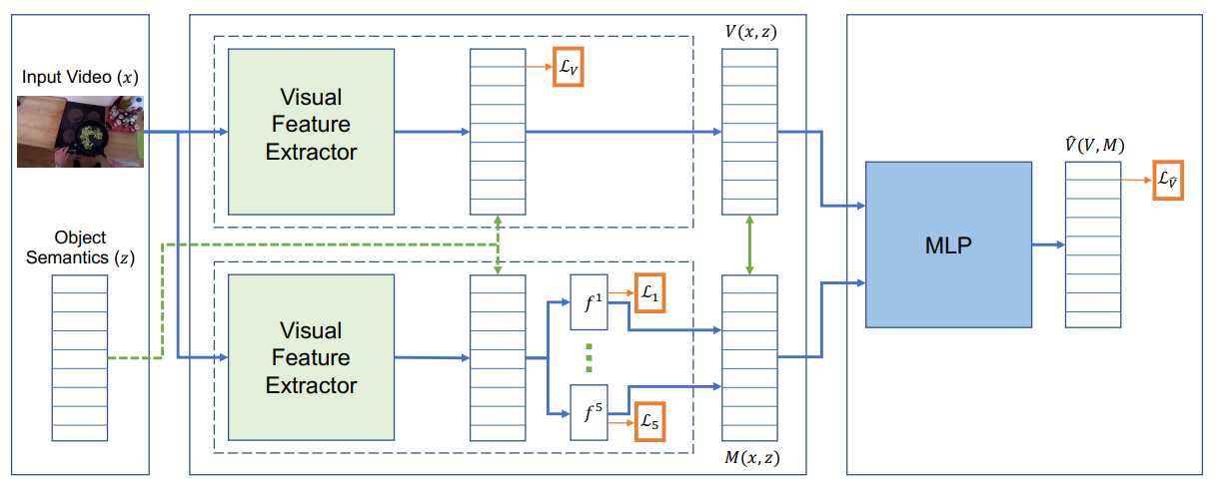
Methodology
Figure 2 (from paper) – Illustration of verb classification framework.
Notes:
This slide demonstrates the structure of our verb classification framework. With extracted visual features from an input video and optionally the semantic data about the objects in action, we can obtain an internal representation of the action as motion codes. Here , the baseline visual feature extractor is Inflated 3D Convolutional neural network or I3D for short. The motion code prediction is combined with visual features to obtain a verb prediction.
In the figure, you could also see the second input to our model, which is the semantic data about the object-in-action. This branch is optional in our pipeline. We added this input to see how the model would react to the information about the objects being involved and whether it will find and leverage any correlations between objects and motion codes.

Slide 9
Methodology
Two main processes for model:
Extract visual features from video with CNN
Inflated 3D ConvNets (I3D) [Carreira et al. 2017]
Combining RGB and optical flow
Extract semantic features from nouns for objects-in-action
Word2Vec pre-trained on Google News [Mikolov et al. 2013]
Nouns provided by EPIC-KITCHENS dataset [Damon et al. 2018]
Notes:
50 seconds
To extract latent visual features from the video, we use Inflated 3D ConvNets. This model demonstrated the state-of-the-art results in action recognition task for widely used datasets, including EPIC Kitchens dataset that we use in our experiments. The model was pre-trained on RGB and optical flow videos from the Kinetics dataset.
The object semantic features were extracted with Word2Vec model that was pre-trained on Google News dataset. If the object is represented with multiple words, we take average of the vectors of individual words.
When we use the semantic features, we combine them with visual features by concatenating 2 laten vectors.

Slide 10
Methodology
Goal: Predict motion code components from extracted features:
$ξ∈(Ω,Ψ^{∗})$ – combination of extracted features
$f_{i} :\left(Ω,Ψ^{∗}\right)→Y_{i}$ – classifier for a motion code component $i$
Model is trained with linear combination of cross-entropy losses of all components, as defined by loss $ℒ$:
$$ℒ=\sum_{i=1}^{5}{λ_{i}}ℒ_{i}$$
Notes:
55 seconds
The latent features are used as the input to 5 separate classifiers that predict the motion code components individually. We denote the latent features as vector Xi. The term to the right describes its dimensionality, which may or may not include the semantic features, whose space is denoted as Psi. We denote the classifier for the motion component i as f_{i} that maps the input features to the value of the component.
We train the model with the categorical cross-entropy loss by linearly combining the losses of all classifiers. In our experiments, we set all lambdas to 1. However, this parameter can be tuned based on which motion component is more important.

Slide 11
Experiments
Our objective is to show that motion codes can improve verb classification over the baseline I3D model.
We evaluate the following models:
$V_{x}$ – I3D with visual features only
$V_{x,z}$ – I3D with visual features and nouns
$\hat{V}\left(V_{x},M_{x}\right)$ – our model (I3D + Motion code embedding)
$\hat{V}\left(V_{x},M_{x,z}\right)$ – our model with nouns (I3D + Motion code embedding)
Notes:
The goal of our experiments is to show that we can improve verb classification over the baseline classification model by including motion codes in the classification pipeline. We compare two baselines with two models that feed the output of the motion code embedding model into the baseline verb classifier. The model M_x refers to the baseline motion embedding model that was trained on visual data, while the second motion embedding model was trained on visual and semantic data.
40 seconds
In our experiments, we compare 3 variations of our model. First, we train our model only on videos. Then, we train another model with combination of videos and nouns. For the last model, we add 20% noise to the input nouns. By that we mean that the input nouns have 20% chance to be incorrect and represent another class in the dataset. We added the last experiment to simulate a scenario when the nouns are estimated with object recognition or some other model.

Slide 12
Dataset
Videos were selected from EPIC-KITCHENS (Damen et al. 2018)
Total of 3,528 video segments
Split into 2,742 training videos and 786 evaluation videos
Sampled 1,517 videos for testing
Video segments reflected by 32 unique motion codes across 33 verb classes.
Notes:
25 seconds
Before training our model, we annotated a subset from the EPIC Kitchens dataset with motion codes. We were able to annotate 2,742 training videos and 786 validation videos with 32 unique motion codes. We made sure that every motion code has at least 20 samples in the dataset to avoid overfitting.

Slide 13
Experimental Results
Methods | RGB | Flow | Fused (RGB + Flow)
Baseline ($V_{x}$) | 41.60 | 39.82 | 45.05
Baseline with nouns ($V_{x,z}$) | 48.22 | 44.15 | 49.24
Predicted Motions ($\hat{V}\left(V_{x},M_{x}\right)$) | 41.22 | 40.46 | 46.18
Predicted Motions with nouns ($\hat{V}\left(V_{x},M_{x,z}\right)$) | 43.13 | 42.11 | 47.20
Ground-truth Motions (using true motion code as embedding) - $\hat{V}\left(V_{x},{\overline{M}}_{x,z}\right)$ | 53.82 | 53.69 | 57.63
Table 4 (from paper) – Verb Classification Comparison on validation videos from EPIC-KITCHENS (as %)
Notes:
This table shows verb classification results on our validation set. As can be seen here, verb classification significantly improves over the baseline model due to the inclusion of motion codes in the classification pipeline. The last row shows the verb classification accuracy if we had prior knowledge about the ground truth motion codes. Granted that we can accurately predict motion codes, we can achieve an overall better performance.
The table shows the motion code prediction accuracy of all 3 models on the 786 videos from evaluation set. The values were obtained from the late-fusion of the models that use RGB and flow frames.
The top row shows the accuracy of predicting the entire motion code. The baseline model achieved 39% accuracy. We can see that using nouns improves the performance by 9%, while the application of noisy nouns results in accuracy that lies right in the middle of the previous two.
The second row demonstrates the accuracy of predicting the entire motion code when allowing at most 1 bit to be incorrect. We can see that the overall performance increased by 32%, which means roughly a third of all predicted codes are just one bit off from the ground truth motion code.
The following rows show the accuracy of each motion code component individually. We can see that each component has at least 70% accuracy.
From the last row, which represents the accuracy of predicting the passive object’s motion bit with respect to the active object’s motion, we can see that the integration of noun inputs had the highest impact on predicting this particular bit. Since in most videos we consider the active object as a hand or a utensil, the nouns annotated for each video mostly correspond to the passive object. Hence, the model was able to find correlations between the input nouns and whether the given object is more likely to move with the same trajectory as the active object or not.
Overall, our model shows that it can successfully predict motion components. The performance can be further improved with more training videos annotated with motion codes. The current model was trained on only 10% of videos from the EPIC Kitchens dataset.

Slide 14
Conclusion
Motion codes – motion representation from mechanical perspective of manipulation (i.e., its salient features)
Motion codes can be used with state-of-the-art verb classification models to improve their performance.
More work will be done on improving motion code prediction and overall verb classification pipeline.
Notes:
50 seconds
In conclusion, motion codes represent the motions from mechanical perspective and reduce the ambiguity of semantic representations such as verbs. Thus, they can be used for training robots to replicate motions.
We also developed a deep neural network that can predict the motion codes from the demonstration videos with 70% accuracy when allowing one of nine bits to be incorrect and by training on only 2700 videos. We also found that the information about the objects in action has positive impact on our model.
With a larger dataset, this model can be further improved and used in knowledge representation and action recognition tasks.

Slide 15
Thank you for listening!
For more information, please contact:
Yu Sun (yusun@usf.edu) Maxat Alibayev (alibayevm96@gmail.com) David Paulius (david.paulius@tum.de)
Please visit https://www.rpal.cse.usf.edu for our papers!
This material is based upon work supported by the National Science Foundation under Grant No. 1812933 and 1910040
Notes:
Thank you for your interest in our work, and please feel free to reach out to us if you have any questions or comments. Please also visit our website to read this paper and more. Thank you.

