Slide 1
CSpA-DN: Channel and Spatial Attention Dense Network for Fusing PET and MRI Images
Zhongyuan University of Technology
Bicao Li

Slide 2
Introduction As we know, CT is anatomy image, to show the structure information of human organs or tissues. The PET images can provide the functional information. Different medical images can provide complementary information. Integration of these information is necessary. In this paper, we propose a novel fusion framework based on a dense network with channel and spatial attention (CSpA-DN) for PET and MR images.

Slide 3
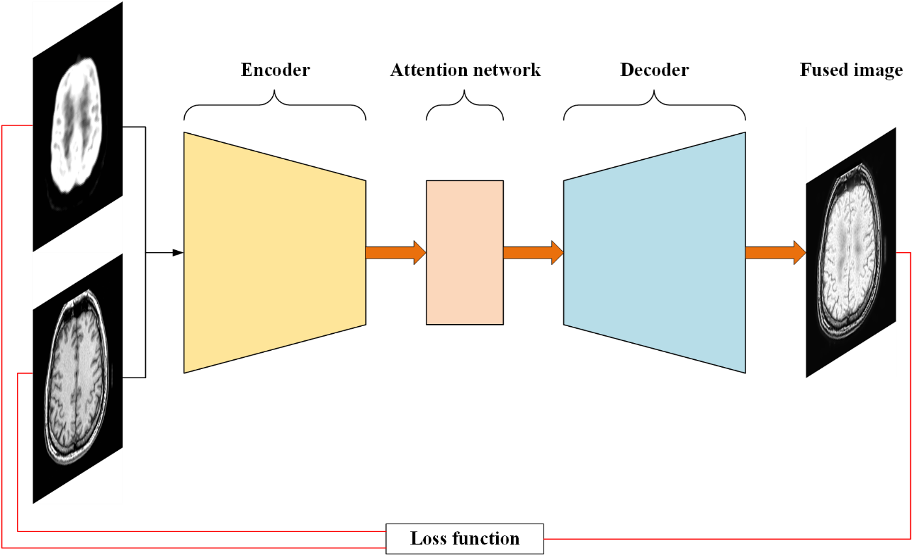
Proposed CSPA-DN Model We will describe in details the network architecture of our proposed CSpA-DN fusion model, a typical encoder-decoder structure as shown in Fig. 1, which consists of an encoder network, an attention network and a decoder.
Fig. 1 Schematic architecture of our proposed CSpA-DN fusion network.

Slide 4
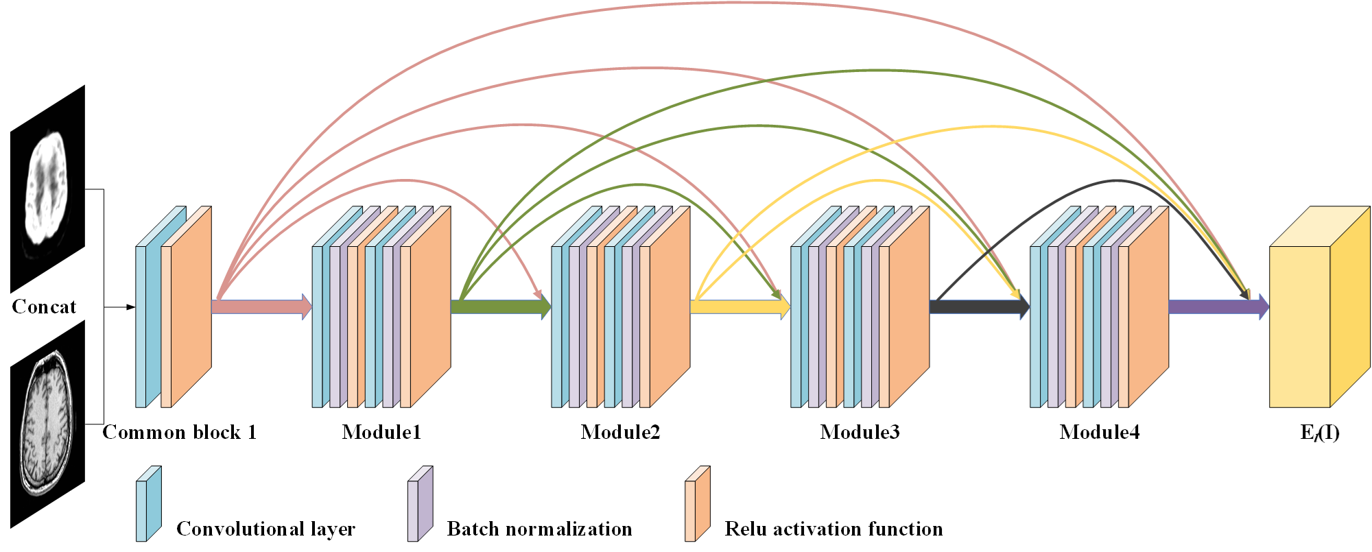
Proposed CSPA-DN Model A. Encoder Network As is shown in Fig. 2, our encoder consists of two parts: the common block 1 and the dense block containing four modules.
Fig. 2 Architecture of the Encoder based on the densely connected network. These color lines represent the skip connections between layers. The output is the encoded feature maps El(I).

Slide 5
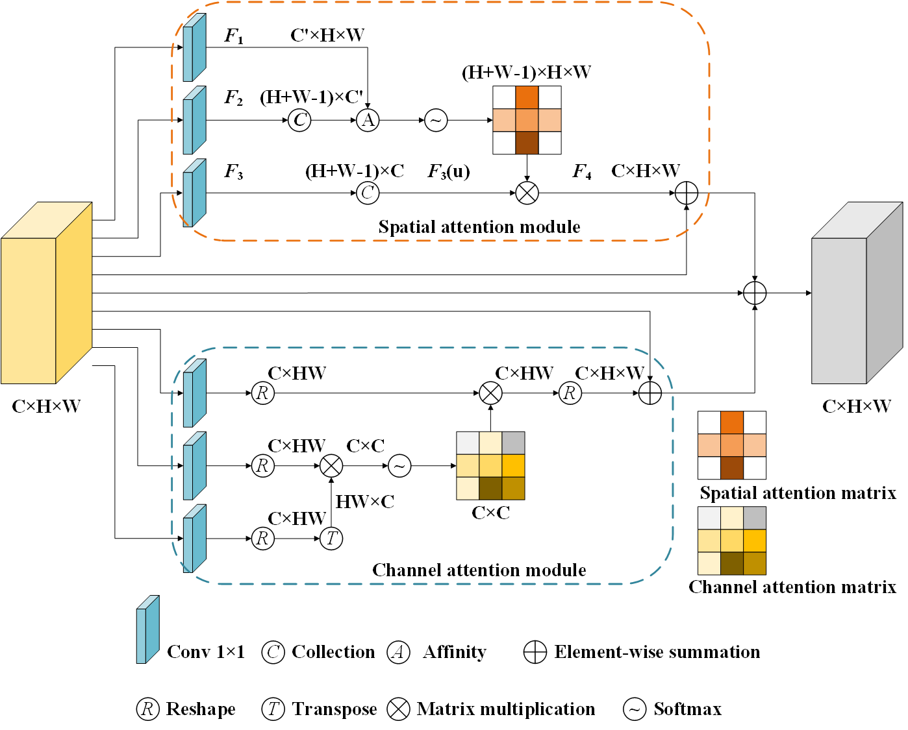
Proposed CSPA-DN Model B. Self-Attention Network The upper and lower parts in Fig. 3 represent the spatial and channel attention modules, respectively.
Fig. 3 The architecture of spatial attention module and channel attention module.

Slide 6
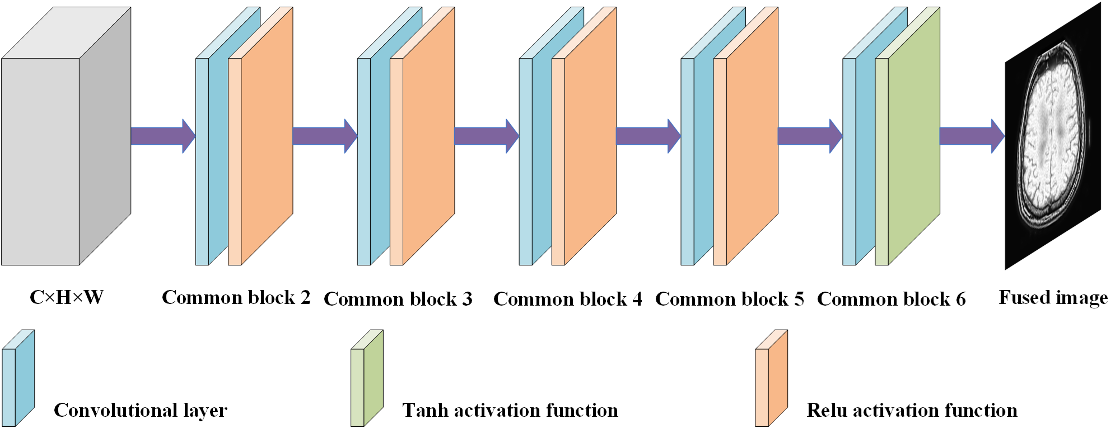
Proposed CSPA-DN Model C. Decoder Network The decoder network consists of five blocks.
Fig. 4 The detailed structure of the decoder network. The input is feature maps obtained by channel and spatial attention network with the same size as E_{l}(I).

Slide 7
Proposed CSPA-DN Model D. Loss function We minimize the following loss function L to train our fusion model.
MSE loss function constrains the intensity information between the fusion image and two source images. SSIM denotes the structural similarity index measure and it measures the structural similarity of two images.

Slide 8
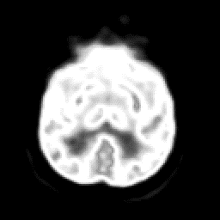
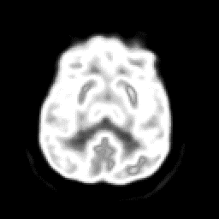
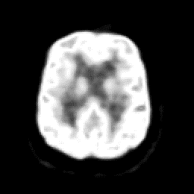
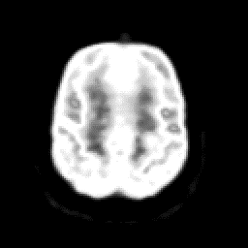
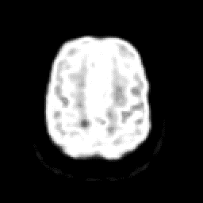
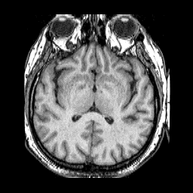
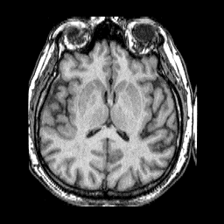
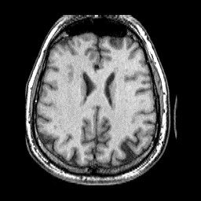
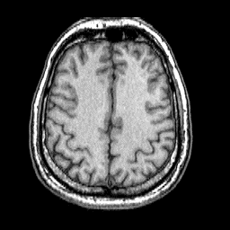
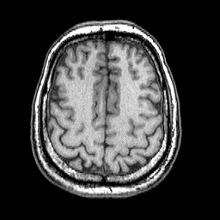
Experimental results A. Dataset and Parameter Setting The dataset used for medical image fusion in this work is obtained from the database of Whole Brain Atlas [28]. Among these data, 58 pairs of PET and MRI images are selected as the training data and 20 pairs are employed as test images to evaluate the performance of our fusion model.
Fig. 5 The PET and MRI images.

Slide 9
Experimental results A. Dataset and Parameter Setting To evaluate the quality of the fused image and assess the performance of different fusion methods, four objective evaluation metrics are considered to evaluate quantitatively our fusion model and other methods in this work, i.e., entropy measure (EN) , Xydeas and Petrovic metric (Qabf) , feature mutual information using image pixels (FMI_pixel) , FMI with discrete cosine transformation (FMI_dct).

Slide 10
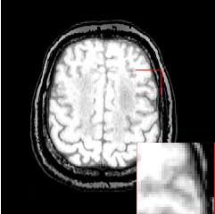
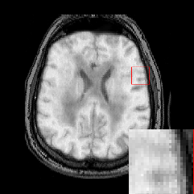
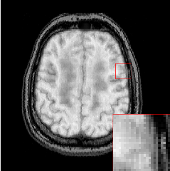
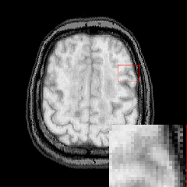
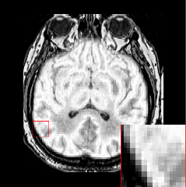
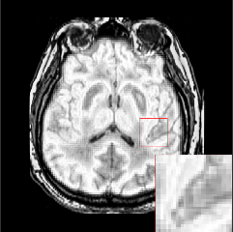
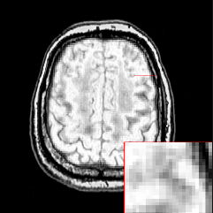
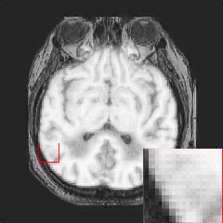
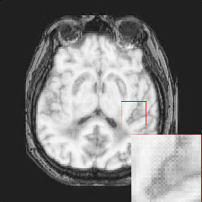
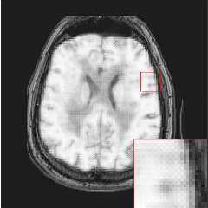
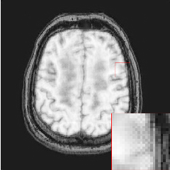
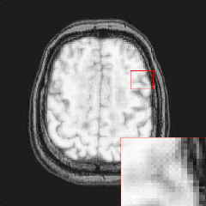
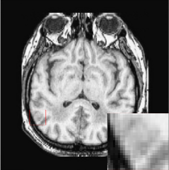
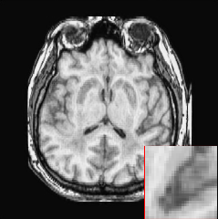
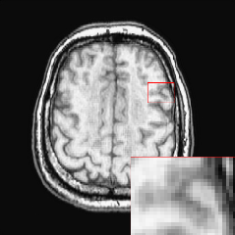
Experimental results B. Qualitative Assessments
Fig. 6 Qualitative results of five fusion methods.

Slide 11
Experimental results C. Quantitative Evaluations
Table 1 Mean values of Assessment Results on PET and MRI Image Fusion. Bold black indicates the best.
 | EN | Q_{abf} | FMI_pixel | FMI_dct
GTF | 4.2897 | 0.5562 | 0.8453 | 0.3256
MSVD | 4.8821 | 0.4776 | 0.8578 | 0.2841
IFCNN | 4.8187 | 0.6663 | 0.8613 | 0.3746
TFNet | 5.4555 | 0.3457 | 0.8404 | 0.2353
Ours | 5.5289 | 0.7111 | 0.8770 | 0.3933

Slide 12
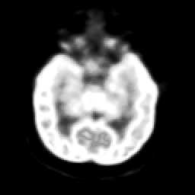
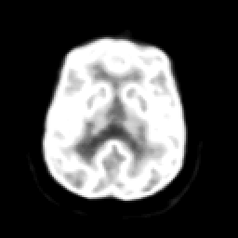
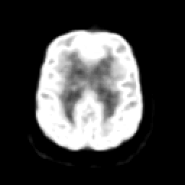
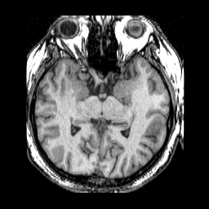
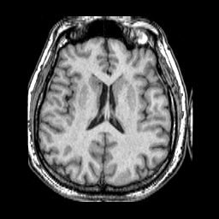
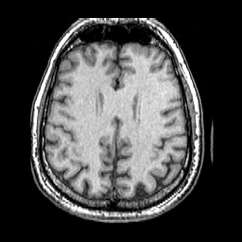
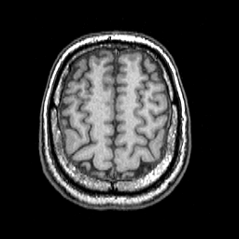
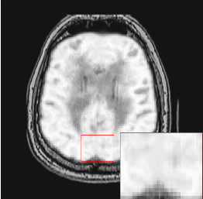
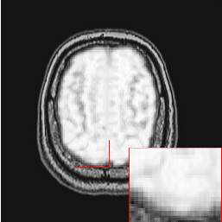
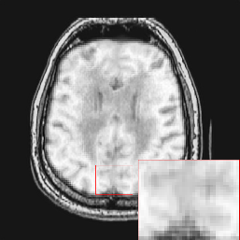
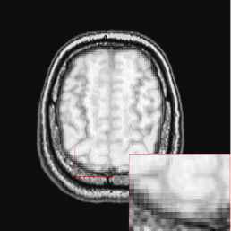
Experimental results D. Ablation study
Fig. 7 Effectiveness of self-attention mechanism in our fusion model.

Slide 13
Conclusion
We propose a novel fusion framework, named CSpA-DN, based on a densely connected network with channel and spatial attention for PET and MR images. Our algorithm is an end-to-end model with the encoder-decoder architecture.
Experimental results on twenty pairs of test images demonstrate the better performance of our proposed CSpA-DN fusion model compared with other four fusion approaches, according to both qualitative assessments and quantitative evaluations by using four objective metrics.
In addition, the ablation experiments illustrate that the self-attention mechanism in our fusion model can effectively preserve more structural information from the source images.

Slide 14
Thank You！

