Slide 1
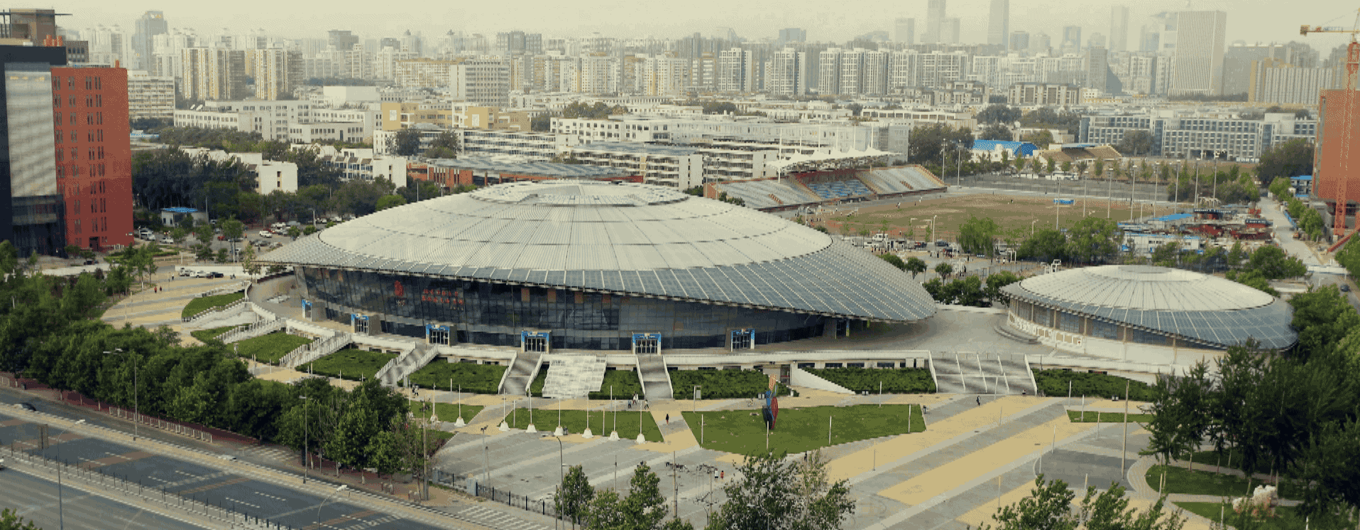
Zero-Shot Text Classification with Semantically
Extended Graph Convolutional Network
Reporter: Tengfei Liu
Yongli Hu*
Beijing University of Technology
Endless pursuit of truth as aim, persistent innovation as way

Slide 2
contents
Problem Formulation
Research Background
Research Contents
Experiment Results
Conclusions and Prospect

Slide 3
Problem Formulation

Slide 4
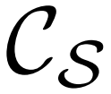
Problem Formulation
Zero-shot learning: aims to detect classes that the model has never seen during training
01
Zero-shot Learning
seen class: training set
unseen class: testing set
02
One-shot Learning
03
Few-shot Learning(<20)
04
K-shot Learning
The 25th International Conference on Pattern Recognition

Slide 5
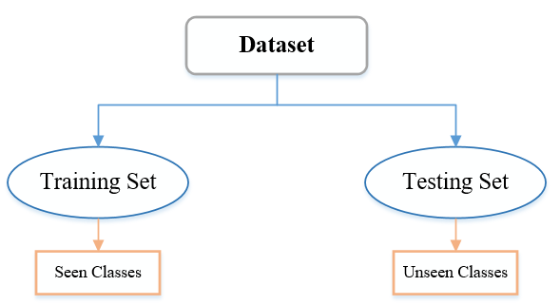
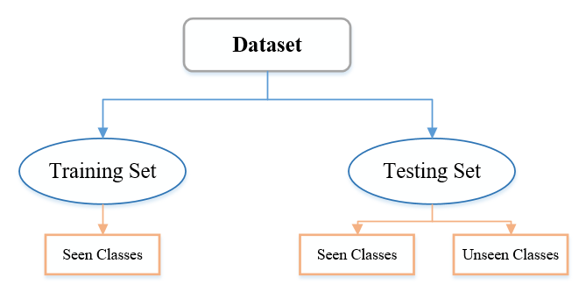
Problem Formulation
Zero-shot Learning
Generalized Zero-shot Learning
The 25th International Conference on Pattern Recognition

Slide 6
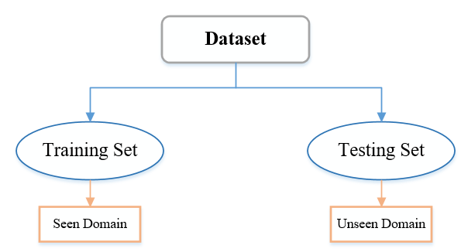
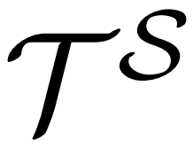
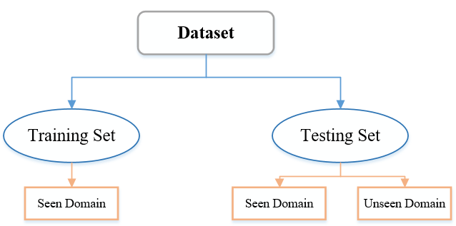
Problem Formulation
Zero-shot Learning
Zero-shot learning: aims to detect classes that the model has never seen during training
Training Set:
Seen samples
+
Seen labels
+
Unseen labels
Generalized Zero-shot Learning
Unseen samples
Model
Unseen labels
Testing Set:
The 25th International Conference on Pattern Recognition

Slide 7
Research Background

Slide 8
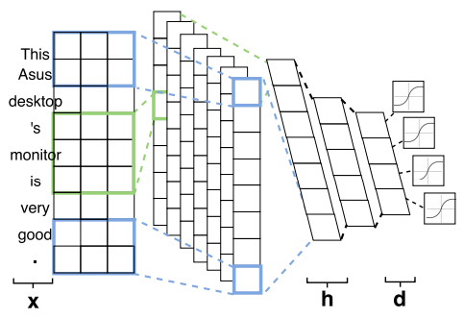
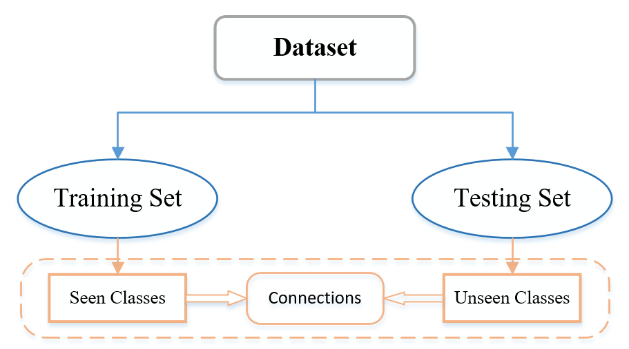
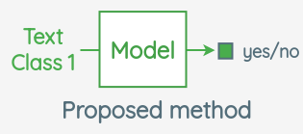
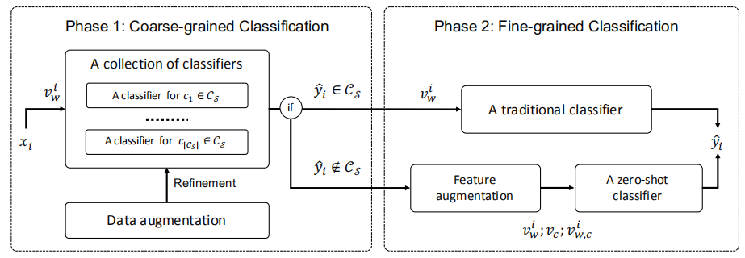
Research Background
“DOC: Deep Open Classification of Text Documents”
Key Problem
“Train Once, Test Anywhere: Zero-Shot Learning for Text Classification”
“Integrating Semantic Knowledge to Tackle Zero-shot Text Classification”
The 25th International Conference on Pattern Recognition

Slide 9
Research Contents

Slide 10
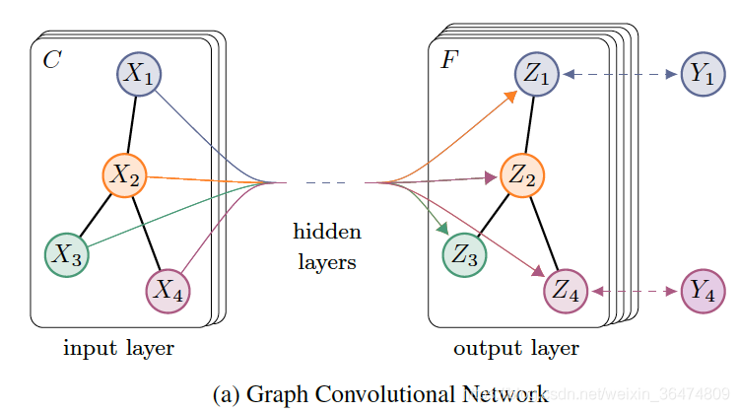
Research Contents
Preliminary:
Graph Convolutional Network
the set of graph nodes
the set of graph edges
the graph adjacency matrix
Propagation rule:
（1）
The 25th International Conference on Pattern Recognition

Slide 11
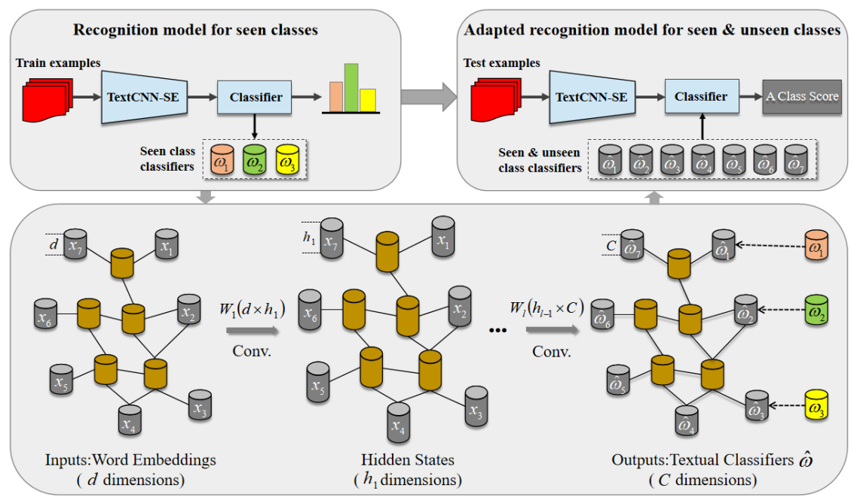
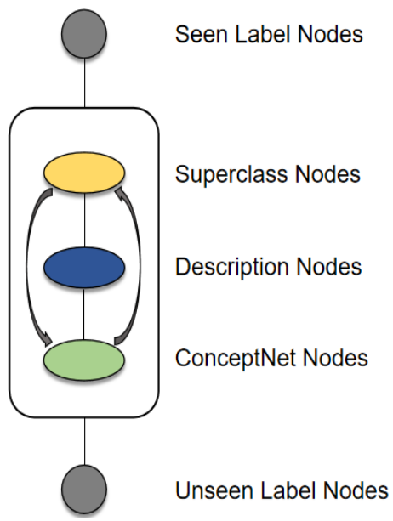
Research Contents
Semantically Extended Graph Convolutional Network:
The 25th International Conference on Pattern Recognition

Slide 12
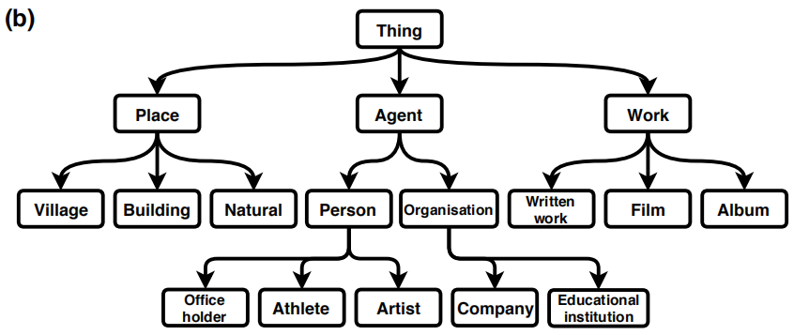
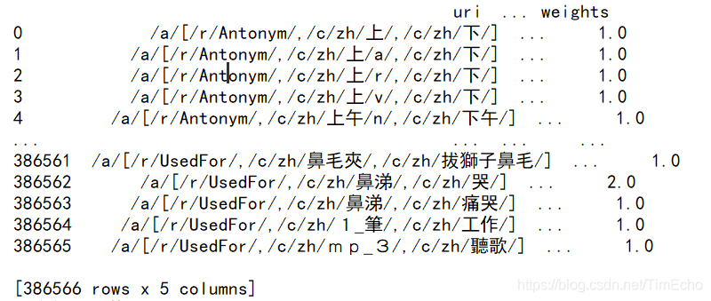
研究内容
research content
Knowledge Extended
Superclass Nodes
Description Nodes
'/r/IsA'
'/r/PartOf'
ConceptNet Nodes
'/r/AtLocation'
'/r/RelatedTo'
The 25th International Conference on Pattern Recognition

Slide 13
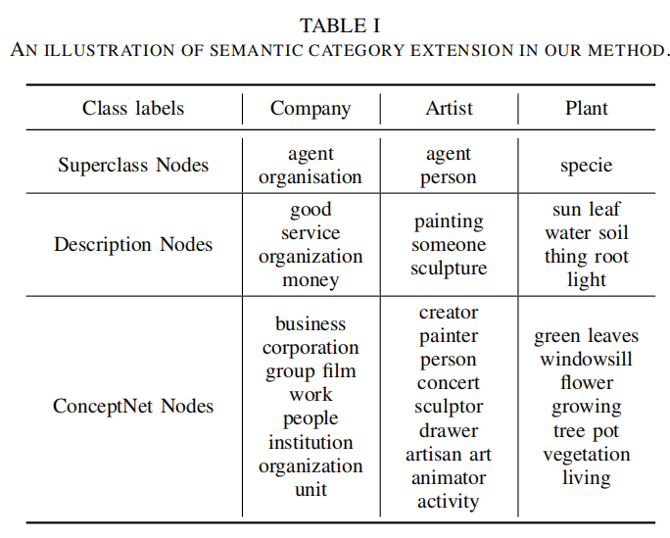
研究内容
research content
Knowledge Extended
1
cosine similarity
1
The 25th International Conference on Pattern Recognition

Slide 14
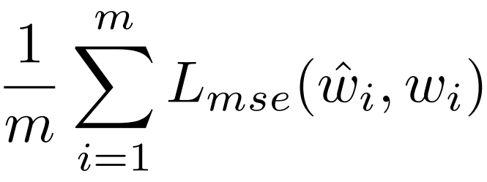
Research Contents
Semantically Extended Graph Convolutional Network:
Loss-function:
The 25th International Conference on Pattern Recognition

Slide 15
Experiment Results

Slide 16
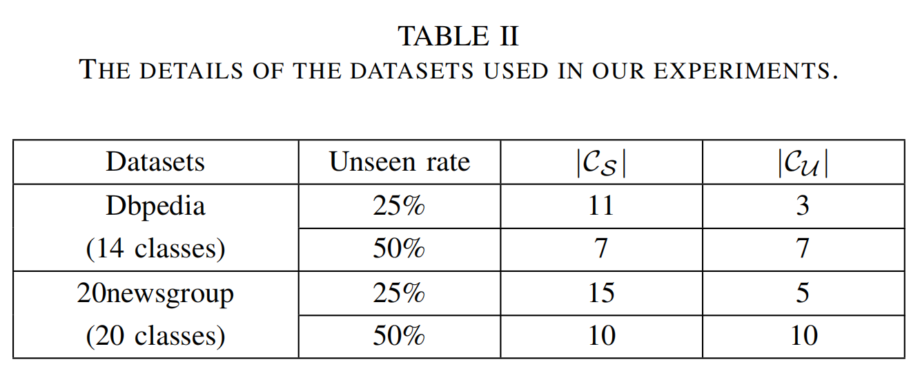
Experiment Results
The 25th International Conference on Pattern Recognition

Slide 17
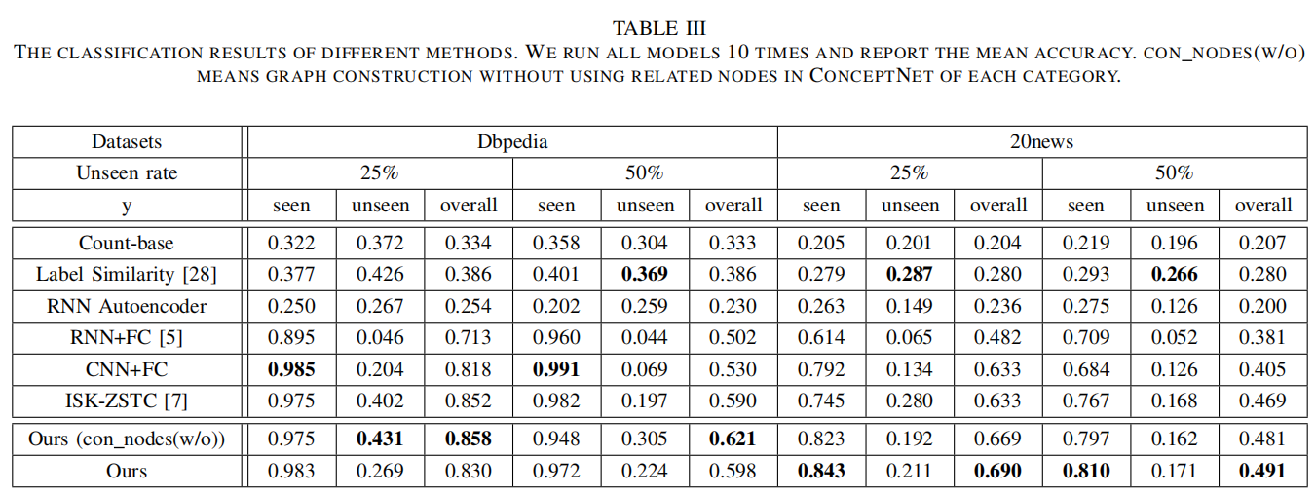
Experiment Results
The 25th International Conference on Pattern Recognition

Slide 18
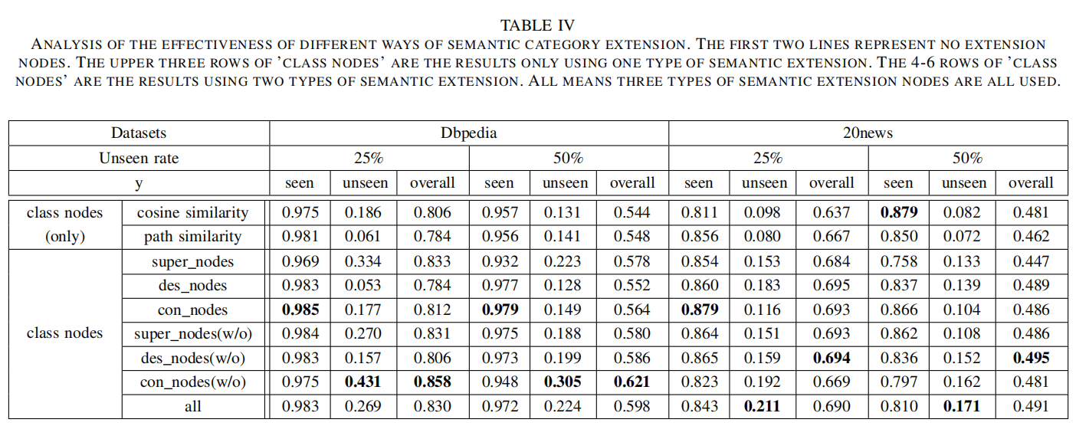
Experiment Results
The 25th International Conference on Pattern Recognition

Slide 19
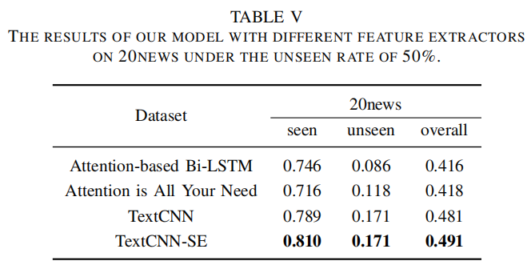
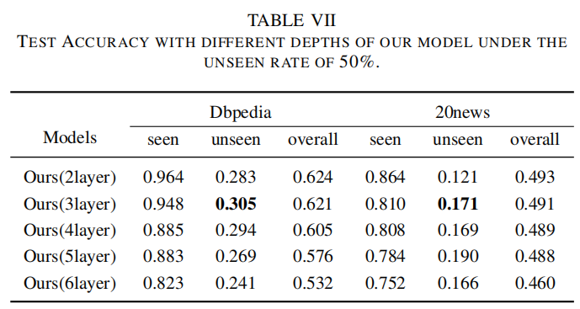
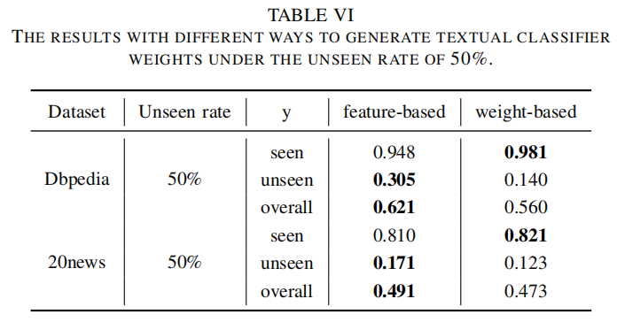
Experiment Results
The 25th International Conference on Pattern Recognition

Slide 20
Conclusions and Prospect

Slide 21
Conclusions and Prospect
We propose a novel method for graph construction by extending each category with three types of semantic knowledge, the class description, the class hierarchy and the class knowledge in ConceptNet, to tackle the zero-shot text classification and explore the effect of different semantic extension methods.
The Graph Convolutional Networks is firstly introduced into the task of zero-shot text classification, to the best of our knowledge.
The experiment results on two challenging datasets, Dbpedia and 20newsgroup, with two unseen rates show that our method outperform the state-of-the-art zero-shot text classification methods.
The 25th International Conference on Pattern Recognition

Slide 22
Thank You
Notes:
以上就是我的汇报，敬请批评指正！

