Slide 1
GAP: Quantifying the Generative Adversarial Set and Class Feature Applicability of Deep Neural Networks
Edward Collier
Louisiana State University
Supratik Mukhopadhay
Louisiana State University

Slide 2
Outline
Generative Adversarial Networks, Transferability and Applicability
Contributions
GAN Applicability
Experimental Setup
Results
Conclusions

Slide 3
Generative Adversarial Networks (GAN)
GANs are a semi supervised neural network model that consists two competing networks; a generator and a discriminator.
The Generator’s objective is to produce products almost identical to the ground truth.
The Discriminator’s objective is to discriminate between the ground truth and the generator’s output.
The two competing networks eventually converge at the Nash equilibrium.

Slide 4
Transferability
Humans are able to discern what previous knowledge might apply to new problems.
The brain will ”fit” previous knowledge to new tasks where it applies.
This same idea can apply to neural networks, which we know as transferability.
Transferability utilizes the idea that certain features overlap many classes.

Slide 5
Applicability
We define applicability as how well known features at a specific layer can be used to differentiate.
In neural networks this can be broken down into three sub-groups
Set applicability: How well does a network apply to a whole task?
Class applicability: How well can the known features be used to differentiate an input class from all other input classes?
Input applicability: How well can the known features be used to differentiate a single input from all other inputs?

Slide 6
Set Applicability

Slide 7
Class Applicability

Slide 8
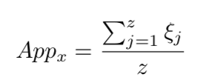
Measuring Applicability
By freezing and retraining layers we measure how well a network N can separate input x from a class from the unknown set un_{j} at layer n_{i}.
Class applicability is then the average separability between x and all un_{j}.

Slide 9
Contributions
Explore the applicability of features between discriminative networks non-adversarially trained classification networks.
Demonstrate the differences between the learned features in a discriminative and a classification process.
Transferability of features to a GAN is judged by measuring the applicability of features to the generator and discriminator.

Slide 10
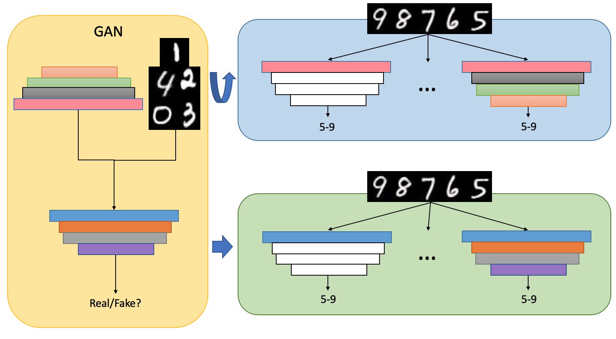
Experimental Setup
Classification is a good task to measure differentiation and thus applicability.
Applying the features learned by the generator and discriminator to classification allows for measuring their applicability at the different levels.

Slide 11
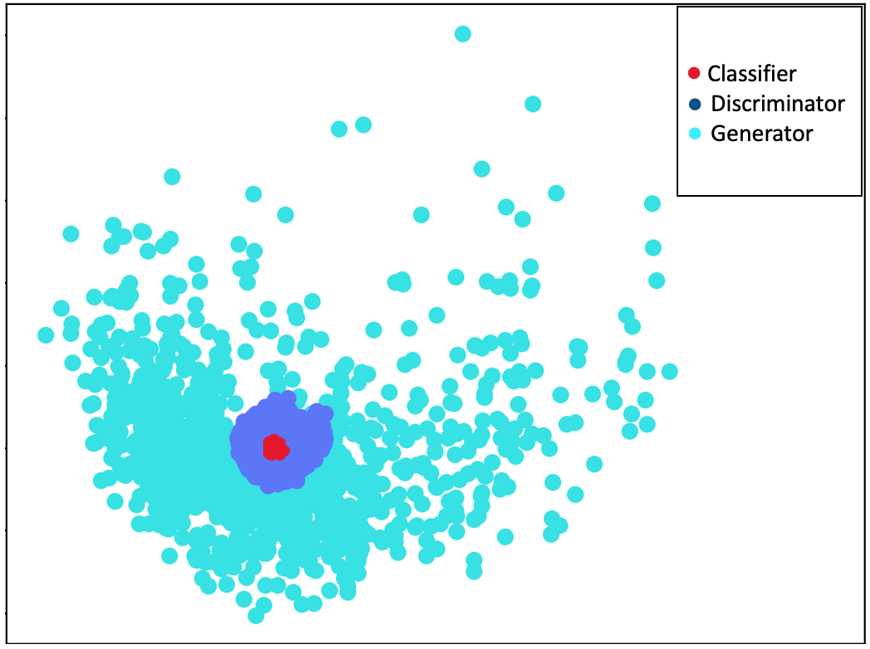
GAN Set Applicability
Apply the learned weights from both Generator G and Discriminator D to classification of the unknown data set.
Weights are transferred layer by layer.
The set applicability for each network is then the ability to use those features at each layer to differentiate known from unknown.

Slide 12
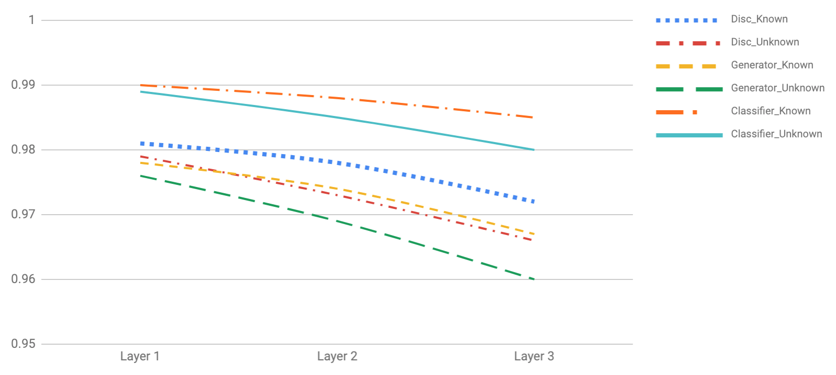
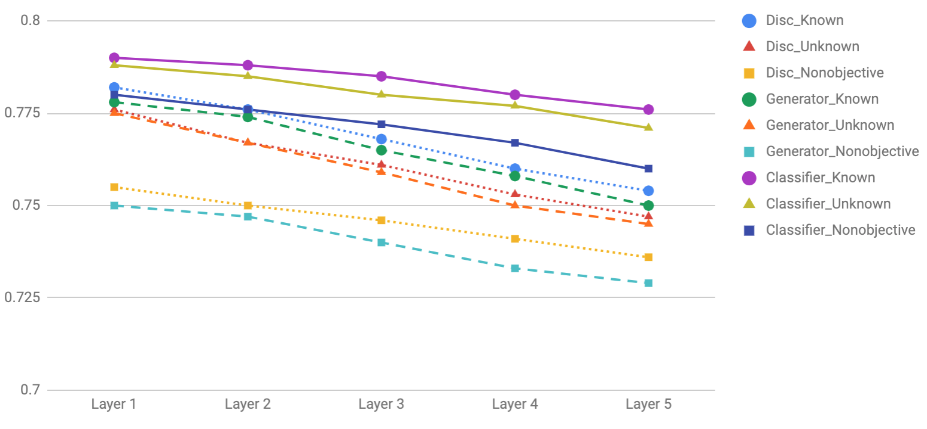
GAN Class Applicability
MNIST
CIFAR

Slide 13
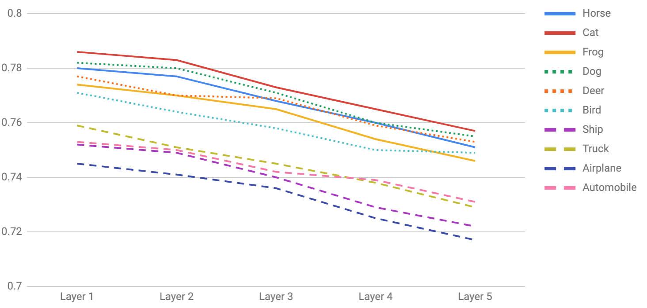
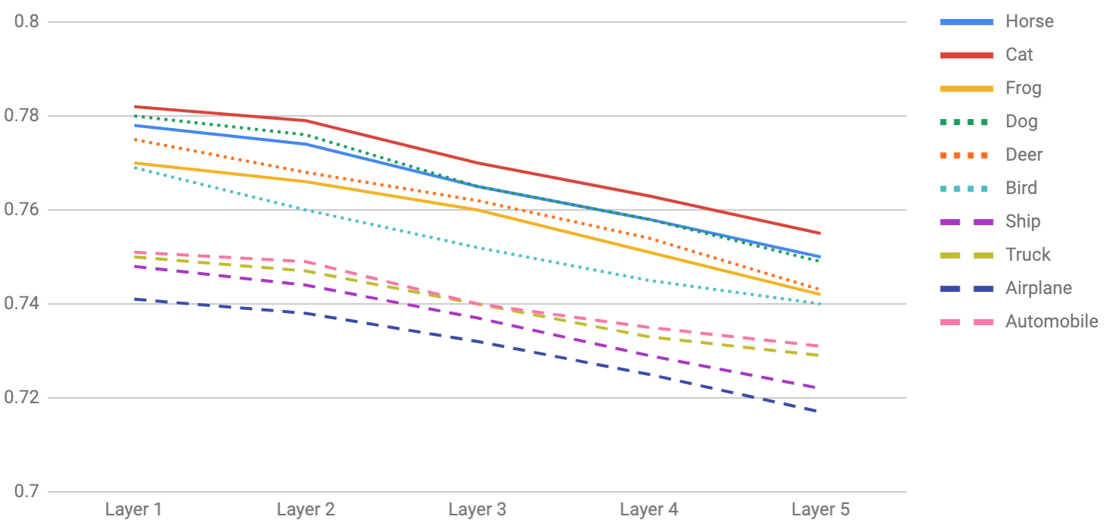
GAN Layer Applicability
Discriminator
Generator

Slide 14
GAN Transfer
We have seen that there is high applicability between the generator and discriminator for similar tasks.
Given the relationship between the tasks it goes to reason that they learn similar features and apply them differently.
We swapped roles of the generator and discriminator to measure how well the learned features could be transferred to the opposite task.

Slide 15
Conclusions
Presented, to the best of our knowledge, the first results on evaluation of feature applicability and transferability in generative adversarial networks.
Demonstrated a discriminator and a generator can both be applicable to classification tasks.
Provided resented insights into how applicable they are to a classification task from both a set and class applicability perspective.

Slide 16
Thank You!

