Slide 1
25th International Conference on Pattern Recognition
Milan, Italy 10|15 January 2021
2D-Discrete Mirror Transform for
Image Non-Linear Approximation
Alessandro Gnutti, Fabrizio Guerrini, and Riccardo Leonardi
Department of Information Engineering, CNIT – University of Brescia, Italy
Notes:
Welcome, the title of our paper is «Two-dimensional Discrete Mirror Transform for Image Non-Linear Approximation».
The authors are Alessandro Gnutti, Fabrizio Guerrini and Riccardo Leonardi, from University of Brescia.

Slide 2
INTRODUCTION
Efficient transform → generation of a sparse representation
Signal approximation
Data compression
Denoising
…
DFT
DCT
SOT
KLT
DWT
KSVD
*lets
PCA
A priori knowledge of
a good statistical model
Data-driven algorithms
Notes:
Let me start with a very brief introduction: in many signal processing ields, such as signal approximation, data compression, denoising, and so on, we are interested in efficient transforms, namely those transforms that are able to generate a sparse representation of a signal.
There are two families of transforms, the ones that assume an a priori knwoledge of a good statistical model (you can see some popular examples of this family in the set on the left), and others that try to capture the statistics specific for a particular set of data (you can see some other examples of this category in the set on the right).

Slide 3
GENERAL IDEA
2D - Discrete Mirror Transform (2D - DMT)
Iterative optimal even/odd decomposition wrt a given direction
Maximal energy concentration
into the even or odd part
Notes:
In our paper we have proposed a new transfrom that we have called two-dimensional Discrete Mirror Transform.
It is generated by iterating the optimal even/odd decomposition with respect to a given direction.
Let’s consider, for example, an image x: the equation on the left shows all the potential even/odd decompositions when considering the symmetry axes as the different columns of the image.
For «optimal decomposition», we mean that we are interested in obtaining the maximal energy distribution from the original signal to the even or the odd part.
It can be proven that this optimal position can be found by identifying the maximum of the convolution modulus of the signal, in this case just in the «horizontal» direction.
Of course, we will give some more details on the proof in our poster session.

Slide 4
OPTIMAL EVEN/ODD DEC.
(image)
(even part)
Convolution
(odd part)
Notes:
Here, we show a visual example. The figure on the bottom left is the convolution of the top left image. Tha maximum identifies the symmetry axis around which we can compute the optimal even/odd decomposition of the image.
In particular, this symmetry axis allows to distribute the 86% of the signal energy into the even part, and the remaining in the odd part.
Note that both the even and the odd part contains a shared portion of columns, that we call tail and that is marked by these blue lines.

Slide 5
ONE-STEP ITERATION
Notes:
At this point, we may wonder how to regenerate the original image by minimizing as much as possible the information contained into the even and odd components.
Two considerations: the first is that both even and odd parts are completely defined by the last (or the first) half of the columns. And the second is that it is sufficient to consider the tail just in the even or the odd part, since that information is the same in the two decompositions as said before.
In the end, to regenerate the original signal, we need just to consider the causal even part, tail included, and the causal odd part with no tail.

Slide 6
ENERGY COMPACTION
Notes:
But, what is the improvement of representing a signal with this representation.
As said before, we have moved the 86% of the energy in a smaller set of samples.
In other words, consider this figure: the blue line shows the ratio between the energy of the image when keeping just a certain percentage of the largest pixel values and the total energy of the image. The red curve evaluates the same ratio, but considering the “concatenation” of the two decomposition instead of the original image. The fact that the second curve overcomes the first one, shows that the energy of this new representation is more concentrated in a few samples with respect to how much it is in the original image.

Slide 7
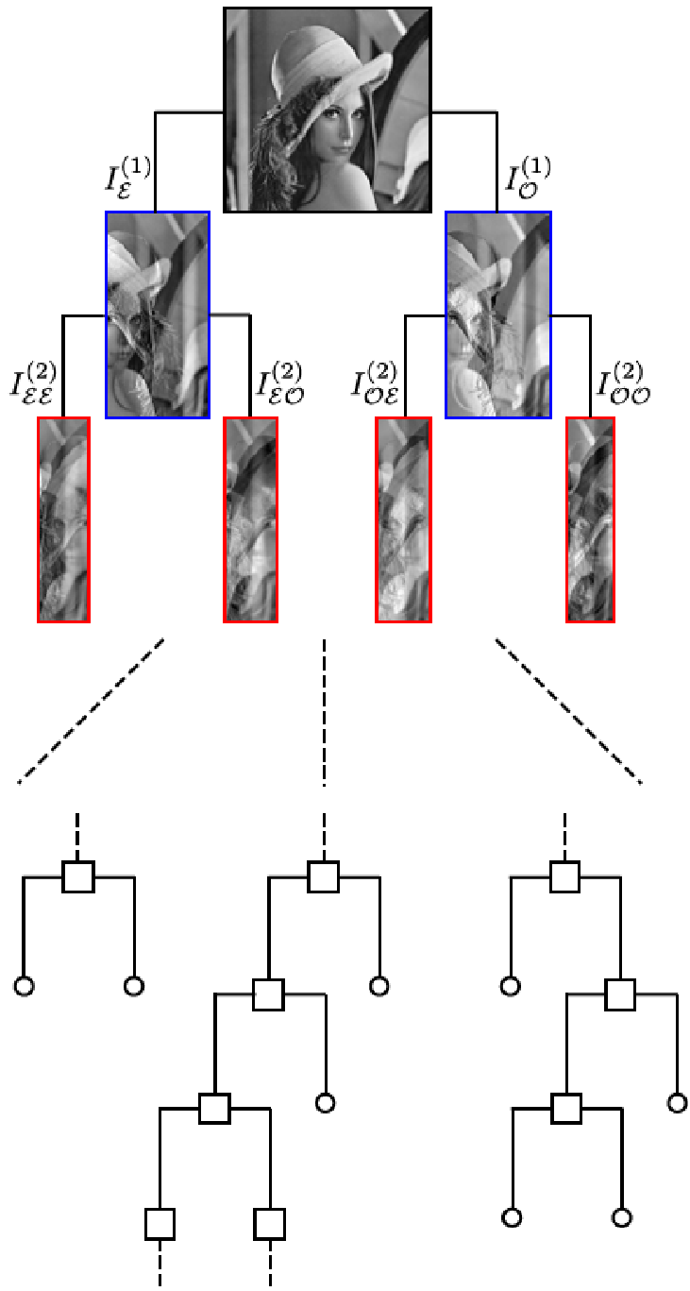
BINARY TREE: ITERATIVE SIGNAL DECOMPOSITION
Discrete Mirror Transform
Even/odd decomposition iteration up to achieving single coefficients
Notes:
Starting from this observation, we propose to iterate the even/odd decomposition up to when single coefficients are achieved. In this way, we generate a binary tree, whose
nodes represent the even or the odd part obtained from a previous decomposition. We call this procedure the Discrete Mirror Transform (DMT) of a signal.
This figure depicts this process: we start from the original image, here in the first level we have the two decompositions described earlier, and the procedure continues until we reach single coefficients that are indicated with these circles.

Slide 8
ENERGY COMPACTION (2)
Measure of the energy compaction at varying of the decomposition level
Notes:
This figure presents the curves related to the energy functions when varying the number of the kept largest coefficients (in modulus) for each level. What emerges is that the higher is the level, namely, the deeper is the decomposition, the sparser is the signal representation at that corresponding level, proving the strong sparsity property of the Discrete Mirror Transform.

Slide 9
EXPERIMENTAL RESULTS
Performance comparison between DCT, DWT, DMT and ODMT
SD dataset:
Baboon
SD dataset:
average and std
HD dataset:
Cathedral
HD dataset:
average and std
Notes:
We have carried out some experiments on various databases aimed to highlight the sparsity properties of the Discrete Mirror Transform.
To measure the ability of the DMT to compact the energy, it has been compared with other two popular transforms: the
Discrete Cosine Transform (DCT) and the Discrete Wavelet Transform (DWT).
Note that an optimized version of the DMT has been implemented as well, and we refer to it as Optimized DMT or ODMT. This transform differs with respect to the DMT based on the fact that for each symmetry decomposition the system decides in which direction to perform the decomposition itself. Again, we will give more details in the poster session.
In the end, the experiments show that the DCT and DWT performance are consistently worse than those given by both DMT and ODMT, independently by the image class.

Slide 10
CHALLENGE
HOW TO EFFICIENTLY REPRESENT THE DECOMPOSITION BINARY TREE?
Notes:
What is the challenge of this work?
Well, in order to reconstrcut the signal we need both the single coefficients of the transform and their position in the binary tree.
It means that, in a compression scenario, for example, we should send also the structure of the decomposition tree, and not just the transform coefficients.
How to efficently represent the decomposition binary tree is not trivial, and it is indeed the main focus of our current research.

Slide 11
THANKS!
Notes:
Thanks, and see you in our poster session!

