Slide 1
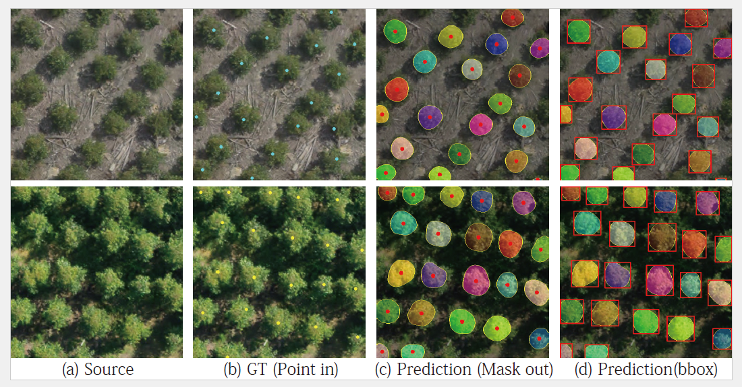
Point in: Counting Trees with Weakly Supervised Segmentation Network
Pinmo Tong, Xishan Zhang, Pengcheng Han, Shuhui Bu
Pilot intelligence Lab
Notes:
In this video I'm going to talk about a framework to count trees with weakly supervised network. In this framework, the annotation is only point supervision. The network could estimate the number, location, and mask of trees in an image.

Slide 2
MOTIVATION
BACKGROUND
IDEA
CONTENTS
METHODS
EXPERIMENTS
CONCLUSION
Notes:
I will begin my presentation in the following order.

Slide 3
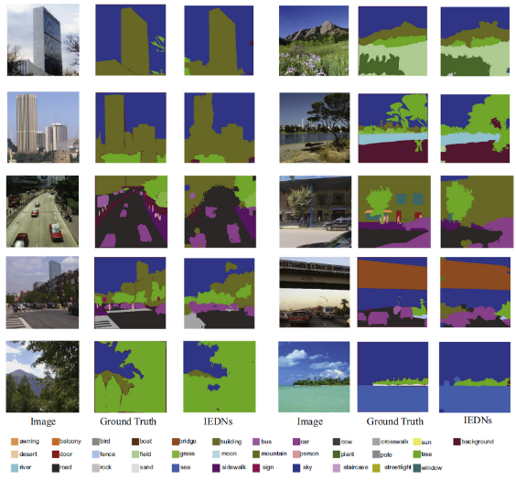
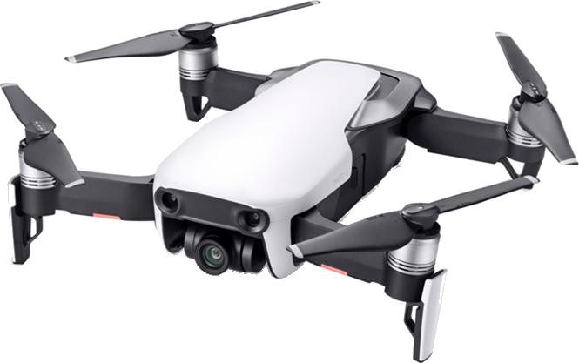
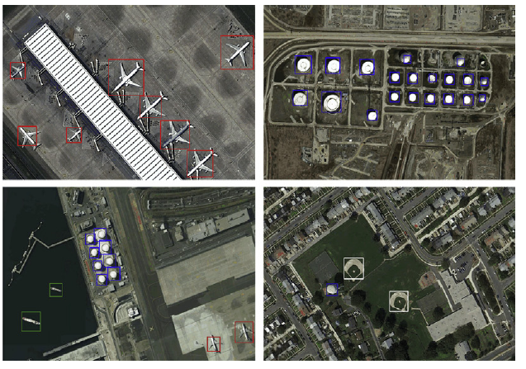
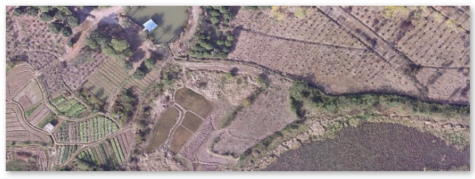
Motivation - Application
Scene Perception
Detection, Classification, Segmentation
Widely used in multiple fields: Agriculture , Surveillance, ...
Unmanned Aerial Vehicles (UAVs)
Develop rapidly and are in widespread use.
Make it easily to collect aerial images at a low cost and high mobility.
Notes:
A rapid application of deep learning methods, such as scene perception, agriculture and so on. The fast-growing UAV industry makes it easily to collect aerial images at a low cost and high mobility. Therefore, the requirements of deep learning applications are increasing.

Slide 4
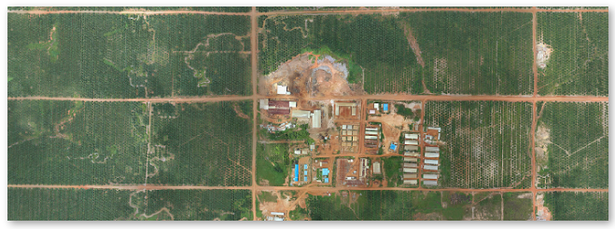
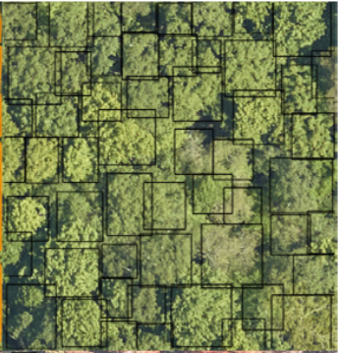
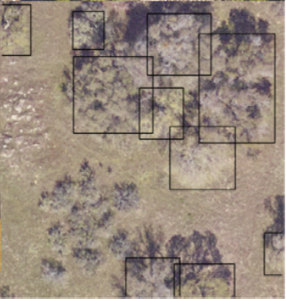
Motivation - Research Meaning
Large areas plantation
Economy revenues
Large areas of agriculture monitoring
Precision agriculture: Maximize productivity
Notes:
In the agriculture field, information about the locations and the number of economic tree species like acacia and oil-palm is of vital importance. Our research is to improve economy revenues with weakly supervised methods.

Slide 5
Motivation - Research Background
Aerial object detection
Point in, point out
Box in, box out
Mask in, mask out
Regression
Bounding box
Full supervised
Only localization, No full mask, size
Time-consuming, human labor,
complex
Notes:
At present, there are two three methods of aerial object detection: point in, point out`, ‘Box in, box out`, ‘Mask in, mask out`. (1)“point in, point out”
methods cast the problem as regressing a density map, the mask and size could not get. “box in, box out” and “mask in, mask out” methods could offer sufficient information, but they need a large amount of annotations like bounding box or full pixel label, which is time-consuming, tedious and easy to
get wrong annotation data.

Slide 6
Idea
Avoid expensive bounding box or full supervised annotations, reduce human labor
Reduce the complexity of training model
Get the appropriate size, position and mask
Multi-
species
Multi-
scales
Occlusion
Overlap
Weakly Tree Counting Network (WTCNet)
Aims to complete counting, localization, mask with only point supervised segmentation network
Notes:
Our idea is to obtain the position and size of the object at the same time without a large number of annotations, and make
sure the accuracy can be comparable to the full supervised methods.

Slide 7
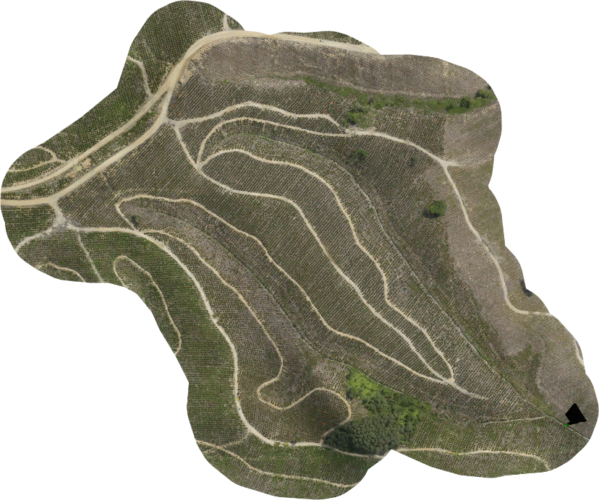
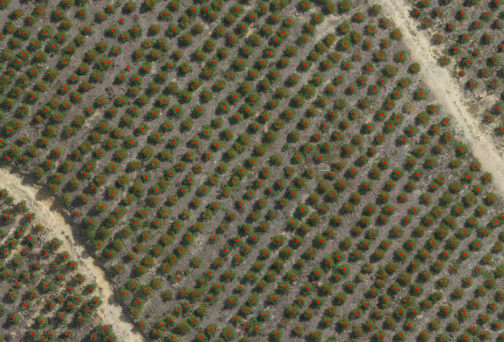
Overview - large plantation
Plantation mapping
Tree detection and counting
Notes:
The overview of our method. Counting and detect trees of large plantation.

Slide 8
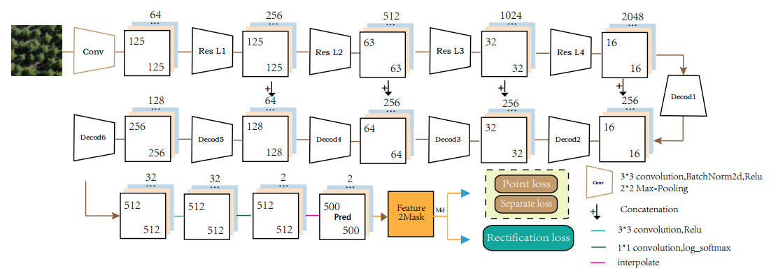
Methods - Architecture
Feature extractor
Feature2Mask strategy
loss function
Notes:
Our architecture consists of three parts: Feature extractor module, Feature2mask strategy and final loss function.

Slide 9
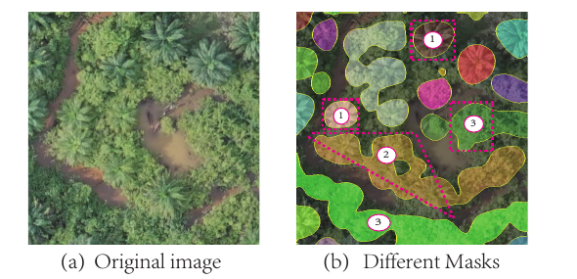
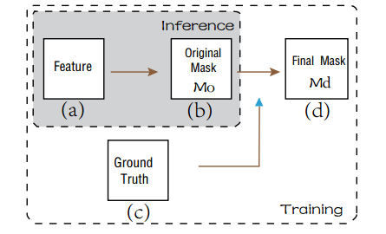
Methods - Feature2Mask Strategy
To deal with different mask situations
Mask situations:
One-to-one
Many-to-one
FP ones
Notes:
In the project, there will be different kind of mask in the training process. `One-to-one` stands for per mask with only one tree. `Many-to-one` is the predicted situation when two or more tree masks are connected. The `FP ones` means the model prediction without point annotations, which needs to be removed.

Slide 10
Methods - Loss Function
Point-loss
basic
One-to-one
Basic localization Guidance
Separate-loss
divide
Many-to-one
Rectification Guidance
Rectification-loss
remove
Fp ones
Notes:
The loss function is designed corresponding to the Feature2Mask Strategy. The point-loss enforces the model to predict the semantic segmentation labels for each pixel in the image. However, there may be two or more point-annotations in one mask area. The separate-loss is proposed to divide the whole large pieces that are joined together into smaller ones. And the last rectification loss is used to reduce the commission error without point annotations.

Slide 11
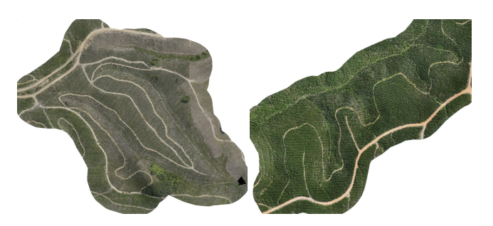
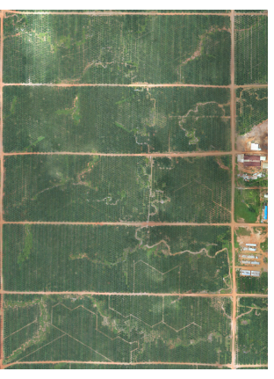
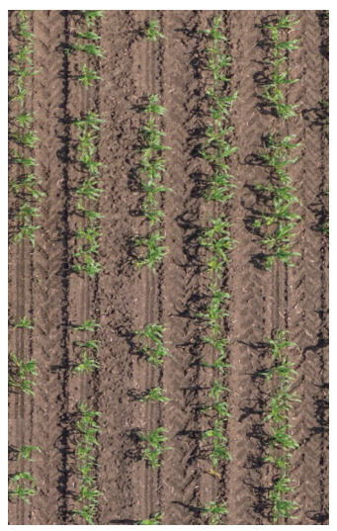
Experiments - Dataset
Acacia-6
Acacia-12
Oil-Palm
Sorghum-Plant
https://1drv.ms/f/s!AsFz7oLq0ulekgDLUWqpwWBtuXnh
https://engineering.purdue.edu/~sorghum/dataset-plant-centers-2016/
Notes:
The datasets are available at the address. You can download them for research.

Slide 12
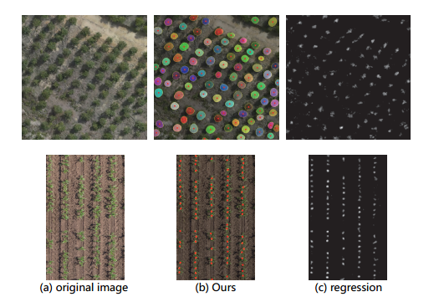
Experiments - Counting
Evaluation on four datasets
More Clear
Notes:
We conduct the experiments on three tasks: Counting, localization and mask. In the qualitative and quantitative results, the performance of our method are more clear.

Slide 13
Experiments - Localization
Evaluation on three different annotation methods
More Accurate
Notes:
In the localization performance compared with three different annotation methods. Our method achieve better results and are more accurate.

Slide 14
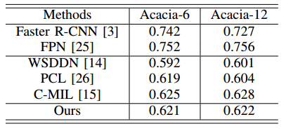
Experiments - Mask
Catch up with full supervised methods
More Appropriate
Notes:
In the mask generated performance compared with full supervised annotation methods. The performance can compare with full supervised methods and are closer to the actual object.

Slide 15
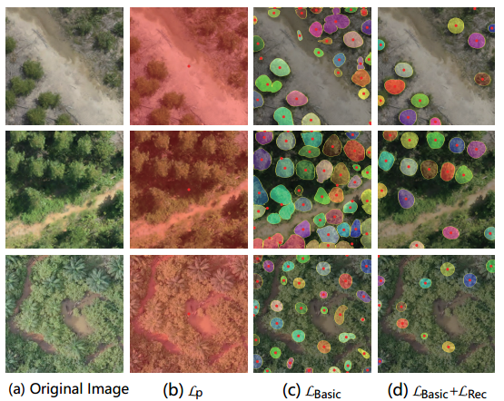
Experiments - Ablation Study
Notes:
In the ablation study, we explore the effect of different components in the proposed framework over the Acacia dataset. One is Tree Feature Extractor Study, and the other is Loss Study.

Slide 16
Conclusion
Contributions:
A novel weakly supervised network architecture
A novel feature2mask strategy and loss function
Provide three aerial datasets for research
Future Work:
Explore new features of the proposed method
Explore different algorithms and splitting methods
Improve the efficiency to deal with complicated shapes

Slide 17
Point in: Counting Trees with Weakly Supervised Segmentation Network
Pinmo Tong, Xishan Zhang, Pengcheng Han, Shuhui Bu
Questions contact Pinmo Tong:
Email: 2018200078@mail.nwpu.edu.cn
Address: Northwestern Polytechnical University, 710072 Xi’an, China
Pilot intelligence Lab
Notes:
Thank you for listening my presentation. If you have any question, you can contact with me.

Slide 18
Thank you
Question?

