Slide 1
A Low-complexity R-Peak Detection Algorithm with Adaptive Thresholding for Wearable devices
Tiago Rodrigues ^{1,2}, Sirisack Samoutphonh ¹, Hugo Silva ^{2,3}, Ana Fred ^{2,3}
1 - Advanced Sport Instruments S.A., Av. de Beaumont 5, 1012 Lausanne, Switzerland
2 - IST - Instituto Superior Técnico, Av. Rovisco Pais n. 1, 1049-001 Lisboa, Portugal
3 - IT - Instituto de Telecomunicações, Av. Rovisco Pais n. 1, Torre Norte - Piso 10, 1049-001 Lisboa, Portugal
Notes:
Research that we have done on heart rate monitoring using the FieldWiz wearable device.
Motivation for heart rate monitoring
Methodology for data acquisition, processing and results.

Slide 2
1| MOTIVATION
“Is it possible to accurately detect R-peaks from ECG signals in dynamic conditions, e.g. sports?”
IMPROVEMENT IN
1. Motivation
SPORTS PERFORMANCE
HEALTH
BIOMETRICS
Pathology detection
User identification based on the ECG waveform
Internal load monitoring
Heart Rate (HR) related metrics
Heart Rate Variability (HRV) related metrics
OUTLINE ∙ MOTIVATION ∙ METHODOLOGY AND RESULTS∙ CONCLUSION
Notes:
The goal of these research was to evaluate the accuracy of R-peak detection on ECG when acquired under dynamic conditions.
If used correctly, these insights can be used to improve
- health, e.g. apple watch and the controverse atrial fibrillation detection
- biometrics, e.g. ECG waveform for user identification
- sport performance, measuring internal load from HR and HRV related metrics.
The goal of these research was to evaluate the reliability of these metrics when using FieldWiz

Slide 3
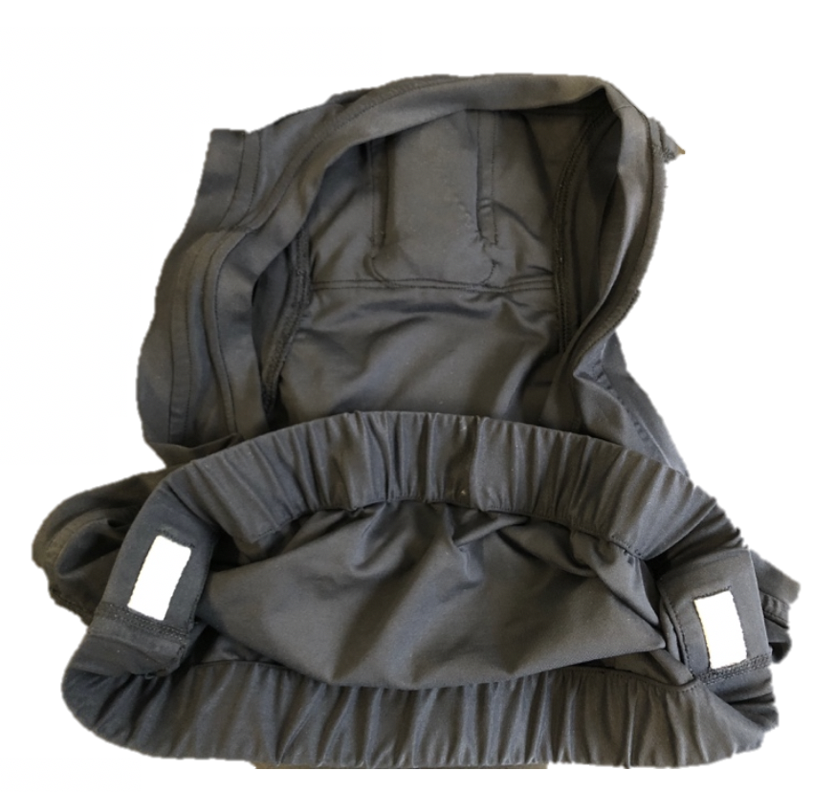
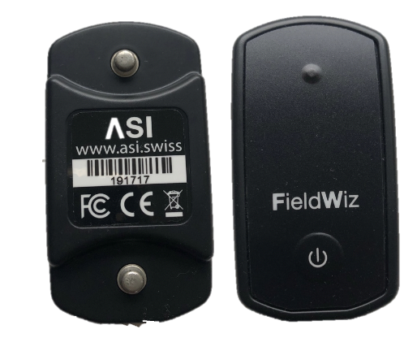
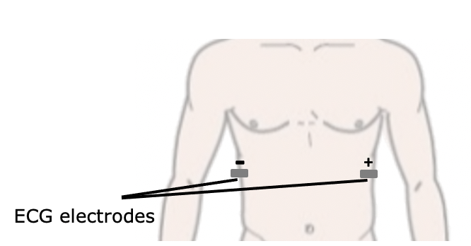
1| FIELDWIZ DEVICE
FieldWiz, ECG acquisition^{[1]}:
250 Hz sampling rate
16-bit resolution
1-50 Hz Band Pass filter
a)
b)
1. Case Study: FieldWiz
2. R-Peak Detection
3. Private Database
4. Results
Wiz connected shirt:
Versions 1 and 2
c)
Fig 1. Acquisition Setup. a) FieldWiz and b) Wiz shirt, Version 2^{[1]} and c) Placement of the electrode pads.
[1] - Advanced Sports Instruments - https://asi.swiss/
OUTLINE ∙ MOTIVATION ∙ METHODOLOGY AND RESULTS∙ CONCLUSION
Notes:
FieldWiz which has an ECG acquisition module
combined with an wearable t-shirt with conductive pads
As shown in the figure

Slide 4
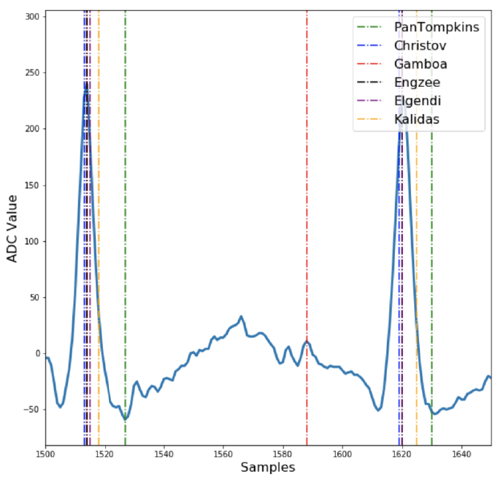
2| R-PEAK DETECTION METHOD
State of the art:
Pan and Tompkins
Christov
Gamboa
Engzee
Elgendi
Kalidas
1. Case Study: FieldWiz
2. R-Peak Detection
3. Private Database
4. Results
Proposed Approach:
Pre-Processing
Finite state machine (FSM) detection method
Fig 2. Segment of 150 samples raw ECG signal sampled at 250 Hz (blue) and detected R-peak positions using different methods: Pan and Tompkins (green), Christov (blue), Gamboa (red), Engzee (black), Elgendi (purple) and Kalidas (yellow).
OUTLINE ∙ MOTIVATION ∙ METHODOLOGY AND RESULTS∙ CONCLUSION
Notes:
First step, we performed an evaluation of the common detectors:
Combination of different pre-processing / filtering /derivatives / moving averages / stationary wavelet decomposition -> Detection thresholds
Figure:
Pan and Tompkins introduces temporal imprecisions
Engelse was introduced as an R-peak detector
Kalidas has a constant delay, also due to the moving integration
Proposed method:
Pre-processing pipeline, enhancing the R-peak
FSM based on 3 states

Slide 5
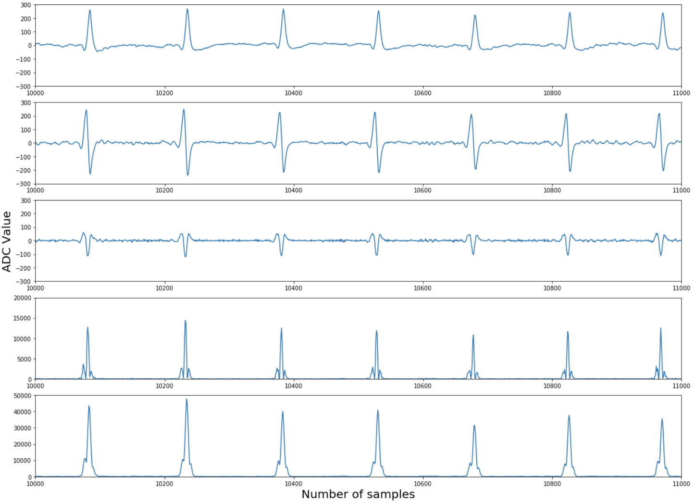
2| R-PEAK DETECTION METHOD
Pre-Processing:
1. Case Study: FieldWiz
2. R-Peak Detection
3. Private Database
4. Results
$$x[n]$$
$$1^{st}Derivative$$
$$2^{st}Derivative$$
$$Squaring$$
y$[n]$
OUTLINE ∙ MOTIVATION ∙ METHODOLOGY AND RESULTS∙ CONCLUSION
Notes:
Pre-Processing:
1. 1st derivative to eliminate base-wander and enhance the QRS
2. 2nd derivative to isolate the R-peak
3. Squaring to enhance the peak
4. Moving average

Slide 6
2| R-PEAK DETECTION METHOD
Finite State Machine^{[2]}:
$counter>{RR}_{min}$:
$counter=n − R_{peak}Pos$
$save R_{peak}Pos$
State 1
find maximum value
$$counter++$$
$$y\left[n\right]> t_{h}\left[n\right]:$$
$counter=0$
1. Case Study: FieldWiz
2. R-Peak Detection
3. Private Database
4. Results
State 3
$$t_{h}\left[n\right]=t_{h}\left[n−1\right] × e^{− \frac{P_{th}}{Fs}}$$
State 2
$$counter++$$
$counter>{RR}_{min}$:
$t_{h}[n]=\frac{1}{20} \sum_{i=1}^{20}{R_{peak}{Amp}_{i}}$
Fig 3. Application of the R-peak detector in a 5 seconds ECG segment. Top: Raw ECG signal (blue) and detected R-peaks (red dots); and Bottom: Processed ECG (blue) and detection threshold (red dashed line).
[2] - FSM adapted from Raquel Gutiérrez-Rivas, Juan Jesús García, William P Marnane, and Alvaro Hernández. Novel real-time low-complexity QRS complex detector based on adaptive thresholding. IEEE Sensors Journal, 15(10):6036–6043, 2015.
OUTLINE ∙ MOTIVATION ∙ METHODOLOGY AND RESULTS∙ CONCLUSION
Notes:
Detection:
1. State 1: Search for absolute max in processed signal
2. Update counter with respect to the Peak position
3. State 2: Not allow detections during Rmin to avoid false detections
4. Update initial threshold value. Moving average of the last 20 RpeakAmp -> account for changing R-amplitudes
5. State 3: Decaying exponential threshold. Higher Pth, decreases faster. Higher Fs, decreases slower
1/20 RpeakAmp to account for varying R-amplitudes
N to account for sampling frequency, derivative approximately half of the QRS complex
Pth parameter adjusted for the HR

Slide 7
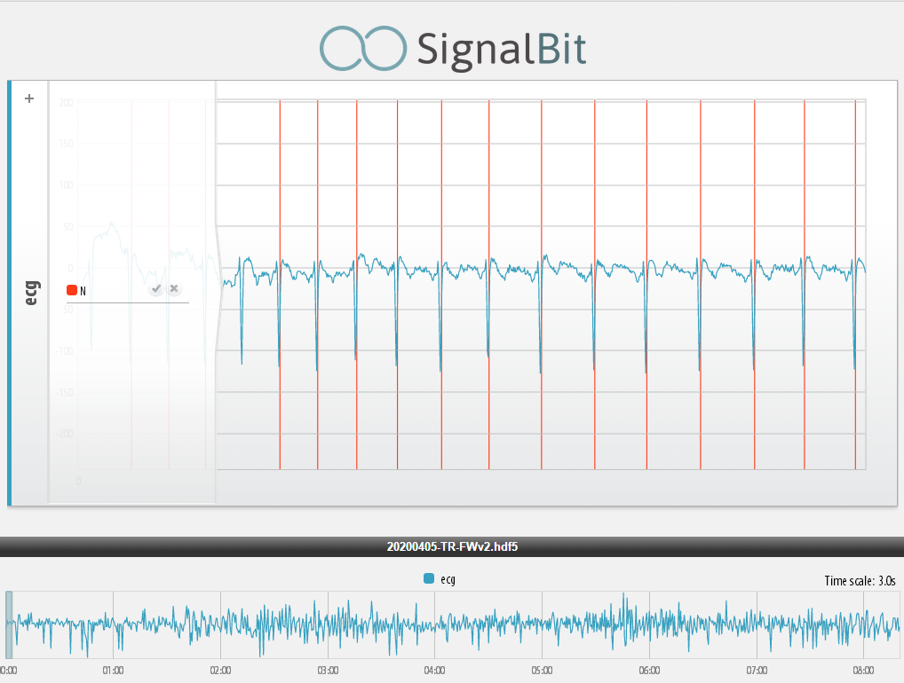
3| FIELDWIZ PRIVATE DATABASE: SignalBit
Dataset:
$$N_{recordings}=5$$
$$R_{peaks}=39817$$
$$60<HR<190$$
Methodology:
1. Pre-annotation using the method by Kalidas et al.^{[3]}
2. Confirmation by Cardiopneumologist.
3. R-peak annotations saved.
1. Case Study: FieldWiz
2. R-Peak Detection
3. Private Database
4. Results
Fig 4. SignalBit web-application environment^{[4]}. Example of raw ECG and normal sinus rhythm R-peaks.
[3] - Kalidas, V. and Tamil, L. (2017). Real-time QRS detector using stationary wavelet transform for automated ECG analysis. In Proc. of the IEEE Int’l Conf. on Bioinformatics and Bioengineering (BIBE), pages 457–461.
[4] - Lourenço, A., Plácido da Silva, H., Carreiras, C., Priscila Alves, A., and Fred, A. L. N. (2014). A web-based platform for biosignal visualization and annotation. Multimedia Tools and Applications, 70:433–460.
OUTLINE ∙ MOTIVATION ∙ METHODOLOGY AND RESULTS∙ CONCLUSION
Notes:
In this study:
The raw ECG R-peaks were pre-annotated using the approach by Kalidas (better temporal precision)
Annotations were manually confirmed by a cardiopneumologist, stored and saved
Web-based annotation tool developed by our group:
Tool allows easy annotation and storage of bio-signals related events
Figure:
ECG in blue
R-peaks, annotated in red
Pan window to select different time windows

Slide 8
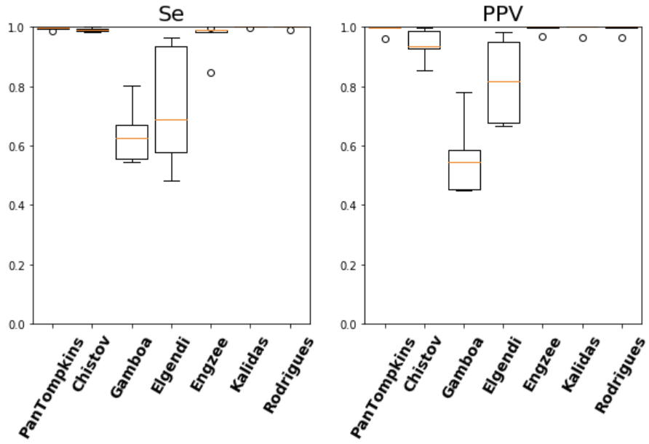
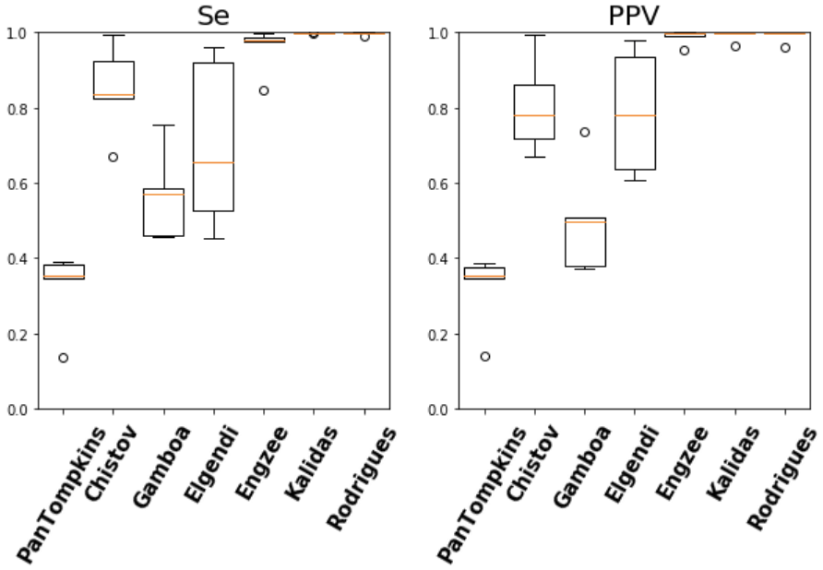
4| RESULTS: FieldWiz
a)
b)
1. Case Study: FieldWiz
2. R-Peak Detection
3. Private Database
4. Results
Fig 5. Different QRS detectors: PanTompkins, Christov, Gamboa, Elgendi, Engzee, Kalidas and Rodrigues (proposed approach, P_{th} = 5 & N = 5). Se and PPV using FieldWiz dataset for a detection window of a) 100 ms and b) 20 ms.
OUTLINE ∙ MOTIVATION ∙ METHODOLOGY AND RESULTS∙ CONCLUSION
Notes:
Next, all QRS detectors were evaluated using 100ms and 20 acceptance windows.
Left, 100 ms for QRS detection evaluation:
Se and PPV > 99% for PanTompkins, Kalidas and Proposed
Right, 20 ms for R-peak accuracy detection:
Se and PPV > 99% for Kalidas and Proposed
PanTompkins and Christov decreased performance, since integration and moving average affects the temporal precision
From the results:
Kalidas, the proposed approach or PanTompkins with and additional peak search would be suitable for R-peak detection

Slide 9
1| CONCLUSIONS
FieldWiz device for Heart Rate Monitoring:
Evaluated 6 QRS detectors
Proposed R-peak detector:
Robust to diferent polarities
Increased Sensitivity for fast changing heart rates under dynamic conditions, introducing two free parameters P_{th} and N.
Experimental Results:
FieldWiz Database Se = 99.77 % and PPV = 99.18 %
Kalidas and proposed approach showed higher temporal precision.
Combination of PanTompkis with local max search
1. Conclusions
OUTLINE ∙ MOTIVATION ∙ METHODOLOGY AND RESULTS∙ CONCLUSION
Notes:
Evaluated 6 QRS detectors
Introduced new R-peak detector
Results showed that either Kalidas, the proposed approach or Pantompkins with local max search would be suitable.
Next steps:
- Adapt parameters based on different settings/activities
- Study the stability of the method
- Evaluate in a larger dataset and compare precision of the R-peak location
Overall, the results showed promising for accurately detecting the R-peak. Which sheds light in pathology detection / accurate heart rate estimation when using this type of wearables t-shirts.

Slide 10
ACKOWLEDGMENTS
Joana Santos, for the manual verification and annotation of the ECG R-peaks.
Sirisack Samoutphonh, for the support with the embedded implementation.
This work has been partially funded by Instituto de Telecomunicacões (IT) via FCT/MCTES through national funds and when applicable co-funded EU funds under the project UIDB/50008/2020.

Slide 11
A Low-complexity R-Peak Detection Algorithm with Adaptive Thresholding for Wearable devices
Tiago Rodrigues ^{1,2}, Sirisack Samoutphonh ¹, Hugo Silva ^{2,3}, Ana Fred ^{2,3}
1 - Advanced Sport Instruments S.A., Av. de Beaumont 5, 1012 Lausanne, Switzerland
2 - IST - Instituto Superior Técnico, Av. Rovisco Pais n. 1, 1049-001 Lisboa, Portugal
3 - IT - Instituto de Telecomunicações, Av. Rovisco Pais n. 1, Torre Norte - Piso 10, 1049-001 Lisboa, Portugal

