Slide 1
Learning Stable Deep Predictive Coding Networks
with Weight Norm Supervision
Ruohao Guo
University of Illinois Urbana-Champaign
ruohaog2@illinois.edu

Slide 3
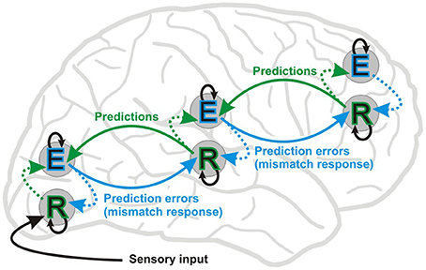
Predictive Coding Theory
Feedforward
Feedback
Figure 1. A visualization of predictive coding theory ([1]).

Slide 4
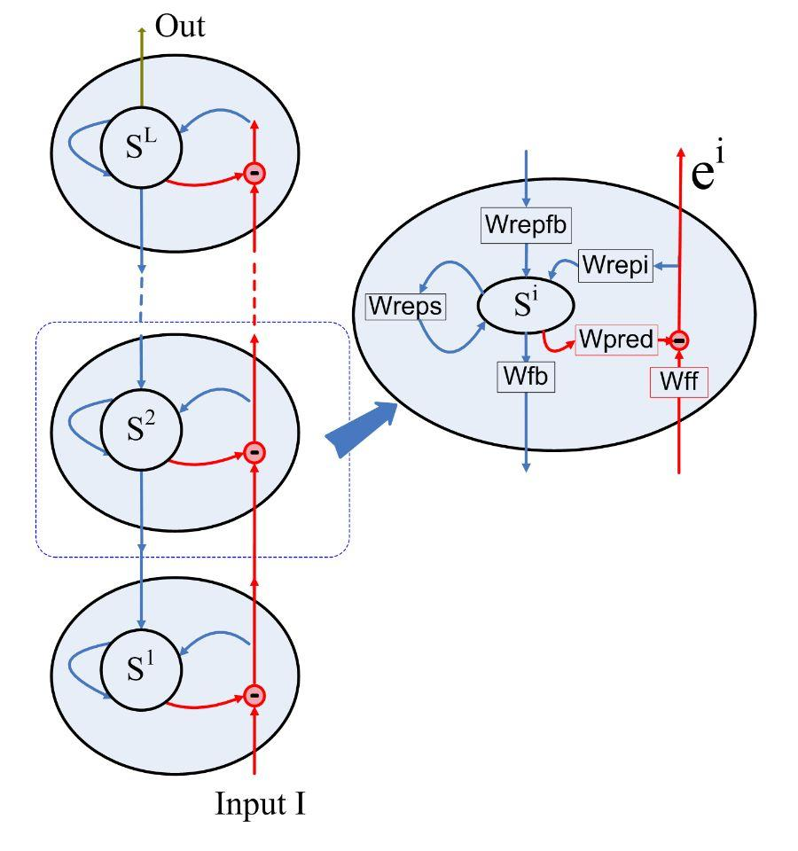
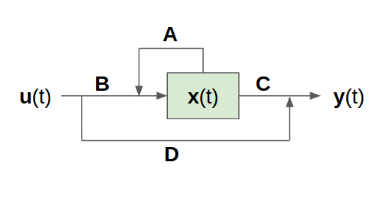
Predictive Coding Network
Training:
BackPropagation Through Time (BPTT)

Slide 5
Problems of training PCN with BPTT:
(1) BPTT unrolling the recurrence in finite time steps can only approximate how real PCN works;
(2) The number of recurrent cells needed in PCN is big, and this long-term dependency could lead to vanishing and exploding gradient problems in BPTT training.

Slide 6
Our Contribution
Study the dynamics of PCN from a dynamic system perspective;
Propose a sufficient condition for learning a stable hierarchical RNN;
Propose the weight norm supervision method to learn a stable PCN, which helps approach how real PCN works;
Conduct experiments on five datasets to show that our method always learns a stable PCN, and that it has better prediction results and more stable classification accuracy than other methods. It also benefits from sparse weights.

Slide 7
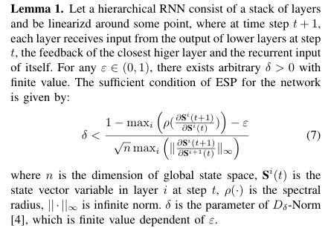
A Sufficient Condition of Echo State Property for Hierarchical RNNs

Slide 8
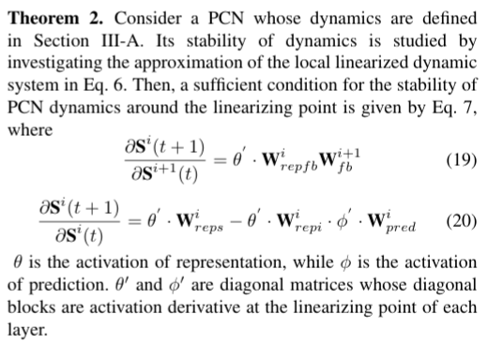
A Sufficient Condition to Train a Stable PCN

Slide 9
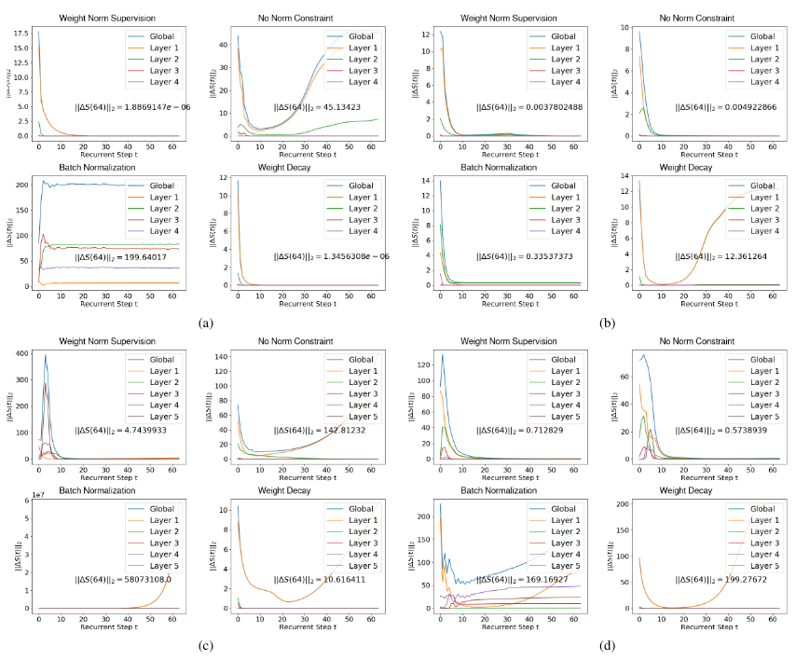
State asymptotic on different datasets with different training methods.

Slide 10
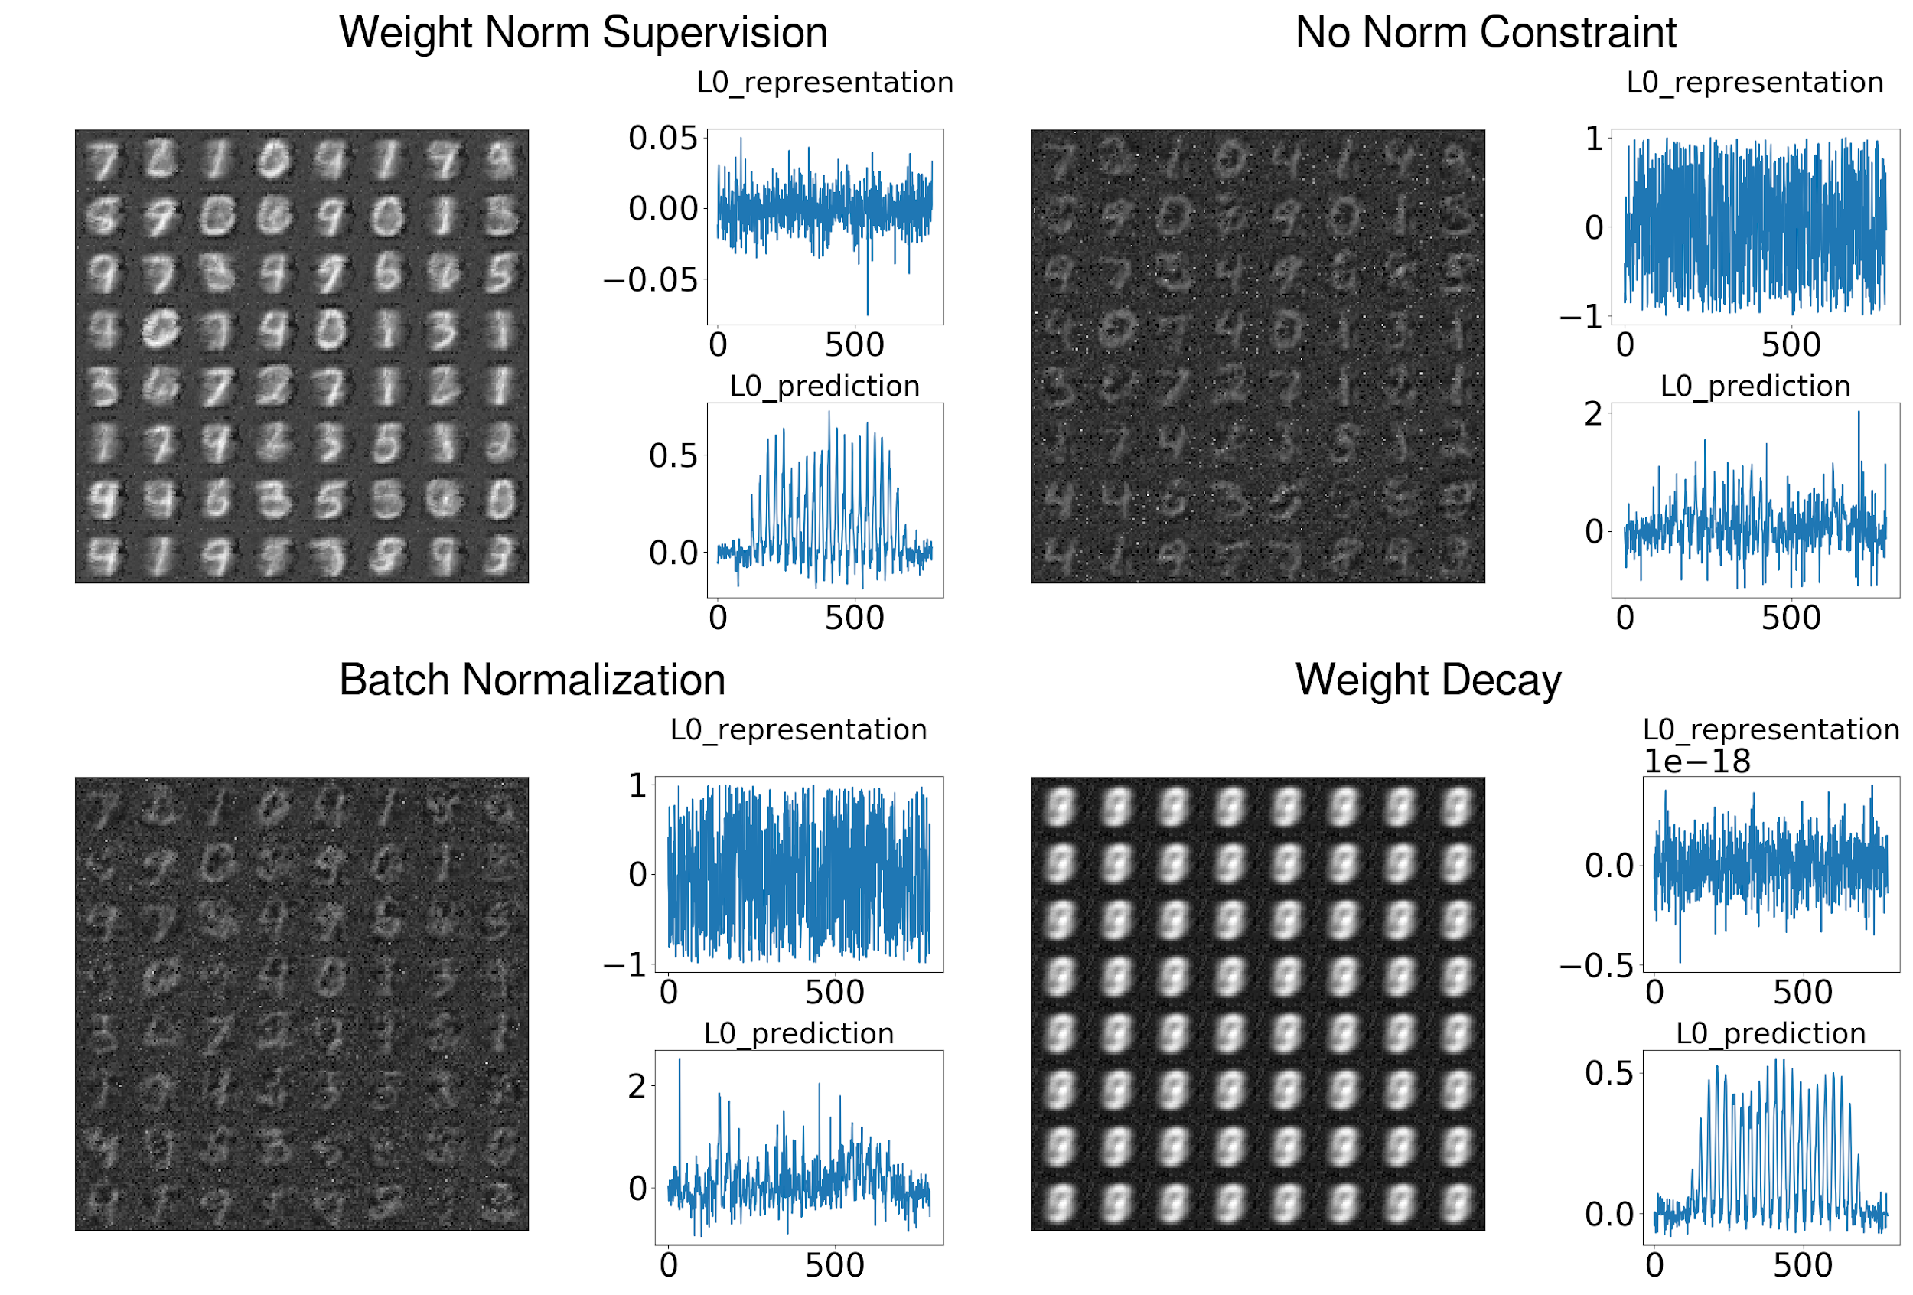
Qualitative evaluation of prediction capacity after 64 settling cycles

Slide 11
Please see more results of our experiments in paper and appendix.
Thank you!

Slide 12
References
[1] Stefanics, Gábor & Kremláček, Jan & Czigler, István. (2014). Visual mismatch negativity: A predictive coding view. Frontiers in human neuroscience. 8. 666. 10.3389/fnhum.2014.00666.

